Slide 1
International Union of ​Forest Research Organizations
The
Global Network
for Forest Science
Cooperation
| iufro.org

Slide 2
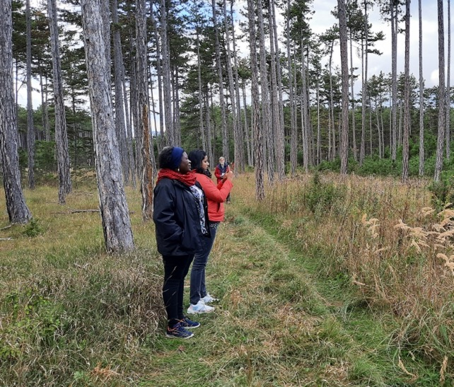
Structure
What is IUFRO?
How does IUFRO work?
Network structure
Partners
Publications
How to get involved
Member benefits

Slide 3
What is IUFRO?
IUFRO is a non-profit, non-governmental international network of forest scientists with headquarters in Vienna, Austria.​
Our global network for voluntary cooperation is open to all individuals and organizations dedicated to forest and forest products research and related disciplines.

Slide 4
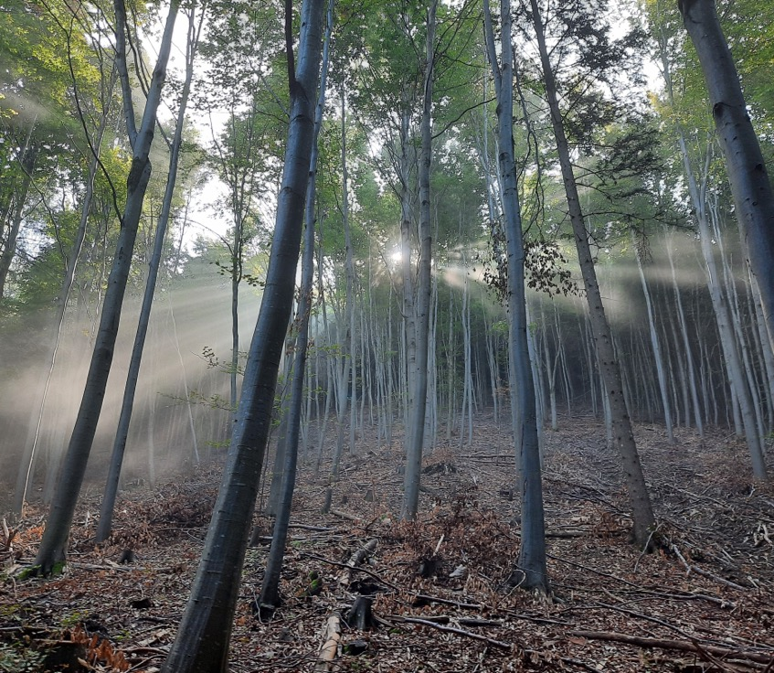
How does IUFRO work?
IUFRO advances research excellence and knowledge sharing, and fosters development of science-based solutions to forest-related challenges for the benefit of forests and people worldwide.
IUFRO provides a diverse thematic structure for forest-related research. ​Within this structure scientists collaborate on a voluntary basis.​
IUFRO addresses research needs and priorities of its members and stake-holders, including policy and decision makers, practitioners, industry and civil society.

Slide 5
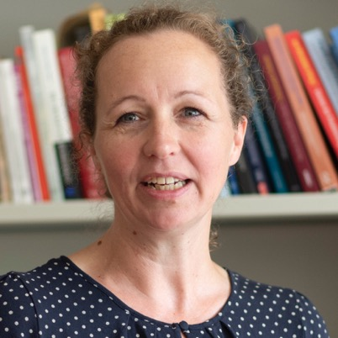
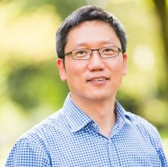
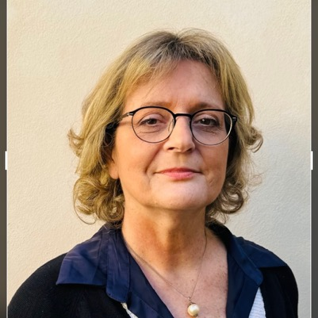
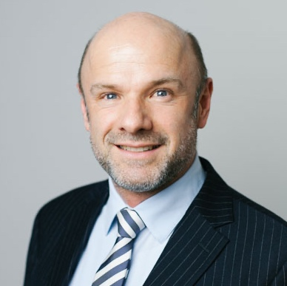
Our President, Vice-Presidents & CEO
Daniela Kleinschmit​
Woodam Chung
Elena Paoletti
Alexander Buck
President
Freiburg University
Vice-President
Oregon State University
Vice-President
National Research
Council of Italy
Executive Director IUFRO Headquarters

Slide 6
Network structure
9 Divisions
Task Forces (selection underway)
60+ Research Groups
180+ Working Parties
4 Special Programmes and Projects

Slide 7
Divisions
Div 1 Silviculture
Div 2 Physiology & Genetics
Div 3 Forest Op, Engineering & Mgmt
Div 4 Forest Assessment, Modelling
& Mgmt
Div 5 Forest Products
Div 6 Social Aspects of Forests & Forestry
Div 7 Forest Health
Div 8 Forest Environment
Div 9 Forest Policy & Economics

Slide 8
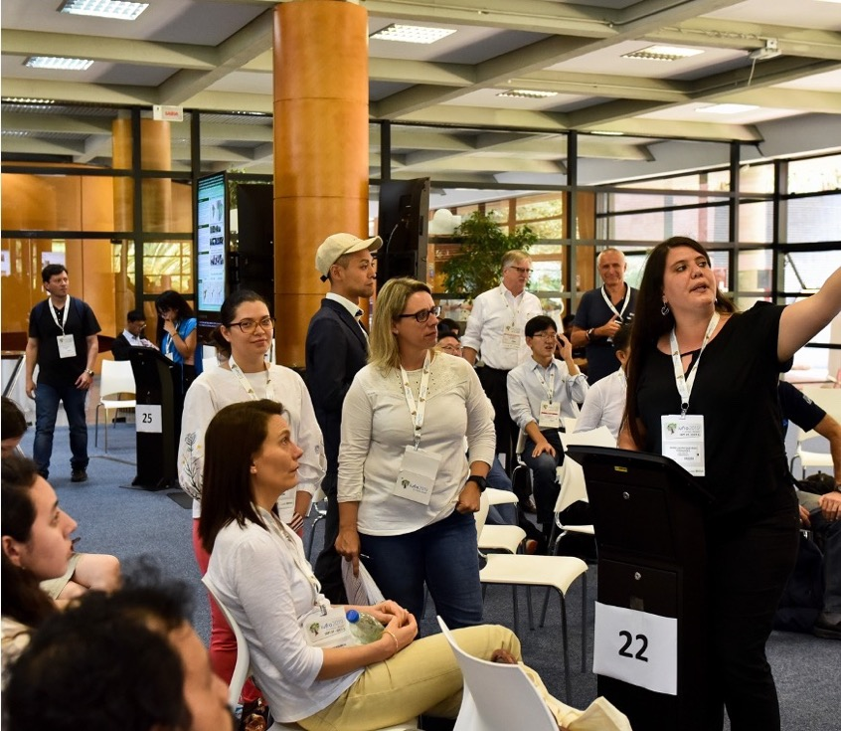
Task Forces
established on a temporary basis to advance inter‐disciplinary forest science cooperation
focus on emerging key issues of strong interest to policy makers and the forest sector
develop expanded global collaboration and information-sharing
organize meetings or workshops, publish books or in special issues of peer-reviewed journals, and present in major science-policy platforms
Task Force coordinators are non-voting members of the IUFRO Board, and are invited and expected to attend IUFRO’s annual Board meetings.

Slide 9
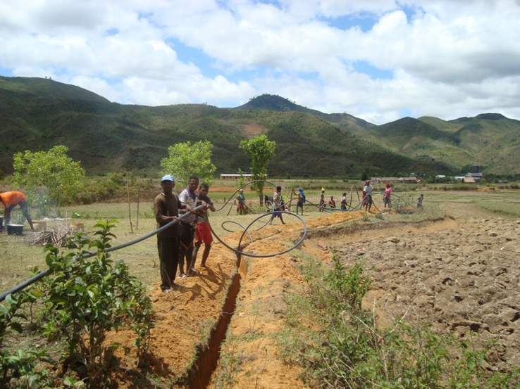
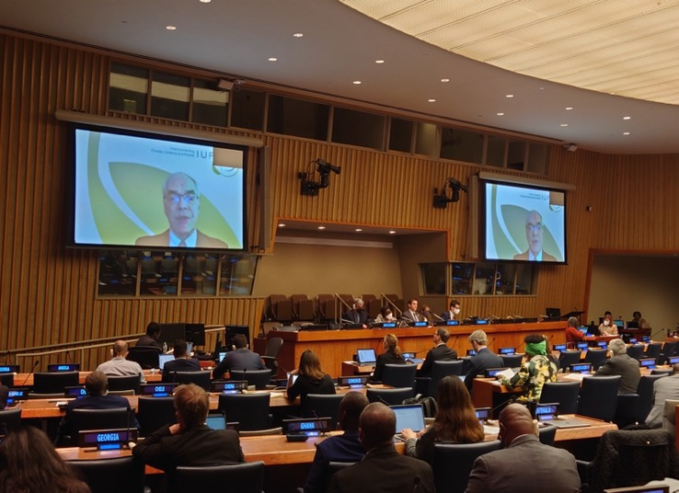
has been expanding and fostering forest research capacities in economically disadvantaged countries since 1983. IUFRO-SPDC offers training and mobility opportunities and is engaged in thematic networking, e.g., in the field of forest landscape restoration (FLR).
provides a mechanism for effectively communicating information and scientific expertise to governments and intergovernmental processes related to forests and trees. It mobilizes and synthesizes relevant scientific expertise to contribute to policy processes, among other things.​
IUFRO-SPDC, Special Programme for Development of Capacities
IUFRO‘s Science-Policy Programme (SciPol)

Slide 10
Partners
Government
Intergovernamental
Non-Government

Slide 11
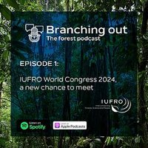
Publications and podcast
IUFRO World Series
Occasional Papers
Podcast
Topics of far-reaching importance to the international forest and forest-related community and to the IUFRO network
Designed to give IUFRO officeholders the possibility to make their expertise known to a larger public
Breaking down complex forest topics so listeners can discover the role of forests and trees for people and nature.

Slide 12
How to get involved
Visit the iufro.org and DISCOVER IUFRO​
Look for IUFRO units under SCIENCE IN IUFRO ​
Find out WHO IS WHO and contact officeholders​
Participate in IUFRO co-sponsored EVENTS​
Read & contribute to IUFRO PUBLICATIONS ​
Communicate & publish news in IUFRO MEDIA​
Become a member – become an officeholder!

Slide 13
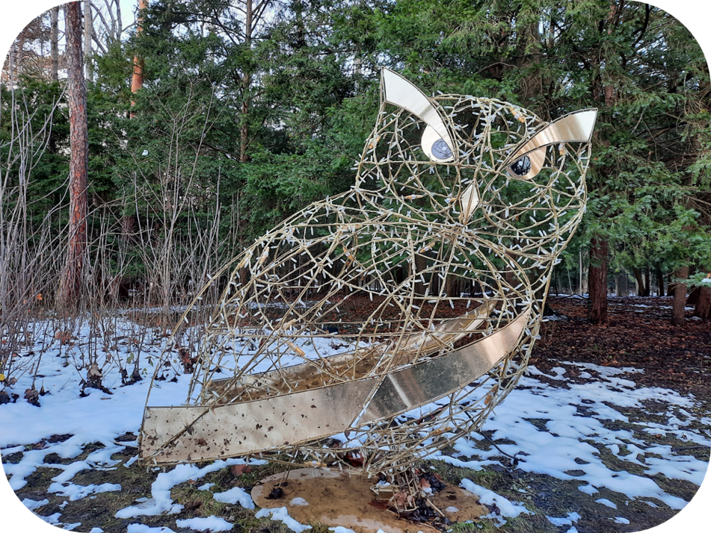
Member benefits
Expand your network​
Get access to expertise ​
Exchange knowledge ​
Gain visibility​
Make an impact ​
Receive awards​
Benefit from grants

Slide 14
International Union of ​Forest Research Organizations
IUFRO HQ
Marxergasse 2
1030 Vienna
Austria
Thank
you!
| iufro.org

