Slide 1
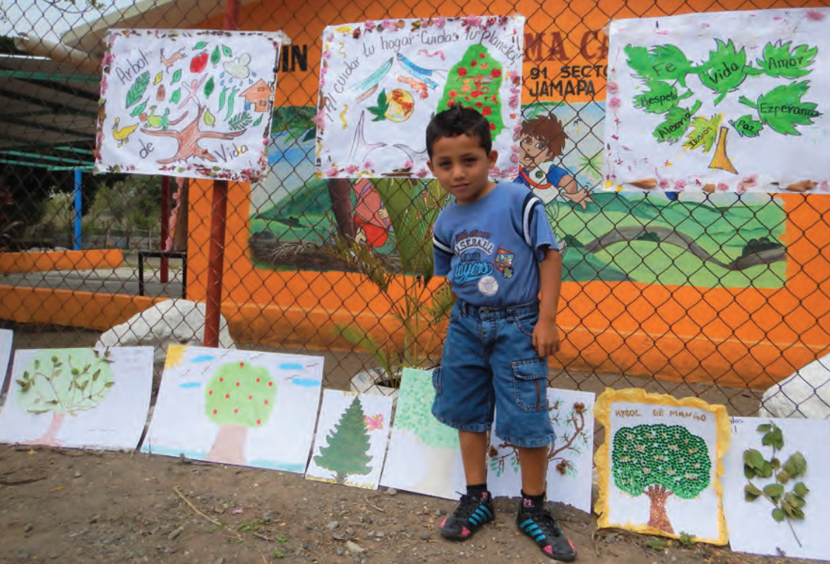
Module 1 |
Principles and guiding elements for forest landscape restoration (FLR) in the tropics.
ITTO-IUFRO: FLR Learning Modules
Notes:
This is the first of 4 FLR modules:
Module 1: Principles and guiding elements for forest landscape restoration (FLR) in the tropics.
Module 2: Forest landscape restoration (FLR) project design and implementation.
Module 3: Forest landscape restoration (FLR) facilitation and capacity development.
Module 4: Securing forest landscape restoration (FLR) finances.

Slide 2


Module 1:
Objective
  Learning level:
  Students at high schools, training centres and universities.
  Learning objective:
  By the end of Module 1, students will be able to name the 6 globally recognized principles of FLR in the tropics, as well as describe the conceptual basis and guiding elements for each principle.
Notes:
Module 1 has the following learning objective:
Learning level: Students at high schools, training centres, and universities in Asia-Pacific, Africa and Latin America.
Learning objective: By the end of Module 1, students will be able to name the 6 globally recognized principles of FLR in the tropics, as well as describe the conceptual basis and guiding elements for each principle.

Slide 3

Module 1:
Outline
Overview
TOPIC 1: Focus on landscapes.
TOPIC 2: Engage stakeholders, and support participatory governance.
TOPIC 3: Restore multiple functions for multiple benefits.
TOPIC 4: Maintain and enhance natural forest ecosystems within landscapes.
TOPIC 5: Tailor to the local context using a variety of approaches.
TOPIC 6: Manage adaptively for long-term resilience
Summary
Credits
Notes:
Module 1 comprises 6 topics (1 topic for each principle).

Slide 4
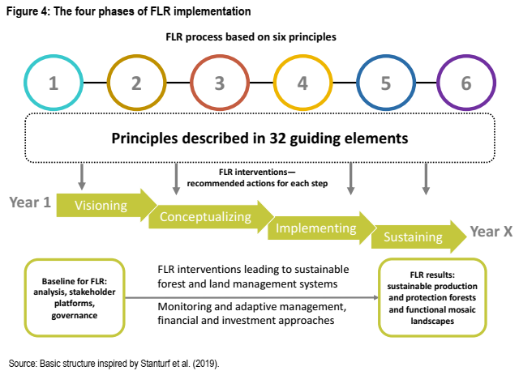
Module 1:
Overview
The Guidelines for Forest Landscape Restoration (FLR) in the Tropics (ITTO, 2020):
Support FLR interventions.
Contain 6 principles and 32 guiding elements (GEs) with recommended actions for each phase of FLR (from visioning to sustaining).
Define FLR as an ongoing process that requires participation, adaptive management, and monitoring & learning.
Source: ITTO (2020)
Source: ITTO (2020)
Notes:
The Guidelines for Forest Landscape Restoration (FLR) in the Tropics (ITTO, 2020) were developed by ITTO in collaboration with many partners including AFoCO, CIFOR, FAO, IUCN and IUFRO under a joint initiative of the Collaborative Partnership on FLR.
These guidelines:
Support FLR interventions at the policy, planning and operational levels.
Contain 6 principles and 32 guiding elements (GEs) with recommended actions for each phase of FLR (from visioning to sustaining).
Define FLR as an ongoing process with 3 key elements: (1) participation; (2) adaptive management; and (3) a consistent monitoring and learning framework
Source: ITTO (2020)

Slide 5
Topic 1:
Focus on landscapes
  Learning activities:
  Class presentation, small group questions and student assignments.
  Learning outcome:
  By the end of Topic 1, students will be able to describe the conceptual basis for focussing on landscapes, as well as the 4 essential conditions for a successful FLR project.
Notes:
Topic 1 comprises:
Learning activities: Class presentation (including a case-study video), small group questions and student assignments.
Learning outcome: By the end of Topic 1, students will be able to describe the conceptual basis for focussing on landscapes (Principle 1), as well as the 4 essential conditions (GE 1-4) for a successful FLR project.

Slide 6
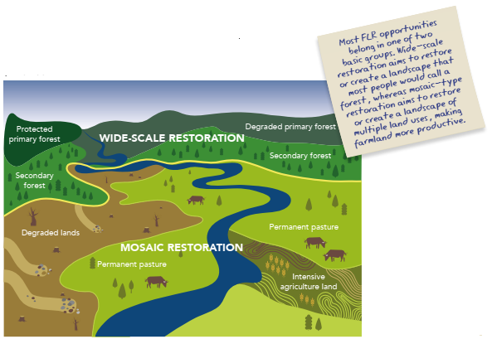
Topic 1:
Focus on landscapes
WHY should we focus on landscapes?
A landscape scale allows us to:
Balance environmental, social and economic priorities.
Restore functional forest ecosystems within a mosaic of land uses.
Create a mosaic of forest types for different purposes.
Secure international support.
Source: ITTO (2020)
Source: IUCN & WRI (2014)
Notes:
WHY should we focus on landscapes (not individual project sites)?
Principle 1 aims to secure commitment for the restoration of degraded forests and non-forest land at the landscape scale, based on adequate land-use planning. FLR takes place within and across entire landscapes, and focusses on restoring landscapes, not individual sites.
A landscape scale allows us to:
Balance the environmental, social and economic priorities of different stakeholders.
Restore functional forest ecosystems within a mosaic of different, land uses and land tenure arrangements (e.g. agroforestry blocks).
Create a mosaic of forest types for different purposes (e.g. timber production, fuel wood production, crop production, soil protection, watershed protection and habitat restoration).
Secure international support since FLR is supported by the SDGs (particularly SDG 15), the Bonn Challenge, REDD+, the Green Climate Fund and the Global Environment Facility.
Source: ITTO (2020)

Slide 7
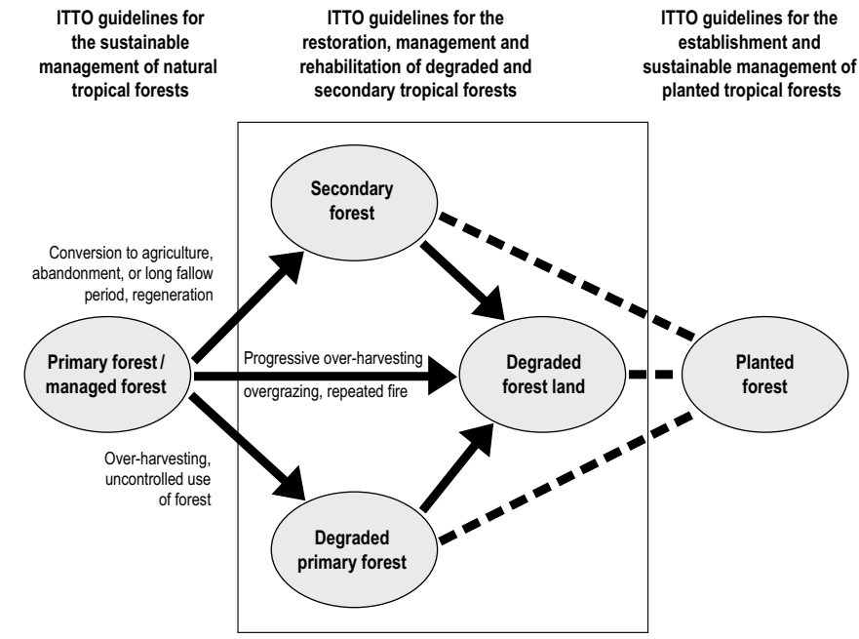
Topic 1:
Focus on landscapes
WHICH landscapes should we focus on?
These days, there are many different forest landscapes to focus on:
Nearly a billion hectares of tropical forest landscapes have recently become degraded.
Considerable knowledge and experience exists on how to restore these landscapes.
FLR can help us to reverse land degradation, and support local communities in Africa, Asia-Pacific and Latin America.
Source: ITTO (2020)
Source: ITTO (2002)
Notes:
WHICH landscapes should we focus on?
All types of forests need to be managed sustainably in any given landscape.
These days, there are many different forest landscapes to focus on:
Nearly a billion hectares of tropical forest landscapes have recently become degraded and require urgent restoration.
Considerable knowledge and experience exists on how to restore these degraded forest landscapes, and there are many case studies for us to learn from.
FLR is an inclusive and integrated approach that can help us to reverse land degradation, increase carbon storage, conserve biodiversity and create sustainable livelihoods for local communities in Asia-Pacific, Africa and Latin America.
Source: ITTO (2020)

Slide 8
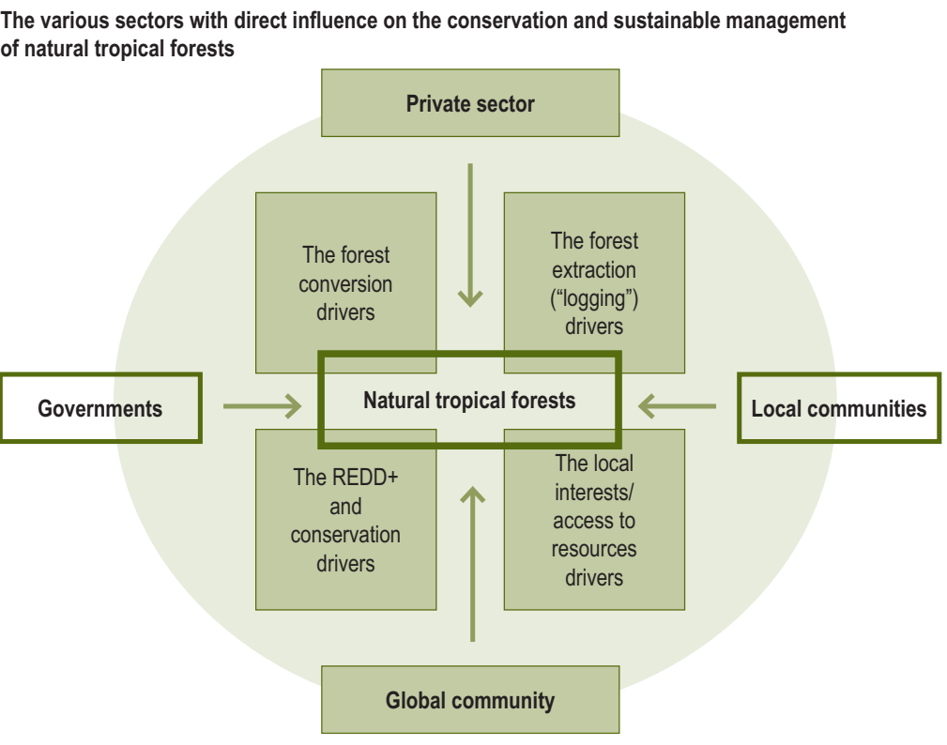
Topic 1:
Focus on landscapes
HOW should we focus on landscapes?
GE 1: We should undertake inclusive, gender responsive landscape level assessment and land-use planning through:
Visioning: Define landscape area and identify stakeholders.
Conceptualising: Assess and map the baseline situation, as well as consider desired FLR outcomes.
Implementing: Prepare and endorse land-use plans that address the causes of deforestation and degradation.
Sustaining: Monitor and adaptively manage FLR interventions with stakeholders.
Source: ITTO (2020)
Source: ITTO (2015)
Notes:
HOW should we focus on landscapes?
Knowing the resource base (environmental, social and economic conditions) is crucial for developing effective FLR. Robust baseline data should be gathered at the landscape scale, and inclusive land-use planning processes should be in place that will enable the development of multifunctional landscapes.
GE 1: We should undertake inclusive, gender responsive landscape level assessment and land-use planning through:
Visioning: Define landscape area and identify stakeholders through participatory processes (e.g. baseline surveys and participatory rural appraisal).
Conceptualising: Assess and map the baseline situation (environmental, social and economic context), as well as consider desired FLR outcomes.
Implementing: Prepare and endorse land-use plans with stakeholders that address the underlying causes of deforestation and forest degradation, as well as balance environmental, social and economic priorities.
Sustaining: Monitor and adaptively manage FLR interventions with stakeholders.
Source: ITTO (2020)

Slide 9
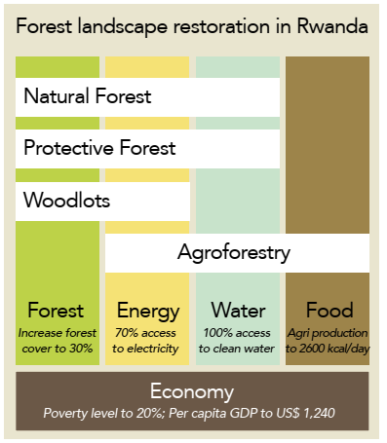
Topic 1:
Focus on landscapes
HOW should we focus on landscapes?
GE 2: We should gain recognition that FLR must transcend sector policies through:
Visioning & conceptualising: Formulate multi-sectoral policies, laws and regulations.
Implementing & sustaining: Develop communication strategies for FLR.
GE 3: We should conduct FLR at an appropriate scale through:
Visioning & conceptualising: Select landscape scales that balance the priorities of different stakeholder groups.
Implementing & sustaining: Integrate and adapt land-use plans across jurisdictions
Source: ITTO (2020)
Source: IUCN & WRI (2014)
Notes:
HOW should we focus on landscapes?
FLR policies need to be people-centred and applied cross-sectorally, spanning the forest, agriculture, mining and other relevant sectors. A landscape does not always correspond with a single jurisdiction.
GE 2: We should gain recognition that FLR must transcend sector policies through:
Visioning & conceptualising: Formulate multi-sectoral policies, laws and regulations that protect natural forests and support FLR (e.g. agricultural policies must not contradict forestry policies).
Implementing & sustaining: Develop communication strategies for FLR interventions that build understanding and consensus among all sectors and stakeholder groups.
GE 3: We should conduct FLR at an appropriate scale through:
Visioning & conceptualising: Select landscape scales that balance the environmental, social and economic priorities of different stakeholder groups (e.g. private sectors and local communities).
Implementing & sustaining: Integrate and adapt land-use plans across jurisdictions, and align with the relevant national and sub-national objectives (e.g. land-use, climate, biodiversity and desertification).
Source: ITTO (2020)

Slide 10
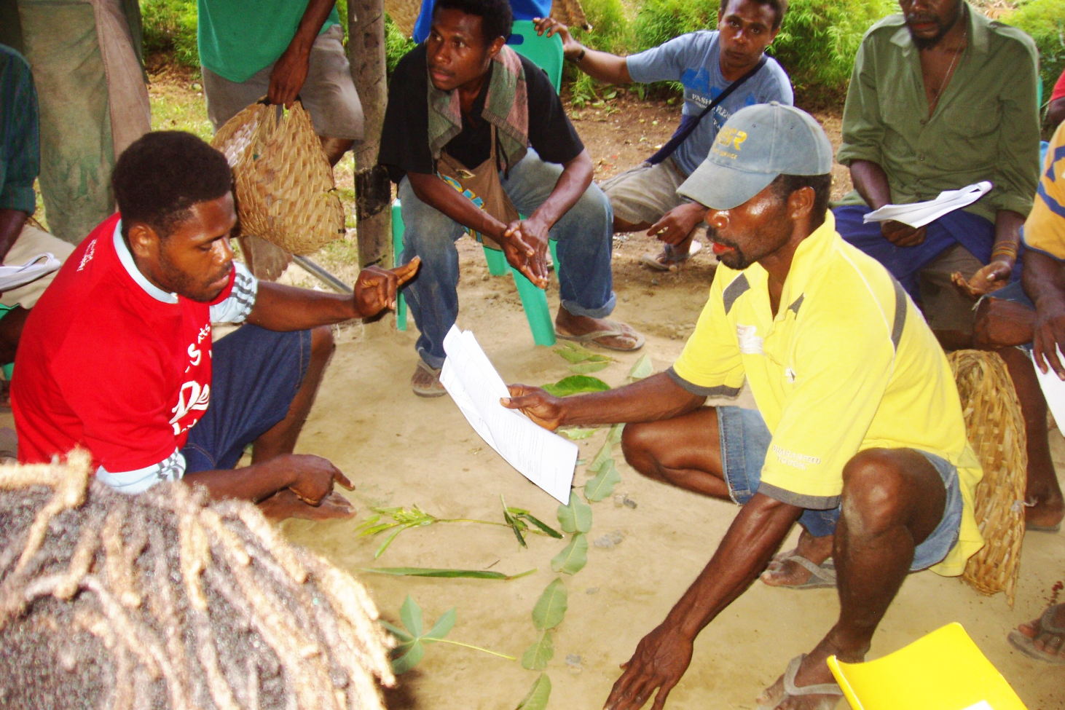
Topic 1:
Focus on landscapes
HOW should we focus on landscapes?
GE 4: We should address tenure and access rights through:
Visioning: Map land tenure and access rights.
Conceptualising: Develop transparent and equitable processes for conflict resolution.
Implementing: Address gender equity, and strengthen the access rights of forest dwellers and indigenous peoples.
Sustaining: Ensure the long-term security of FLR investments.
Source: ITTO (2020)
VISIONING: Mapping clan land in Toma Valley, Papua New Guinea.
Photo: S. Rollinson
Notes:
HOW should we focus on landscapes?
Transparent and equitable approaches to land tenure, access, customary rights and property rights are essential for ensuring the long-term security of FLR investments.
GE 4: We should address tenure and access rights through:
Visioning: Map land tenure and access rights (degraded and secondary forests often have overlapping tenure claims involving the state, private sector and local communities).
Conceptualising: Develop transparent and equitable processes for conflict resolution where rights are unclear, including criteria for taking the preferences of landholders and marginalized groups into account.
Implementing: Address gender equity, and strengthen the access rights of forest dwellers and indigenous peoples.
Sustaining: Ensure the long-term security of FLR investments through the development of unambiguous and universally respected land tenure, resource access and management rights.
Source: ITTO (2020)

Slide 11

Topic 1:
References and resources
These helpful guidelines are freely available online:
ITTO. 2002. ITTO guidelines for the restoration, management and rehabilitation of degraded and secondary tropical forests. Yokohama, Japan.
ITTO. 2015. Voluntary guidelines for the sustainable management of natural tropical forests. Yokohama, Japan.
ITTO. 2020. Guidelines for forest landscape restoration in the tropics. Yokohama, Japan.
IUCN & WRI. 2014. A guide to the restoration opportunities assessment methodology. Gland, Switzerland.
This interesting report is freely available online:
FAO and RECOFTC. 2016. Forest landscape restoration in Asia-Pacific forests. Bangkok, Thailand.
Notes:
ITTO (2020) contains additional resources for GE 1-4.

Slide 12
Topic 1:
References and resources
Watch this 14 minute video about forest landscape restoration in Lombok, Indonesia:
https://youtu.be/1UitUemB_h4
Notes:
This FLR initiative has assisted local communities in Lombok, Indonesia, to improve their livelihoods through sustainable forest management activities.

Slide 13

Topic 1:
Small group questions
Each group should discuss one of the questions below with reference to their local context, and then present their findings to the class:
Why does FLR take place within and across entire landscapes?
Where are the best places to undertake FLR?
How should we undertake landscape level planning?
How should we promote a multi-sectoral approach?
How should we determine the most appropriate scale for FLR?
How should we tackle land tenure and land access issues?
Notes:
Divide the class into 6 groups (one question per group).

Slide 14
Topic 1:
Student assignments
Each student should research one of the questions below with reference to local case-studies, and then present their findings in a written report.
Explain why nearly a billion hectares of tropical forest landscapes have recently become degraded, and require urgent restoration.
Explain which communication strategies can be used to build understanding and consensus among all sectors and stakeholder groups.
Explain how FLR helps to balance the environmental, social and economic priorities of different stakeholders.
Notes:
Provide students with a deadline for their written reports.

Slide 15
Topic 2:
Engage stakeholders, and support participatory governance
  Learning activities:
  Class presentation, small group questions and student assignments.
  Learning outcome:
  By the end of Topic 2, students will be able to describe the conceptual basis for engaging stakeholders and supporting participatory governance, as well as the 8 essential conditions for a successful FLR project.
Notes:
Topic 2 comprises:
Learning activities: Class presentation (including a case-study video), small group questions and student assignments.
Learning outcome: By the end of Topic 2, students will be able to describe the conceptual basis for engaging stakeholders and supporting participatory governance (Principle 2), as well as the 8 essential conditions (GE 5-12) for a successful FLR project.

Slide 16
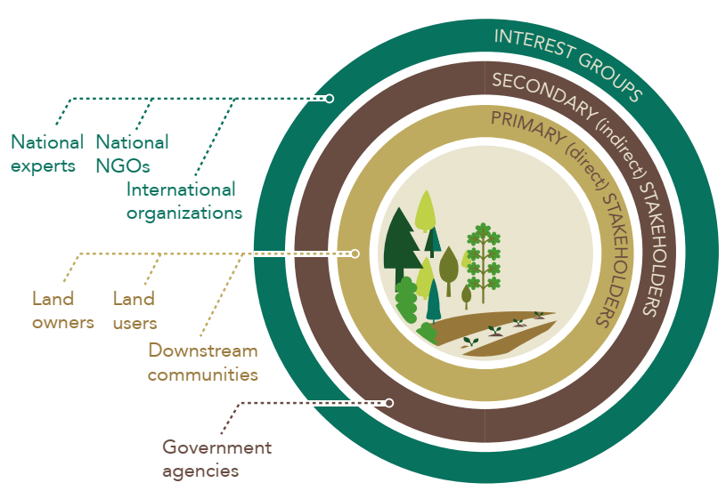
Topic 2:
Engage stakeholders, and support participatory governance
WHY should we engage all stakeholders?
Active stakeholder engagement allows us to:
Understand how stakeholders interact in a landscape.
Balance the diverse requirements, values and perspectives of stakeholders.
Benefit from the diverse knowledge and experience of stakeholders.
Source: ITTO (2020)
Source: IUCN & WRI (2014)
Notes:
WHY should we engage all stakeholders (not just the responsive ones)?
A stakeholder is any individual, social group or institution that has interest in, is directly or indirectly affected by or can influence or contribute to an issue or activity or transaction, and therefore has a natural right to participate in decisions relating to it.
Principle 2 aims to deliver optimal FLR outcomes (environmental, social and economic). Stakeholders - including women, young people and vulnerable groups – must be actively engaged in FLR planning and decision-making activities.
Active stakeholder engagement allows us to:
Understand how stakeholders interact in a landscape, including recent arrivals and groups indirectly affected by (or affecting) the landscape.
Balance the diverse requirements, values and perspectives of stakeholders, including landholders and marginalized groups.
Benefit from the diverse knowledge and experience of stakeholders, including vulnerable and indigenous people.
Source: ITTO (2020)

Slide 17
Topic 2:
Engage stakeholders, and support participatory governance
HOW should we engage stakeholders, and support participatory governance?
GE 5: We should build adequate governance capacity for decentralized FLR through:
Visioning & conceptualising: Identify, inform and entrust responsibility for FLR management at the landscape level.
Implementing & sustaining: Support regular inter-agency meetings, as well as provide strategic guidance on FLR management.
GE 6: We should obtain strong stakeholder engagement through:
Visioning & conceptualising: Develop a shared vision for the future with stakeholders.
Implementing & sustaining: Increase understanding of the factors that influence stakeholder engagement in FLR, and build productive partnerships at all levels.
Source: ITTO (2020)
Notes:
HOW should we engage stakeholders, and support participatory governance?
Decentralized control and decision-making can provide the enabling conditions for FLR interventions. It is important that local communities and stakeholders participate
actively in and share responsibility for decision-making in planning and implementing FLR. Local leadership, trust and social cohesion are crucial ingredients for representative, long-lasting FLR.
GE 5: We should build adequate governance capacity for decentralized FLR through:
Visioning & conceptualising: Identify, inform and entrust responsibility for FLR management to the appropriate institutions at the landscape level.
Implementing & sustaining: Support regular inter-agency meetings that encourage collaboration at all levels, as well as provide strategic guidance on FLR management (e.g. local safeguards).
GE 6: We should obtain strong stakeholder engagement through:
Visioning & conceptualising: Develop a shared vision for the future with stakeholders, as well as create platforms for discussing FLR strategies that minimize power imbalances, and achieve equitable outcomes.
Implementing & sustaining: Increase understanding of the factors that influence stakeholder engagement in FLR (e.g. through stakeholder platforms), and build productive partnerships at all levels (from global corporations to local community groups).
Source: ITTO (2020)

Slide 18
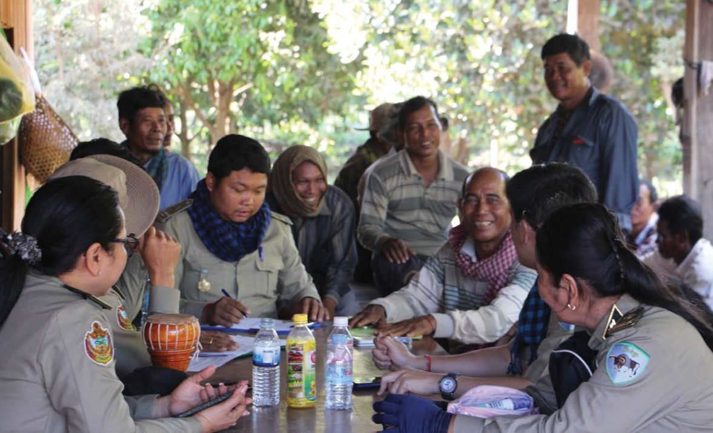
Topic 2:
Topic 2:
Engage stakeholders, and support participatory governance
STAKEHOLDERS
VISIONING & CONCEPTUALISING: A group discussion between Forestry Administration officials, community forestry management committee members and local authorities about land use in Veal Okdey, Santuk district, Kampong Thom province, Cambodia.
Source: ITTO, TFU 29/2 2020. Photo: Chhorn Vireak.
Notes:
This slide accompanies the previous slide.

Slide 19
Topic 2:
Engage stakeholders, and support participatory governance
HOW should we engage stakeholders, and support participatory governance?
GE 7: We should conduct joint stakeholder analysis of the drivers of degradation through:
Visioning & conceptualising: Define the underlying causes of land-use change and forest degradation, and assess the potential for FLR.
Implementing & sustaining: Reduce or remove degradation pressures, and ensure all additional interventions are suitable for the site.
GE 8: We should strive for social equity and benefit sharing through:
Visioning & conceptualising: Promote the equitable sharing of FLR costs & benefits.
Implementing & sustaining: Utilise effective mechanisms for resolving conflicts.
Source: ITTO (2020)
Notes:
HOW should we engage stakeholders, and support participatory governance?
The causes of forest and land degradation should be eliminated. To do so, a common and sustained effort is required among all stakeholder groups. Stakeholders should strive for the equitable sharing of the market and non-market costs and benefits of FLR, which should enhance and diversify local livelihoods.
GE 7: We should conduct joint stakeholder analysis of the drivers of degradation through:
Visioning & conceptualising: Define the underlying causes of land-use change and forest degradation (current and past) through participatory processes, and assess the potential for FLR.
Implementing & sustaining: Reduce or remove degradation pressures (e.g. prevent illegal activities), and ensure all additional interventions (e.g. tree planting) are suitable for the site.
GE 8: We should strive for social equity and benefit sharing through:
Visioning & conceptualising: Promote the equitable sharing of FLR costs and benefits, and develop benefit sharing plans through participatory processes that will enhance and diversify local livelihoods.
Implementing & sustaining: Utilise effective mechanisms for resolving conflicts among stakeholders, including landholders and marginalised groups.
Source: ITTO (2020)

Slide 20
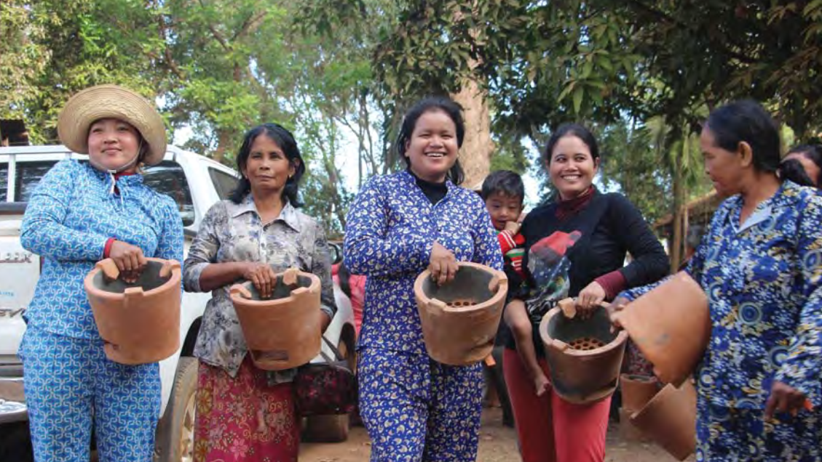
Topic 2:
Topic 2:
Engage stakeholders, and support participatory governance
STAKEHOLDERS
IMPLEMENTING & SUSTAINING: Local women show their newly acquired fuel-efficient wood stoves, which have helped reduce wood fuel consumption in the forest communities of Kampong Thom province, Cambodia.
Source: ITTO, TFU 29/2 2020. Photo: S. Sineth/Forestry Administration.
Notes:
This slide accompanies the previous slide.

Slide 21
Topic 2:
Engage stakeholders, and support participatory governance
HOW should we engage stakeholders, and support participatory governance?
GE 9: We should conduct participatory FLR planning, decision-making & monitoring through:
Visioning & conceptualising: Develop participatory planning & monitoring framework with reference to desired outcomes and indicators of success.
Implementing & sustaining: Engage stakeholders in participatory planning and monitoring activities.
GE 10: We should build stakeholder capacity for sharing responsibility for FLR through:
Visioning & conceptualising: Engage stakeholders in FLR through decision-support tools, and the formulation of scenarios, maps and restoration plans.
Implementing & sustaining: Deliver relevant capacity building programs for all stakeholder groups.
Source: ITTO (2020)
Notes:
HOW should we engage stakeholders, and support participatory governance?
The effective participation of all stakeholders in the planning and monitoring of FLR processes and projects is vital for success. There is a need to strengthen the capacities of institutions and community groups operating within landscapes.
GE 9: We should conduct participatory FLR planning, decision-making and monitoring through:
Visioning & conceptualising: Develop participatory planning and monitoring framework with reference to desired outcomes and selected indicators of success (at site & landscape scales, and different stages of FLR).
Implementing & sustaining: Engage stakeholders in participatory planning and monitoring activities (e.g. data collection, analysis, reporting, communication and adaptive management).
GE 10: We should build stakeholder capacity for sharing responsibility for FLR through:
Visioning & conceptualising: Engage stakeholders in FLR through decision-support tools, and the collaborative formulation of scenarios, maps and restoration plans.
Implementing & sustaining: Deliver relevant capacity building programs for all stakeholder groups (e.g. leadership, negotiation, decision-making, afforestation and reforestation).
Source: ITTO (2020)

Slide 22
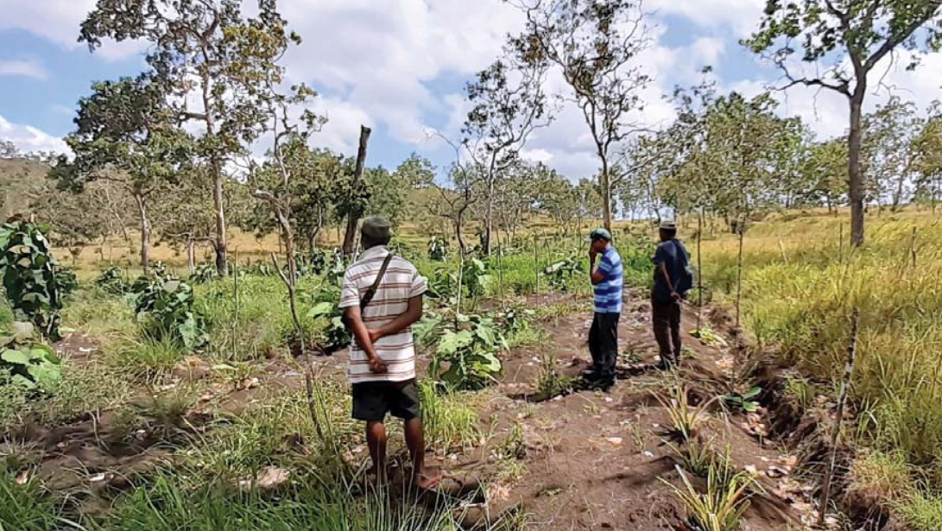
Topic 2:
Topic 2:
Engage stakeholders, and support participatory governance
STAKEHOLDERS
IMPLEMENTING & SUSTAINING: National Forest Service field workers inspect teak seedlings growing in ploughed soil, intercropped with pineapple in Rigo district, Central province, Papua New Guinea.
Source: ITTO, TFU 29/2 2020. Photo: S. Rollinson.
Notes:
This slide accompanies the previous slide.

Slide 23
Topic 2:
Engage stakeholders, and support participatory governance
HOW should we engage stakeholders, and support participatory governance?
GE 11: We should address long-term financing for FLR interventions through:
Visioning & conceptualising: Develop a financing strategy for each phase of FLR, and formulate proposals in consultation with selected funding agencies.
Implementing & sustaining: Broaden the funding portfolio to sustain FLR.
GE 12: We should establish a favourable investment environment for FLR through:
Visioning & conceptualising: Establish the required enabling conditions to attract investments.
Implementing & sustaining: Assess the expectations and concerns of potential investors, and promote workable processes that address their needs.
Source: ITTO (2020)
Notes:
HOW should we engage stakeholders, and support participatory governance?
Sufficient resources must be committed to initiate FLR processes and implement FLR interventions. Investments are needed to ensure the restoration and sustainable
management of degraded forests and landscapes, and these are most likely to be forthcoming with conducive policies and institutions.
GE 11: We should address long-term financing for FLR interventions through:
Visioning & conceptualising: Develop a financing strategy for each phase of FLR (from visioning to sustaining), and formulate proposals in consultation with selected funding agencies.
Implementing & sustaining: Broaden the funding portfolio to sustain FLR (e.g. payments for ecosystem services, biodiversity offsets, results-based payments for climate-change mitigation, and public & private finance schemes).
GE 12: We should establish a favourable investment environment for FLR through:
Visioning & conceptualising: Establish the required enabling conditions to attract investments (e.g. conducive policies & land tenure arrangements, and easy access to information).
Implementing & sustaining: Assess the expectations and concerns of potential investors, and promote workable processes that address their needs (e.g. conflict resolution mechanisms).
Source: ITTO (2020)

Slide 24
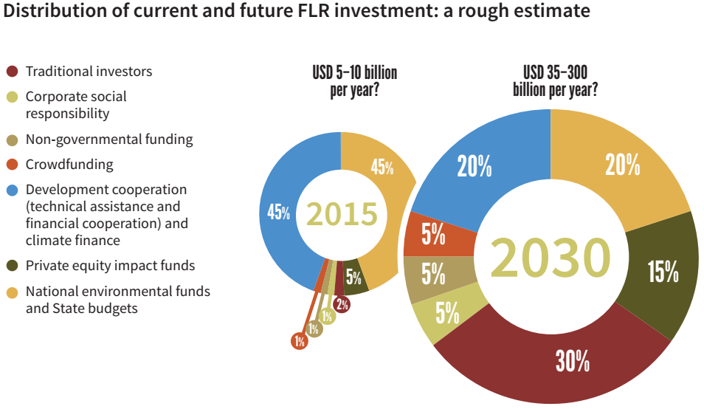
Topic 2:
Engage stakeholders, and support participatory governance
Source: FAO & UNCCD. 2015.
Image caption Photo: [image source information]
Notes:
This slide accompanies the previous slide.

Slide 25
Topic 2:
References and resources
These helpful guidelines are freely available online:
Hanson et al. 2015. The restoration diagnostic. WRI, Washington, DC.
ITTO. 2020. Guidelines for forest landscape restoration in the tropics. Yokohama, Japan.
Stanturf, J., Mansourian, S. & Kleine, M., eds. 2017. Implementing forest landscape restoration: a practitioner‘s guide. IUFRO, Vienna, Austria.
These interesting reports are freely available online:
Evans, K. & Guariguata, M.R. 2019. A diagnostic for collaborative monitoring in forest landscape restoration. CIFOR, Bogor, Indonesia.
FAO & UNCCD. 2015. Sustainable financing for forest and landscape restoration. Rome.
Notes:
ITTO (2020) contains additional resources for GE 5-12.

Slide 26
Topic 2:
References and resources
Watch this 8 minute video about strengthening the governance of community forests in Java and Nusa Tenggara, Indonesia:
https://youtu.be/QNV8TfNUHao
Notes:
This FLR initiative shows how greater administrative efficiency in timber supply chains in Java and Nusa Tenggara, Indonesia, is helping community forestry to boom

Slide 27
Topic 2:
Small group questions
Each group should discuss one of the questions below with reference to their local context, and then present their findings to the class:
Why is stakeholder participation and collaboration essential for FLR?
How should we decentralize control and engage stakeholders?
How should we remove the drivers of degradation, and share the associated costs and benefits?
How should we involve stakeholders in FLR planning, monitoring and decision-making?
How should we ensure there are always sufficient resources for FLR interventions?
Notes:
Divide the class into 5 groups (one question per group).

Slide 28
Topic 2:
Student assignments
Each student should research one of the questions below with reference to local case-studies, and then present their findings in a written report.
Explain why stakeholder participation and collaboration is essential for FLR.
Explain which stakeholder groups should participate in FLR interventions.
Explain how FLR balances the diverse requirements, values and perspectives of stakeholders.
Notes:
Provide students with a deadline for their written reports.

Slide 29
Topic 3:
Restore multiple functions for multiple benefits
  Learning activities:
  Class presentation, small group questions and student assignments.
  Learning outcome:
  By the end of Topic 3, students will be able to describe the conceptual basis for restoring multiple functions for multiple benefits, as well as the 4 essential conditions for a successful FLR project.
Notes:
Topic 3 comprises:
Learning activities: Class presentation (including a case-study video), small group questions and student assignments.
Learning outcome: By the end of Topic 3, students will be able to describe the conceptual basis for restoring multiple functions for multiple benefits (Principle 3), as well as the 4 essential conditions (GE 13-16) for a successful FLR project.

Slide 30
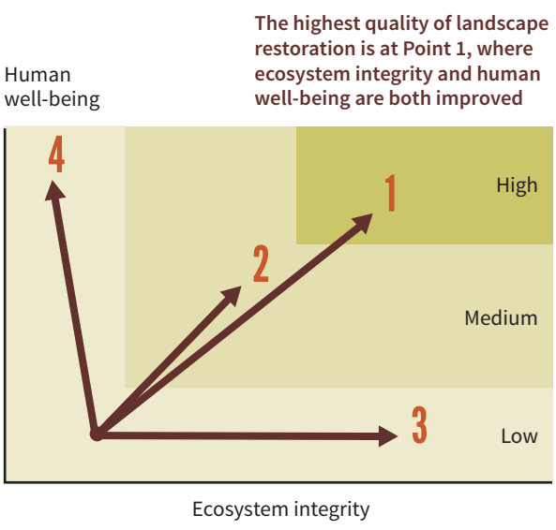
Topic 3:
Restore multiple functions for multiple benefits
WHY should we focus on multiple outcomes?
A multi-purpose approach allows us to:
Maximise the multi-purpose role of forests including restore soil fertility, increase carbon storage, reduce soil erosion, and generate forest products.
Develop forest management strategies that deliver multiple benefits, such as create jobs, diversify livelihoods, and provide recreational areas.
Source: ITTO (2020)
Source: FAO & UNCCD. 2015.
Notes:
WHY should we focus on multiple outcomes (not just a few outcomes)?
Principle 3 aims to restore multiple economic, social and environmental functions in a landscape, and generate a range of ecosystem goods and services that equitably benefit stakeholders.
A multi-purpose approach allows us to:
Maximise the multi-purpose role of forests including restore soil fertility, increase carbon storage, reduce soil erosion, provide shade, improve habitat quality for wildlife, ensure downstream water supplies, and generate timber and non-timber products.
Develop forest management strategies that deliver multiple benefits, such as create jobs, diversify livelihoods, provide recreational areas & cultural sites, and increase landscape & community resilience.
Source: ITTO (2020)

Slide 31
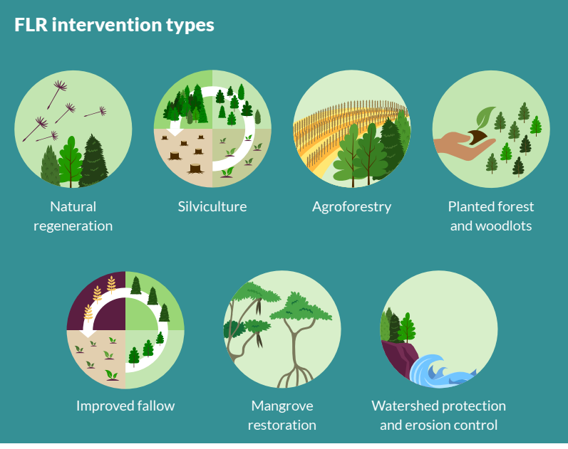
Topic 3:
Restore multiple functions for multiple benefits
HOW should we focus on multiple outcomes?
GE13: We should generate multiple functions and benefits through:
Visioning: Identify high-value forest products and estimate their future potential.
Conceptualising: Develop feasible strategies with stakeholders for generating multiple benefits from forest products and services.
Implementing: Provide information about forests and trees, and promote their value at all levels of society.
Sustaining: Provide incentives for farmers to diversify their agricultural production systems with multi-purpose tree species.
Source: ITTO (2020)
Source: IUCN. 2018.
Notes:
HOW should we focus on multiple outcomes (not just a few outcomes)?
At the landscape scale, generating multiple benefits from a variety of interventions is a fundamental aspect of FLR. FLR should find and use synergies between people-centred functions in landscapes and ecological goals to achieve sustainable restoration outcomes.
GE13: We should generate multiple functions and benefits through:
Visioning: Identify high-value forest products (with reference to local knowledge) and estimate their future potential.
Conceptualising: Develop feasible strategies with stakeholders for generating multiple benefits from forest products and ecosystem services (building synergies and noting trade-offs).
Implementing: Provide relevant technical information about forests and trees, and promote the value of forest goods and ecosystem services at all levels of society.
Sustaining: Provide incentives for farmers to diversify their agricultural production systems with multi-purpose tree species, and assess the market potential of value-added products.
Source: ITTO (2020)

Slide 32
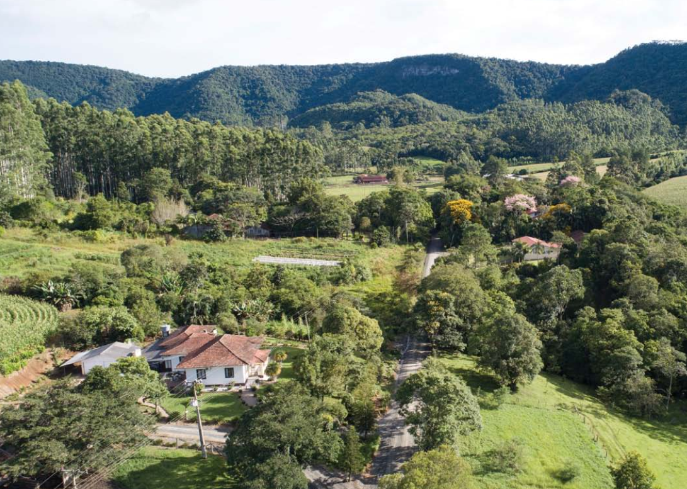
Topic 3:
Restore multiple functions for multiple benefits
HOW should we focus on multiple outcomes?
GE14: We should conserve biodiversity, and restore ecological functions through:
Visioning: Prioritise the restoration of degraded natural forests
Conceptualising: Design FLR interventions that focus on the restoration of ecological functions.
Implementing: Develop FLR strategies that improve conservation planning and impact monitoring in critical areas.
Sustaining: Provide incentives for diversified agricultural practices that deliver multiple products and ecological services.
Source: ITTO (2020)
SUSTAINING: A healthy forest landscape in the Alto Vale do Itajaí region, Brazil.
Source: ITTO, TFU 29/3 2020. Photo: © Wigold Schaffer.
Notes:
HOW should we focus on multiple outcomes (not just a few outcomes)?
Conserving biodiversity will help sustain the intrinsic values of nature and ensure the healthy functioning of landscapes in the long term.
GE14: We should conserve biodiversity, and restore ecological functions through:
Visioning: Prioritise the restoration of degraded natural forests which will become resilient to future environmental change (regardless of short-term opportunity costs).
Conceptualising: Design FLR interventions that focus on the restoration of ecological functions, such as water catchment protection, soil conservation and pollination services.
Implementing: Develop FLR strategies that improve conservation planning and impact monitoring in critical areas, such as buffer zones, connectivity corridors, high-value conservation forests, and sites that provide key ecosystem services.
Sustaining: Provide incentives for diversified agricultural practices that deliver multiple products and ecological services, such as protecting soils and water resources (e.g. agroforestry systems).
Source: ITTO (2020)

Slide 33
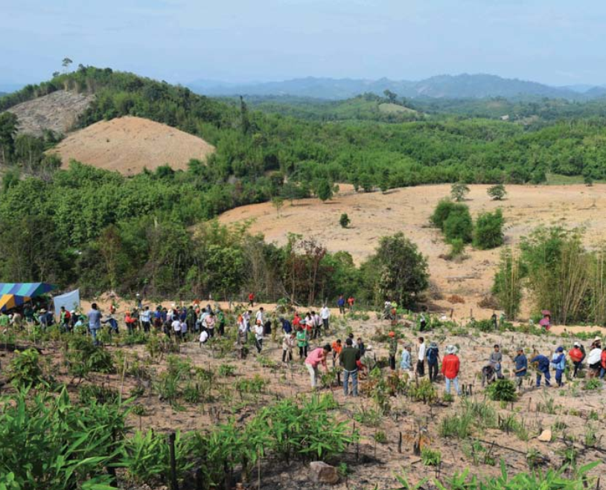
Topic 3:
Restore multiple functions for multiple benefits
HOW should we focus on multiple outcomes?
GE15: We should improve livelihoods through:
Visioning: Determine and prioritise feasible strategies for improving livelihoods.
Conceptualising: Design FLR interventions that have the potential to meet local needs.
Implementing: Engage stakeholders in FLR interventions through incentive mechanisms, capacity building programs and institutional development.
Sustaining: Diversify FLR strategies for improving livelihoods and long-term resource security.
Source: ITTO (2020)
IMPLEMENTING: Villagers restoring highly fragmented and degraded forest landscape in Nongbua, Lao People’s Democratic Republic.
Source: ITTO, TFU 29/3 2020. Photo: Asian Forest Cooperation Organization.
.
Notes:
HOW should we focus on multiple outcomes (not just a few outcomes)?
The diversity of FLR strategies in a landscape helps increase opportunities to improve livelihoods and long-term resource security among landscape stakeholders.
GE15: We should improve livelihoods through:
Visioning: Determine and prioritise feasible strategies for improving livelihoods through participatory processes.
Conceptualising: Design FLR interventions that have the potential to meet the needs of smallholders, rural communities, and forestry & agricultural businesses.
Implementing: Engage stakeholders in FLR interventions through incentive mechanisms (e.g. marketing support), capacity building programs (e.g. business planning) and institutional development (e.g. producer associations).
Sustaining: Diversify FLR strategies to increase opportunities for improving livelihoods and long-term resource security among landscape stakeholders.
Source: ITTO (2020)

Slide 34
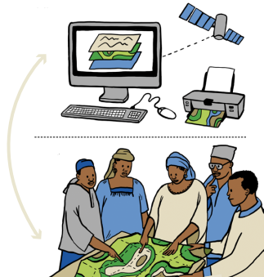
Topic 3:
Restore multiple functions for multiple benefits
HOW should we focus on multiple outcomes?
GE16: We should make full use of locally based knowledge through:
Visioning: Give equal weight to local knowledge when defining FLR outcomes and strategies.
Conceptualising: Design FLR interventions that combine local knowledge with technological advances.
Implementing: Document traditional land-use practices that enable local communities to obtain multiple benefits.
Sustaining: Ensure FLR interventions enhance and sustain local cultural values associated with natural resources.
Source: ITTO (2020)
Source: IUCN & WRI (2014)
Notes:
HOW should we focus on multiple outcomes (not just a few outcomes)?
Local and indigenous knowledge is a valuable resource that should be given equal weight to other knowledge systems in defining FLR outcomes.
GE16: We should make full use of locally based knowledge through:
Visioning: Give equal weight to local and indigenous knowledge (e.g. biodiversity, soils, forest products and landscape potential) when defining FLR outcomes and strategies.
Conceptualising: Design FLR interventions that combine the body of knowledge held by local stakeholders (e.g. indigenous communities and farmers) with technological advances in land and forest use
Implementing: Document traditional land-use practices that enable local communities to obtain multiple benefits from the landscape through participatory processes.
Sustaining: Ensure FLR interventions enhance and sustain local cultural values associated with natural resources.
Source: ITTO (2020)

Slide 35
Topic 3:
References and resources
These helpful guidelines are freely available online:
ITTO. 2020. Guidelines for forest landscape restoration in the tropics. Yokohama, Japan.
These interesting reports are freely available online:
FAO. 2015. Global guidelines for the restoration of degraded forests and landscapes in drylands: building resilience and benefiting livelihoods. Rome
FAO. 2017. Smallholder forest producer organizations in a changing climate. Rome.
Gann et al. 2019. International principles and standards for the practice of ecological restoration. In Restoration Ecology 27(S1).
IUCN 2018. The Bonn Challenge. Gland, Switzerland
Verdone, M. 2015. A cost-benefit framework for analyzing forest landscape restoration decisions. IUCN, Gland, Switzerland.
Notes:
ITTO (2020) contains additional resources for GE 13-16.

Slide 36
Topic 3:
References and resources
Watch this 6 minute video about forest landscape restoration in the Chimbo river basin, Ecuador:
https://youtu.be/dEEDBDw9DAU
Notes:
This FLR initiative has enabled local women in the Chimbo River basin, Ecuador, to establish forest nurseries, and develop a production, marketing, training and awareness-raising plan to help reforest the basin.

Slide 37
Topic 3:
Small group questions
Each group should discuss one of the questions below with reference to their local context, and then present their findings to the class:
Why should we adopt a multi-purpose approach to FLR?
How should we deliver environmental, social and economic outcomes?
How should we create biodiverse landscapes?
How should we improve livelihoods and resource security?
How should we utilise the social capital in landscapes?
Notes:
Divide the class into 5 groups (one question per group).

Slide 38
Topic 3:
Student assignments
Each student should research one of the questions below with reference to local case-studies, and then present their findings in a written report.
Explain why many forest-dependent communities adopt multi-purpose forest management strategies.
Explain which important ecological functions are protected by FLR.
Explain how FLR differs from conventional forest management.
Notes:
Provide students with a deadline for their written reports.

Slide 39
Topic 4:
Maintain and enhance natural forest ecosystems within landscapes
  Learning activities:
  Class presentation, small group questions and student assignments.
  Learning outcome:
  By the end of Topic 4, students will be able to describe the conceptual basis for maintaining and enhancing natural forest ecosystems within landscapes, as well as the 4 essential conditions for a successful FLR project.
Notes:
Topic 4 comprises:
Learning activities: Class presentation (including a case-study video), small group questions and student assignments.
Learning outcome: By the end of Topic 4, students will be able to describe the conceptual basis for maintaining and enhancing natural forest ecosystems within landscapes (Principle 4), as well as the 4 essential conditions (GE 17-20) for a successful FLR project.

Slide 40
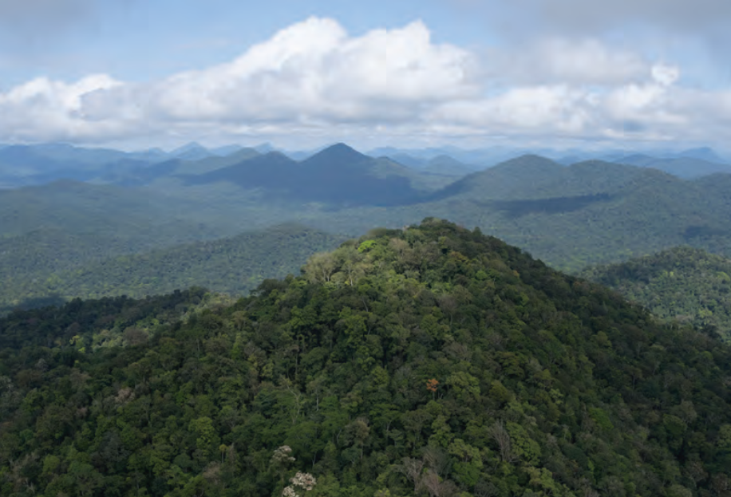
Topic 4:
Maintain and enhance natural forest ecosystems within landscapes
WHY should we maintain and enhance natural forest ecosystems?
Natural forest ecosystem processes are related to:
Species composition
Forest structure
Forest productivity
Biodiversity
Pollination
Floral and faunal genetic diversity.
Source: ITTO (2020)
PRISTINE: Guyana’s vast tropical forests are attracting increasing numbers of tourists, and many Guyanese women are providing ecotourism services.
Source: ITTO, TFU 29/2 2020. Photo: GFC.
Notes:
WHY should we maintain and enhance natural forest ecosystems (not just grow trees)?
Principle 4 aims to restore the productivity, ecosystem functions and carbon stocks of degraded tropical forests.
Natural forest ecosystem processes are related to:
Species composition
Forest structure
Forest productivity
Biodiversity
Pollination
Floral and faunal genetic diversity.
Source: ITTO (2020)

Slide 41
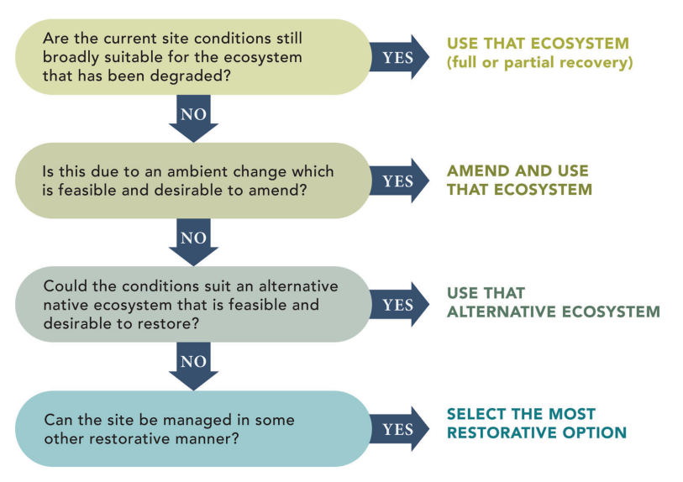
Topic 4:
Maintain and enhance natural forest ecosystems within landscapes
HOW should we maintain and enhance natural forest ecosystems?
GE17: We should avoid the conversion of natural forests through:
Visioning: Define the drivers of land-use change and forest degradation.
Conceptualising: Develop strategies for addressing the causes of conversion using a cross-sectoral approach.
Implementing: Define the permanent forest estate, and create incentives for local stakeholders to stabilise nearby landscapes.
Sustaining: Prioritise sustainable forest management above other non-forest land-uses.
Source: ITTO (2020)
Source: Gann et al. (2019)
Notes:
HOW should we maintain and enhance natural forest ecosystems (not just grow trees)?
Natural forests are an integral part of functional landscapes in the tropics and fulfil important landscape functions.
GE17: We should avoid the conversion of natural forests through:
Visioning: Define the drivers of land-use change and forest degradation (direct and indirect) through participatory processes.
Conceptualising: Develop strategies for addressing the underlying causes of conversion using a cross-sectoral approach that assesses local needs, socio-economic factors, value systems, and access & tenure rights.
Implementing: Define the permanent forest estate designated (generally by law) to be retained as forest, and create incentives for local stakeholders to stabilise nearby landscapes (e.g. agricultural fronts and buffer zones).
Sustaining: Prioritise sustainable forest management above other non-forest land-uses (conversion of degraded and secondary forests to other land-uses must be part of an overall land-use plan).
Source: ITTO (2020)

Slide 42
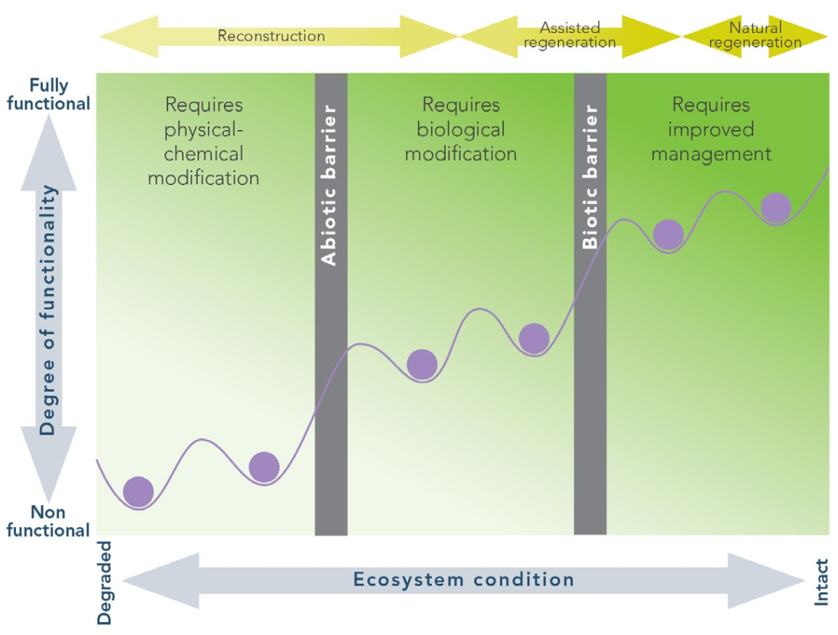
Topic 4:
Maintain and enhance natural forest ecosystems within landscapes
HOW should we maintain and enhance natural forest ecosystems?
GE18: We should restore degraded forests, and rehabilitate degraded forest land through:
Visioning: Identify and prioritise degraded forest areas for FLR.
Conceptualising: Develop cost-effective strategies for achieving desired outcomes.
Implementing: Plan FLR interventions that address the drivers of forest degradation, and recognise the potential to restore full functionality.
Sustaining: Encourage economic activities to increase the economic viability of FLR.
Source: ITTO (2020)
Source: McDonald et al. 2016
Notes:
HOW should we maintain and enhance natural forest ecosystems (not just grow trees)?
Degraded natural forests are generally less biodiverse, and have reduced capacity to supply goods and ecosystem services compared with healthy natural forests that would normally occur on the same site.
GE18: We should restore degraded forests, and rehabilitate degraded forest land through:
Visioning: Identify and prioritise degraded forest areas for FLR (taking into account environmental, social and economic aspects).
Conceptualising: Develop cost-effective strategies for achieving desired outcomes, including selection of promising tree species based on environmental, social and economic criteria.
Implementing: Plan FLR interventions that address the drivers of forest degradation, and recognise the potential to restore full functionality (seed dispersers, pollinators and wildlife are particularly important for natural regeneration processes).
Sustaining: Encourage economic activities, such as intercropping, to increase the economic viability of FLR interventions (especially early in the restoration process).
Source: ITTO (2020)

Slide 43
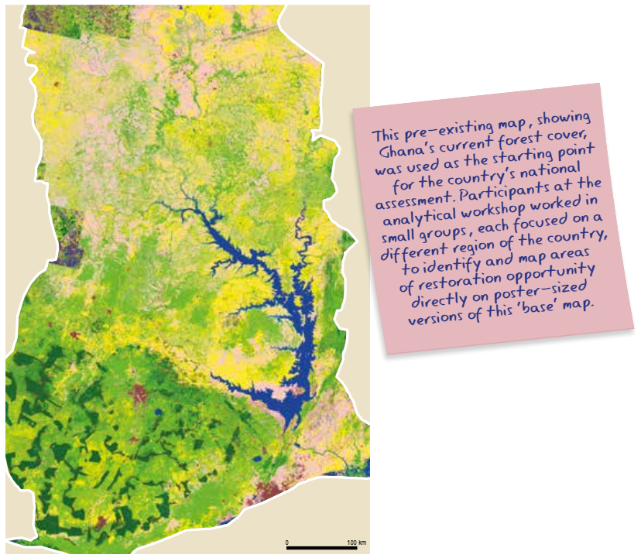
Topic 4:
Maintain and enhance natural forest ecosystems within landscapes
HOW should we maintain and enhance natural forest ecosystems?
GE19: We should avoid forest fragmentation through:
Visioning: Assess the extent of forest fragmentation, and formulate strategies to increase connectivity.
Conceptualising: Prepare/update thematic maps for cross-sectoral landscape planning.
Implementing: Establish agreements with stakeholders that support forest landscape maintenance and connectivity.
Sustaining: Monitor and adaptively manage forest fragmentation.
Source: ITTO (2020)
Source: IUCN & WRI (2014)
Notes:
HOW should we maintain and enhance natural forest ecosystems (not just grow trees)?
In mostly deforested mosaic landscapes, strategies to increase connectivity through biological corridors will be needed to ensure gene flows of fauna and flora between otherwise isolated forests and other ecosystems in a landscape.
GE19: We should avoid forest fragmentation through:
Visioning: Assess the extent of forest fragmentation, and formulate strategies to increase connectivity through biological corridors that ensure gene flows of fauna and flora between and within landscapes.
Conceptualising: Prepare/update thematic maps for cross-sectoral landscape planning, including the identification of biological “stepping stones” and consideration of risks of further forest fragmentation.
Implementing: Establish agreements with stakeholders that support forest landscape maintenance and connectivity (e.g. creation of corridors between fragmented forest stands and productive areas under degradation risk).
Sustaining: Monitor and adaptively manage forest fragmentation.
Source: ITTO (2020)

Slide 44
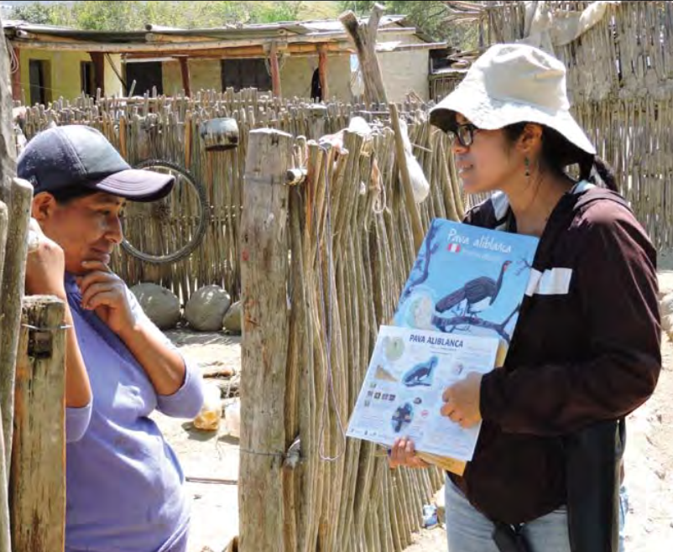
Topic 4:
Maintain and enhance natural forest ecosystems within landscapes
HOW should we maintain and enhance natural forest ecosystems?
GE20: We should conserve natural grasslands, savannas and wetlands through:
Visioning: Identify areas that should be conserved (planted forests should not replace existing native ecosystems).
Conceptualising: Assess the risks of natural areas being converted, and formulate mitigation measures.
Implementing: Undertake conservation and management measures in natural areas.
Sustaining: Monitor and adaptively manage the conservation of natural areas.
Source: ITTO (2020)
IMPLEMENTING: A communication campaign in Peru implemented close to the dry forest habitat of the white-winged guan helped reduce the threatened status of the species.
Source: ITTO, TFU 29/2 2020. Photo: CORBIDI
Notes:
HOW should we maintain and enhance natural forest ecosystems (not just grow trees)?
Under FLR, planted forests - particularly afforestation - should not replace existing native tropical grasslands, wetlands or savanna ecosystems.
GE20: We should conserve natural grasslands, savannas and wetlands through:
Visioning: Identify natural grasslands, savannas and wetlands that should be conserved (planted forests should not replace existing native ecosystems).
Conceptualising: Assess the risks of natural areas being converted to planted forests or other ecosystems, and formulate mitigation measures (e.g. maintain original fire regimes).
Implementing: Undertake conservation and management measures in natural areas through cross-sectoral collaboration.
Sustaining: Monitor and adaptively manage the conservation of natural grasslands, savannas and wetlands.
Source: ITTO (2020)

Slide 45
Topic 4:
References and resources
These helpful guidelines are freely available online:
ITTO. 2015. Voluntary guidelines for the sustainable management of natural tropical forests. Yokohama, Japan.
ITTO. 2020. Guidelines for forest landscape restoration in the tropics. Yokohama, Japan.
ITTO & IUCN. 2008. Guidelines for the conservation and sustainable use of biodiversity in tropical timber production forests. Yokohama, Japan.
Willemen et al. 2014. Spatial planning and monitoring of landscape interventions. EcoAgriculture Partners, Washington, DC.
This interesting report is freely available online:
McDonald et al. 2016. International standards for the practice of ecological restoration. Society for Ecological Restoration,
Washington, DC.
Notes:
ITTO (2020) contains additional resources for GE 17-20.

Slide 46
Topic 4:
References and resources
Watch this 14 minute video about restoring ecosystem service in the Gulf of Mexico:
https://youtu.be/CxH5_-L83I4
Notes:
This FLR initiative has conducted a quantitative assessment of the goods and services provided by the various types of tropical forests and coastal forests (mangrove forests, tropical flood forests, rain forests and scrub forests on dunes), on the coastal plains of Veracruz in the Gulf of Mexico.

Slide 47
Topic 4:
Small group questions
Each group should discuss one of the questions below with reference to their local context, and then present their findings to the class:
Why are natural forest ecosystems important?
How should we address the drivers of land-use change and forest degradation?
How should we go about restoring degraded forests?
How should improve forest structure and dynamics in fragmented landscapes?
How should we conserve natural grasslands, savannas and wetlands?
Notes:
Divide the class into 5 groups (one question per group).

Slide 48
Topic 4:
Student assignments
Each student should research one of the questions below with reference to local case-studies, and then present their findings in a written report.
Explain why natural forest ecosystems are degraded.
Explain which dynamic forest processes benefit from FLR.
Explain how natural forest ecosystems are restored.
Notes:
Provide students with a deadline for their written reports.

Slide 49
Topic 5:
Tailor to the local context using a variety of approaches
  Learning activities:
  Class presentation, small group questions and student assignments.
  Learning outcome:
  By the end of Topic 5, students will be able to describe the conceptual basis for tailoring FLR interventions to the local context, as well as the 6 essential conditions for a successful FLR project.
Notes:
Topic 5 comprises:
Learning activities: Class presentation (including a case-study video), small group questions and student assignments.
Learning outcome: By the end of Topic 5, students will be able to describe the conceptual basis for tailoring FLR interventions to the local context (Principle 5), as well as the 6 essential conditions (GE 21-26) for a successful FLR project.

Slide 50
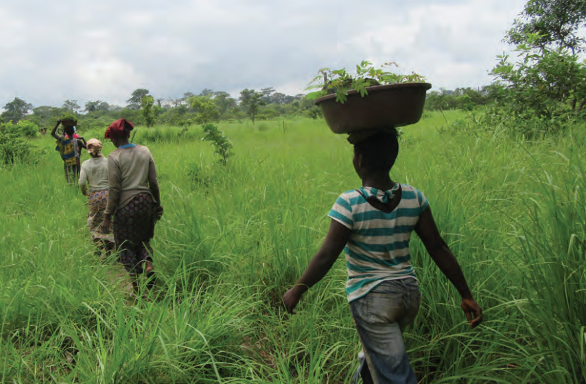
Topic 5:
Tailor to the local context using a variety of approaches
WHY should we tailor interventions to the local context using a variety of approaches?
A tailor-made approach allows us to:
Respond to the needs of local people and ecosystems when planning and implementing FLR interventions.
Undertake a variety of FLR interventions adapted to different situations (e.g. local values & needs, and historical & legal context).
Source: ITTO (2020)
The women's association - MALEBI - in Dimbokro,
Côte d’Ivoire realized they needed to restore the forest to ensure a sustainable supply of wood for their charcoal business.
Source: ITTO, TFU 28/1 2019. Photo: SODEFOR.
Notes:
WHY should we tailor interventions to the local context using a variety of approaches (not just adopt a tried-and-tested approach)?
Principle 5 ensures that FLR planning and implementation responds to the needs of local people and ecosystems.
A tailor-made approach allows us to:
Respond to the needs of local people and ecosystems when planning and implementing FLR interventions.
Undertake a variety of FLR interventions adapted to different situations (e.g. local values & needs, and historical & legal context).
Source: ITTO (2020)

Slide 51
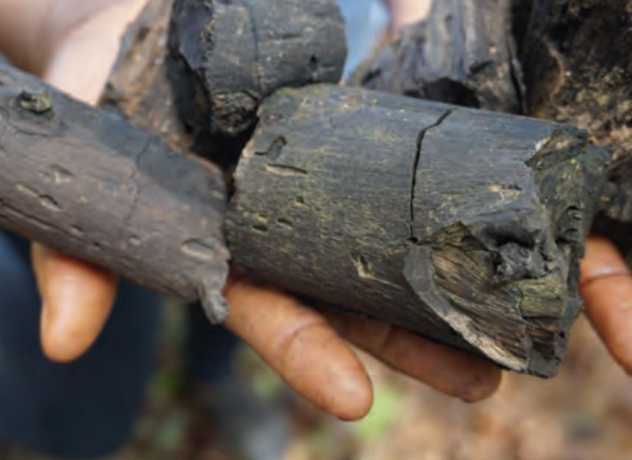
Topic 5:
Tailor to the local context using a variety of approaches
HOW should we tailor interventions to the local context?
GE 21: We should assess local context and restrictions through:
Visioning & conceptualising: Assess the local environmental conditions driving change in the landscape.
Implementing & sustaining: Tailor FLR interventions for specific sites in response to local opportunities and threats.
GE 22: We should allow for future changes in conditions through:
Visioning & conceptualising: Assess future opportunities and emerging threats.
Implementing & sustaining: Provide incentives for climate-smart technologies and land-uses adapted to climate change forecasts.
Source: ITTO (2020)
IMPLEMENTING: MALEBI now produces significant quantities of charcoal for sale in Abidjan, Côte d’Ivoire.
Source: ITTO, TFU 28/1 2019. Photo: R. Carrillo.
Notes:
WHY should we tailor interventions to the local context using a variety of approaches (not just adopt a tried-and-tested approach)?
In a landscape, the economic, sociocultural and ecological context determines the opportunities for and restrictions on FLR. FLR should take into account and be adaptable in the face of future change.
GE 21: We should assess local context and restrictions through:
Visioning & conceptualising: Assess the local environmental, social and economic conditions (past, present and future) driving change in the landscape.
Implementing & sustaining: Tailor FLR interventions for specific sites in response to local opportunities and threats (e.g. economic, population and climate change).
GE 22: We should allow for future changes in conditions through:
Visioning & conceptualising: Assess future opportunities (e.g. infrastructure development and new technologies) and emerging threats (e.g. economic policies, migration and climate change).
Implementing & sustaining: Provide incentives for climate-smart technologies and land-uses adapted to climate change forecasts.
Source: ITTO (2020)

Slide 52
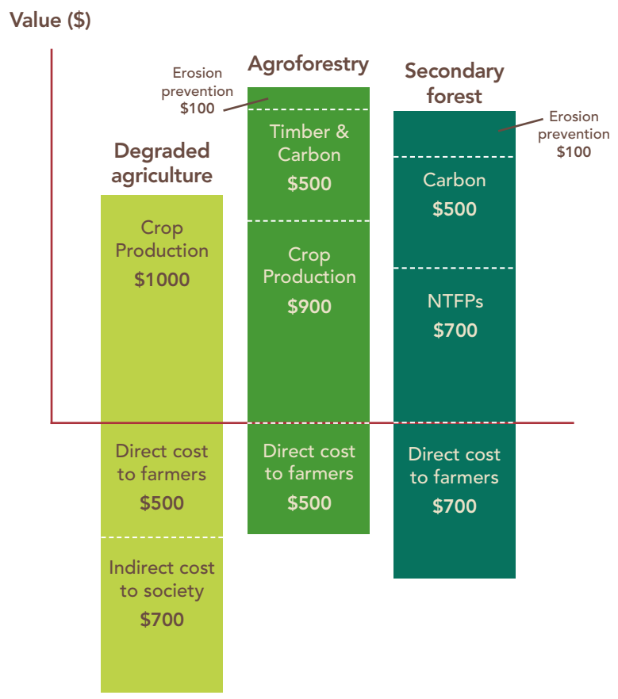
Topic 5:
Tailor to the local context using a variety of approaches
HOW should we tailor interventions to the local context?
GE 23: We should generate local benefits through:
Visioning & conceptualising: Define a vision for the future that benefits local stakeholders without compromising ecological stability.
Implementing & sustaining: Maintain ongoing dialogue with local stakeholders to strive for the equitable sharing of benefits.
GE 24: We should achieve the financial and economic viability of FLR investments through:
Visioning & conceptualising: Analyse the costs and benefits of FLR interventions, and develop attractive strategies for FLR investments.
Implementing & sustaining: Explore opportunities for market-based incentives and adding value to goods and ecosystem services.
Source: ITTO (2020)
Source: IUCN & WRI (2014)
Notes:
WHY should we tailor interventions to the local context using a variety of approaches (not just adopt a tried-and-tested approach)?
Context-tailored interventions consider how FLR can benefit local stakeholders without compromising ecological stability. Financial and economic viability is essential for the success of FLR in the field.
GE 23: We should generate local benefits through:
Visioning & conceptualising: Define a vision for the future that benefits local stakeholders without compromising ecological stability, and has the free prior & informed consent (FPIC) of indigenous peoples.
Implementing & sustaining: Maintain ongoing dialogue with local stakeholders to strive for the equitable sharing of benefits (FLR benefits are likely to change over time in both nature and extent).
GE 24: We should achieve the financial and economic viability of FLR investments through:
Visioning & conceptualising: Analyse the costs and benefits (monetary and non-monetary) of FLR interventions, and develop attractive strategies for FLR investments (e.g. local buy-in, tenure security, agroforestry-based crops, fast-growing woodlots, and supply of ecosystem services).
Implementing & sustaining: Explore opportunities for market-based incentives (e.g. results-based carbon payments) and adding value to goods and ecosystem services (e.g. ecotourism).
Source: ITTO (2020)

Slide 53
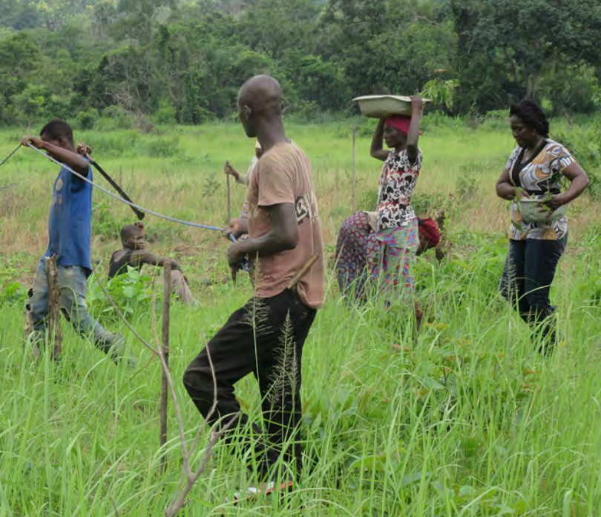
Topic 5:
Tailor to the local context using a variety of approaches
HOW should we tailor interventions to the local context?
GE25: We should identify opportunities to increase local incomes through:
Visioning: Strengthen forest producer organizations and locally based enterprises.
Conceptualising: Promote local value-adding and involvement of women.
Implementing: Partner with public and private sector networks and explore options for community based forest management schemes.
Sustaining: Monitor and adaptively manage interventions to increase local incomes.
Source: ITTO (2020)
CONCEPTUALISING: Gender equality is an issue that concerns both men & women.
Source: ITTO, TFU 28/1 2019. Photo: SODEFOR.
Notes:
WHY should we tailor interventions to the local context using a variety of approaches (not just adopt a tried-and-tested approach)?
Identifying new income-earning opportunities - including through entrepreneurship - will be a powerful incentive for local people to participate in FLR.
GE25: We should identify opportunities to increase local incomes through:
Visioning: Strengthen forest producer organizations and locally
based enterprises (e.g. business management, and technical training & support)
Conceptualising: Promote local value-adding (e.g. improve market access and processing of agricultural and forest products) and involvement of women.
Implementing: Partner with public and private sector networks (e.g. processing and marketing operations) and explore options for community based forest management schemes (e.g. forest goods and ecosystem services).
Sustaining: Monitor and adaptively manage interventions to increase local incomes.
Source: ITTO (2020)

Slide 54
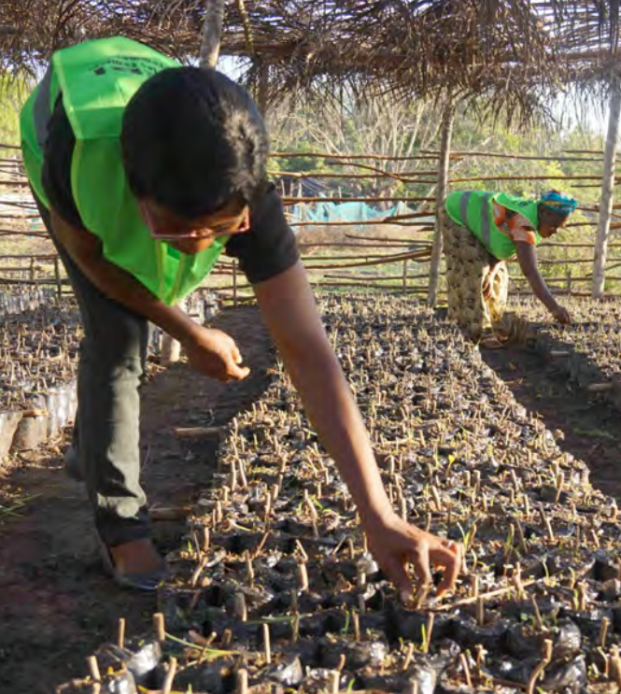
Topic 5:
Tailor to the local context using a variety of approaches
HOW should we tailor interventions to the local context?
GE26: We should develop sustainable supply chains through:
Visioning: Identify the potential to develop legal and sustainable supply chains for goods produced in restored forest landscapes.
Conceptualising: Develop legal and sustainable supply chains in restored forest landscapes that are accessible to local communities.
Implementing: Create enabling conditions for the supply of products from restored forests and agroforestry systems.
Sustaining: Develop marketing opportunities and value chains for forest products and ecosystem services.
Source: ITTO (2020)
IMPLEMENTING: Members of MALEBI tend cuttings that will later be out planted as part of forest restoration efforts in Côte d’Ivoire.
Source: ITTO, TFU 28/1 2019. Photo: R. Carrillo.
Notes:
WHY should we tailor interventions to the local context using a variety of approaches (not just adopt a tried-and-tested approach)?
FLR should seek to support entrepreneurship, and build legal and sustainable supply chains for the goods produced in restored forests and landscapes.
GE26: We should develop sustainable supply chains through:
Visioning: Identify the potential to develop legal and sustainable supply chains for goods produced in restored forest landscapes.
Conceptualising: Develop legal and sustainable supply chains in restored forest landscapes that are accessible to local farmers/communities in collaboration with existing schemes (e.g. certification and timber legality).
Implementing: Create enabling conditions for the supply of products from restored forests and agroforestry systems (e.g. incentives, access to finance, fair taxes and simplified regulations).
Sustaining: Develop marketing opportunities and value chains for forest products and ecosystem services (e.g. lesser-known tree species that are abundant in the landscape).
Source: ITTO (2020)

Slide 55
Topic 5:
References and resources
These helpful guidelines are freely available online:
Barnett et al. 2017. Gender matters in forest landscape restoration. CIFOR, Bogor, Indonesia.
FAO. 2011. Community-based tree and forest product enterprises: Market analysis and development. Rome.
ITTO. 2020. Guidelines for forest landscape restoration in the tropics. Yokohama, Japan.
RECOFTC. 2020. Introduction to forest landscape restoration in Southeast Asia. Bangkok.
These interesting reports are freely available online:
Chazdon, R.L. & Guariguata, M.R. 2018. Decision support tools for forest landscape restoration. CIFOR, Bogor, Indonesia.
Greijmans & Gritten. 2015. Is community forestry open for business? RECOFTC, Bangkok, Thailand.
Notes:
ITTO (2020) contains additional resources for GE 21-26.

Slide 56
Topic 5:
References and resources
Watch this 5 minute video about the charcoal women from Côte d’Ivoire:
https://youtu.be/Lckxy_jHBUo
Notes:
This FLR initiative is restoring the forest to ensure a sustainable supply of wood for the charcoal sellers in Dimbokro, Côte d’Ivoire.

Slide 57
Topic 5:
Small group questions
Each group should discuss one of the questions below with reference to their local context, and then present their findings to the class:
Why should we adopt a tailor-made approach?
How should we respond to external opportunities and threats?
How should we generate local benefits and long-term viability?
How should we increase local incomes?
How should we develop sustainable supply chains for goods produced in restored forests and landscapes?
Notes:
Divide the class into 5 groups (one question per group).

Slide 58
Topic 5:
Student assignments
Each student should research one of the questions below with reference to local case-studies, and then present their findings in a written report.
Explain why some landscapes contain a variety of FLR interventions.
Explain which FLR investments are more likely to be financed.
Explain how FLR responds to the needs of local people and ecosystems.
Notes:
Provide students with a deadline for their written reports.

Slide 59
Topic 6:
Manage adaptively for long-term resilience
  Learning activities:
  Class presentation, small group questions and student assignments.
  Learning outcome:
  By the end of Topic 6, students will be able to describe the conceptual basis for the adaptive management of FLR interventions, as well as the 6 essential conditions for a successful FLR project.
Notes:
Topic 6 comprises:
Learning activities: Class presentation (including a case-study video), small group questions and student assignments.
Learning outcome: By the end of Topic 6, students will be able to describe the conceptual basis for tailoring FLR interventions to the local context (Principle 6), as well as the 6 essential conditions (GE 27-32) for a successful FLR project.

Slide 60
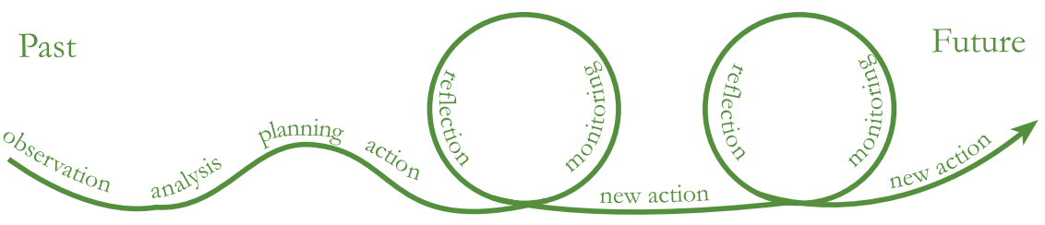
Topic 6:
Manage adaptively for
long-term resilience
WHY should we manage adaptively for long-term resilience?
An adaptive approach allows us to:
Modify FLR interventions over time to reflect changes in the landscape.
Improve FLR management plans using lessons learnt from ongoing monitoring, research and stakeholder feedback.
Maintain resilient and productive forest landscapes that deliver desired environmental, social and economic outcomes.
Source: Evans & Guariguata (2016)
Notes:
WHY should we manage adaptively for long-term resilience (not just refer to the present context)?
Principle 6 aims to increase the resilience of landscapes and communities in the medium to long term. Interventions must be tailored to the local conditions prevailing at the time of commencement, but be capable of adaptation to changing economic, social and environmental circumstances.
An adaptive approach allows us to:
Modify FLR interventions over time to reflect changes in the landscape (e.g. environmental conditions, stakeholder needs and available technologies).
Improve FLR management plans using lessons learnt (positive and negative) from ongoing monitoring, research and stakeholder feedback.
Maintain resilient and productive forest landscapes that deliver desired environmental, social and economic outcomes.
Source: ITTO (2020)

Slide 61
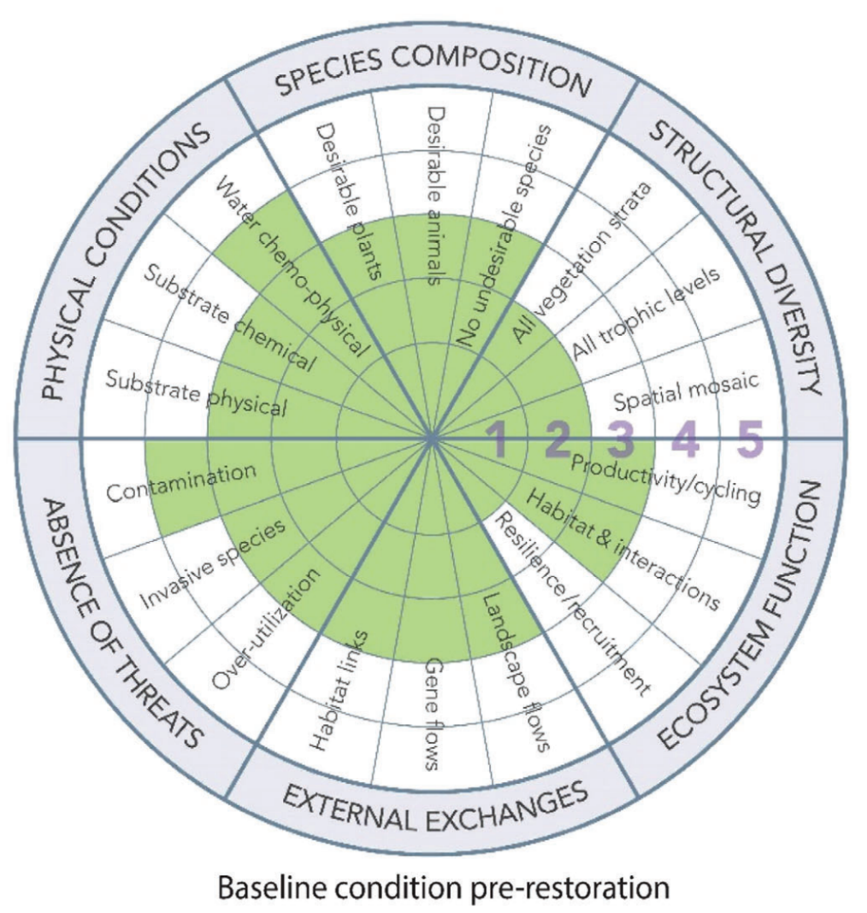
Topic 6:
Manage adaptively for
long-term resilience
HOW should we manage adaptively for long-term resilience?
GE 27: We should take an adaptive management approach through:
Visioning & conceptualising: Ensure stakeholders recognise the importance of adaptive management.
Implementing & sustaining: Regularly improve plans with reference to monitoring and research reports.
GE 28: We should continually measure the biophysical dimensions of the landscape through:
Visioning & conceptualising: Document and map the baseline situation.
Implementing & sustaining: Analyse outcomes with reference to the baseline situation.
Source: ITTO (2020)
Source: Gann et al. (2019)
Notes:
HOW should we manage adaptively for long-term resilience (not just refer to the present context)?
Adaptive management interventions minimize the economic, social and environmental risks associated with FLR. The initial environmental conditions must be assessed periodically. Monitoring change against this baseline information will enable the effective adaptation of FLR over time.
GE 27: We should take an adaptive management approach through:
Visioning & conceptualising: Ensure stakeholders recognise the importance of adaptive management in overcoming potential risks and responding to changes in priorities.
Implementing & sustaining: Regularly improve FLR management plans with reference to environmental monitoring and research reports that compare the present and baseline situations.
GE 28: We should continually measure the biophysical dimensions of the landscape through:
Visioning & conceptualising: Document and map the baseline situation, particularly environmental stresses and risks (e.g. seasonal climate, site exposure and low soil fertility).
Implementing & sustaining: Analyse outcomes with reference to the baseline situation (particularly the environmental stresses and risks) to enable the effective adaptation of FLR over time.
Source: ITTO (2020)

Slide 62
Topic 6:
Manage adaptively for
long-term resilience
HOW should we manage adaptively for long-term resilience?
GE29: We should periodically assess vulnerability to climate change through:
Visioning: Evaluate the adaptive capacity of stakeholders, as well as encourage research aimed at maintaining ecological processes.
Conceptualising: Assess the impact of unpredictable events and long-term global climate change processes on landscape dynamics and ecosystem functions.
Implementing: Develop FLR interventions that increase the resilience of ecosystems and social systems to climate change.
Sustaining: Explore the potential for FLR interventions within the United Nations Framework Convention on Climate Change (UNFCC).
Source: ITTO (2020)
Notes:
HOW should we manage adaptively for long-term resilience (not just refer to the present context)?
The vulnerability of ecosystems and social systems in a landscape must be assessed periodically to ensure the effectiveness of FLR interventions to reduce this.
GE29: We should periodically assess vulnerability to climate change through:
Visioning: Evaluate the adaptive capacity of stakeholders, as well as encourage research aimed at maintaining ecological processes (e.g. pollination, seed dispersal and nutrient cycling).
Conceptualising: Assess the impact of unpredictable events (e.g. fire and drought) and long-term global climate change processes on landscape productivity, ecological dynamics and ecosystem functions.
Implementing: Develop FLR interventions that increase the resilience of ecosystems and social systems to climate change (e.g. appropriate land-use practices and species selection).
Sustaining: Explore the potential for FLR interventions within the United Nations Framework Convention on Climate Change (under adaptation and mitigation mechanisms).
Source: ITTO (2020)

Slide 63
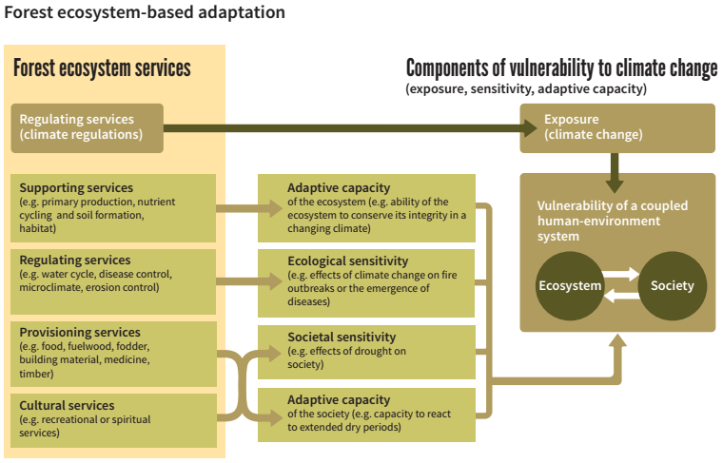
Topic 2:
Topic 6:
Manage adaptively for
long-term resilience
Source: FAO & UNCCD. 2015.
Notes:
This slide accompanies the previous slide.

Slide 64
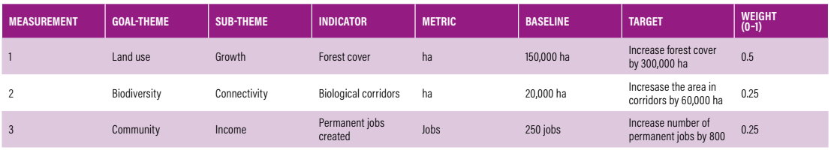
Topic 6:
Manage adaptively for
long-term resilience
HOW should we manage adaptively for long-term resilience?
GE 30: We should develop participatory monitoring of FLR through:
Visioning: Define outcomes and indicators of success through participatory processes.
Conceptualising: Prepare participatory planning and monitoring framework with reference to desired outcomes and indicators of success.
Implementing: Assist stakeholders to recognise the adaptations required to optimize outcomes.
Sustaining: Incorporate participatory monitoring into local networks.
Source: Buckingham et al. (2019)
Notes:
HOW should we manage adaptively for long-term resilience (not just refer to the present context)?
Participatory and user-friendly FLR monitoring should form the basis for adaptive management.
GE30: We should develop participatory monitoring of FLR through:
Visioning: Define desired environmental, social and economic outcomes and indicators of success (with reference to the baseline situation) through participatory processes.
Conceptualising: Prepare participatory planning and monitoring framework with reference to desired outcomes and selected indicators of success (at site & landscape scales, and different stages of FLR).
Implementing: Assist all stakeholders to recognise the adaptations required to optimize FLR outcomes in a changing landscape through participatory planning and monitoring.
Sustaining: Incorporate participatory monitoring into local networks using user-friendly tools and techniques.
Source: ITTO (2020)

Slide 65
Topic 6:
Manage adaptively for
long-term resilience
HOW should we manage adaptively for long-term resilience?
GE 31: We should encourage open access to, and the sharing of, information and knowledge through:
Visioning & conceptualising: Develop communication strategies that ensure all stakeholders have continuous and easy access to information on all aspects of FLR.
Implementing & sustaining: Build information networks for sharing experiences, and developing ideas and actions for FLR.
GE 32: We should report on FLR outcomes through:
Visioning & conceptualising: Develop participatory planning and monitoring framework.
Implementing & sustaining: Establish robust reporting processes to ensure all stakeholders are fully informed.
Source: ITTO (2020)
IMPLEMENTING: This boy from Veracruz in Mexico contributed a drawing to the Day of the Tree.
Source: ITTO, TFU 28/1 2019. Photo: Women of El Piñonal Nurseryin
.
Notes:
HOW should we manage adaptively for long-term resilience (not just refer to the present context)?
Adequate access to information and the dissemination and management of knowledge will maximize the effectiveness of - and public support for - FLR. Measuring outcomes at the landscape level, and reporting on these to all stakeholders, is fundamental for FLR success.
GE 31: We should encourage open access to, and the sharing of, information and knowledge through:
Visioning & conceptualising: Develop communication strategies that ensure all stakeholders have continuous and easy access to information on all aspects of FLR (people are unlikely to participate in FLR unless they appreciate the FLR approach).
Implementing & sustaining: Build information networks at all levels for sharing experiences, and developing ideas and actions for FLR (e.g. localise communication resources).
GE 32: We should report on FLR outcomes through:
Visioning & conceptualising: Develop participatory planning and monitoring framework with reference to desired outcomes and selected indicators of success (at site & landscape scales, and different stages of FLR).
Implementing & sustaining: Establish robust reporting processes to ensure all stakeholders are fully informed on progress, changes, challenges and lessons learned (successes and failures).
Source: ITTO (2020)

Slide 66
Topic 6:
References and resources
These helpful guidelines are freely available online:
Buckingham et al. 2019. A guide to identifying priorities and indicators for restoration monitoring. WRI, Washington, DC.
FAO. 2013. Climate change guidelines for forest managers. Rome.
ITTO. 2020. Guidelines for forest landscape restoration in the tropics. Yokohama, Japan.
These interesting reports are freely available online:
Evans, K. & Guariguata, M.R. 2016. Success from the ground up: participatory monitoring and forest restoration. CIFOR, Bogor, Indonesia.
FAO. 2014. Multi-sectoral platforms for planning and implementation. Rome.
Notes:
ITTO (2020) contains additional resources for GE 27-32.

Slide 67
Topic 6:
References and resources
Watch this 5 minute video about forest management resources for Amazonia, Brazil:
https://youtu.be/1ULJ6rWmb74
Notes:
This FLR initiative has developed a software tool to assist forest managers in preparing sustainable forest management plans in Amazonia, Brazil.

Slide 68
Topic 6:
Small group questions
Each group should discuss one of the questions below with reference to their local context, and then present their findings to the class:
Why do FLR interventions need to be adapted over time?
How should we improve FLR management plans over time?
How should we assess the vulnerability of ecosystems and social systems in a landscape?
How should we undertake participatory planning and monitoring?
How should we communicate FLR information and learning?
Notes:
Divide the class into 5 groups (one question per group).

Slide 69
Topic 6:
Student assignments
Each student should research one of the questions below with reference to their local context, and then present their findings in a written report.
Explain why FLR interventions are modified over time.
Explain which parts of a landscape are more likely to change over time.
Explain how FLR maintains resilient and productive forest landscapes.
Notes:
Provide students with a deadline for their written reports.

Slide 70

Module 1:
Summary
The Guidelines for Forest Landscape Restoration in the Tropics (ITTO, 2020) contain
6 principles and 32 guiding elements (GEs) with recommended actions for each phase of FLR (from visioning to sustaining).
PRINCIPLE 1: Focus on landscapes (4 GEs).
PRINCIPLE 2: Engage stakeholders and support participatory governance (8 GEs).
PRINCIPLE 3: Restore multiple functions for multiple benefits (4 GEs).
PRINCIPLE 4: Maintain and enhance natural forest ecosystems within landscapes (4 GEs).
PRINCIPLE 5: Tailor to the local context using a variety of approaches (6 GEs).
PRINCIPLE 6: Manage adaptively for long-term resilience (6 GEs).
Source: ITTO (2020)
Notes:
Module 1: Principles and guiding elements for forest landscape restoration (FLR) in the tropics.
Learning objective:
By the end of Module 1, students will be able to name the 6 globally recognized principles of FLR in the tropics, as well as describe the conceptual basis and guiding elements for each principle.

Slide 71
Module 1:
Summary
Source: ITTO (2020)
Notes:
This slide accompanies the previous slide.

Slide 72




Module 1:
Credits
Module 1 was developed for ITTO and IUFRO under the GEF-approved project “Fostering Partnerships to Build Coherence and Support for FLR”, which supports the Collaborative Partnership on Forests (CPF) Joint Initiative on FLR.
The following institutions and people collaborated on this module:
Institutions: Pacific Island Projects, Papua New Guinea
Contributor: Simon Rollinson
Layout supporter: Shona Smith
Suggested citation: ITTO-IUFRO FLR learning modules (2021)
Notes:
Encourage students to attend the next FLR learning session for:
Module 2: Forest landscape restoration (FLR) project design and implementation.

