Slide 1
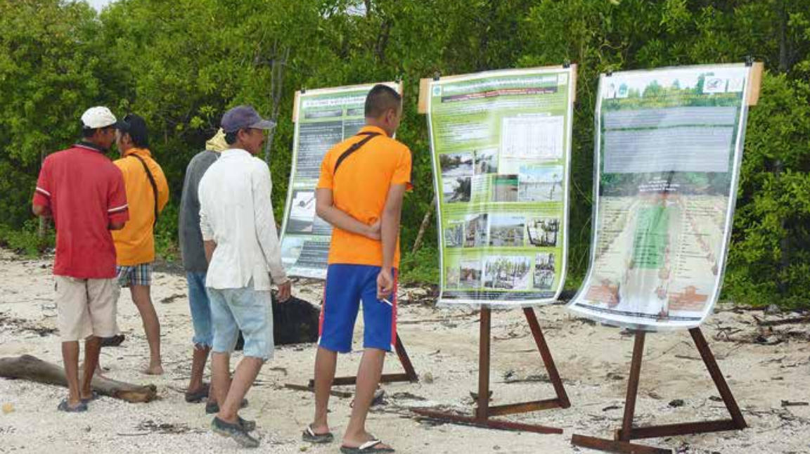
Module 2 |
||
Forest Landscape Restoration (FLR) Project Design and Implementation
ITTO-IUFRO: FLR Learning Modules

Slide 2


Module 2:
Objective
  Learning level:
  Students at high schools, training centres and universities.
  Learning objective:
  Present the FLR process as a long-term intervention into a socio-ecological system based on project cycle management as a tool to address complexity of land use, allow for adaptive management of natural resources and monitoring of progress/impact on the ground.

Slide 3

Module 2:
Outline
TOPIC 1: Underlying causes of degradation
TOPIC 2: Enabling environment for restoration
TOPIC 3: Designing an FLR project
TOPIC 4: Innovative technical restoration approaches
TOPIC 5: Monitoring short- and long-term restoration progress and impact
Credits

Slide 4
Topic 1:
Underlying causes of degradation
  Learning activities:
  Class presentation, small group questions and student assignments.
  Learning outcome:
  By the end of Topic 1, students will have developed a basic understanding of landscape dynamics and the drivers of forest and land degradation representing a complex mix of interacting social, economic and ecological factors.

Slide 5
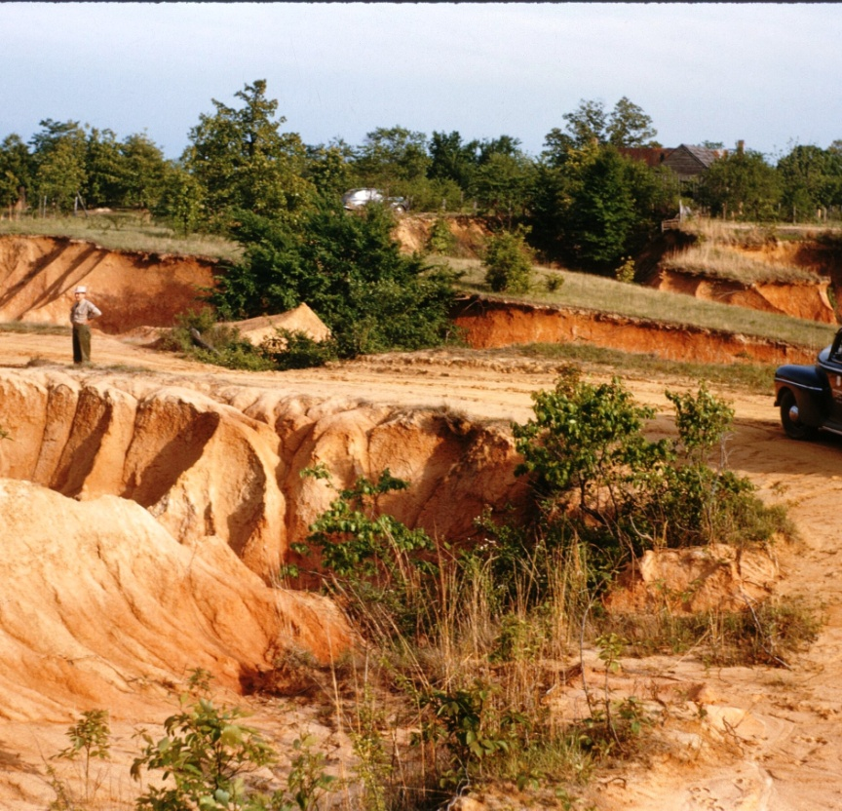
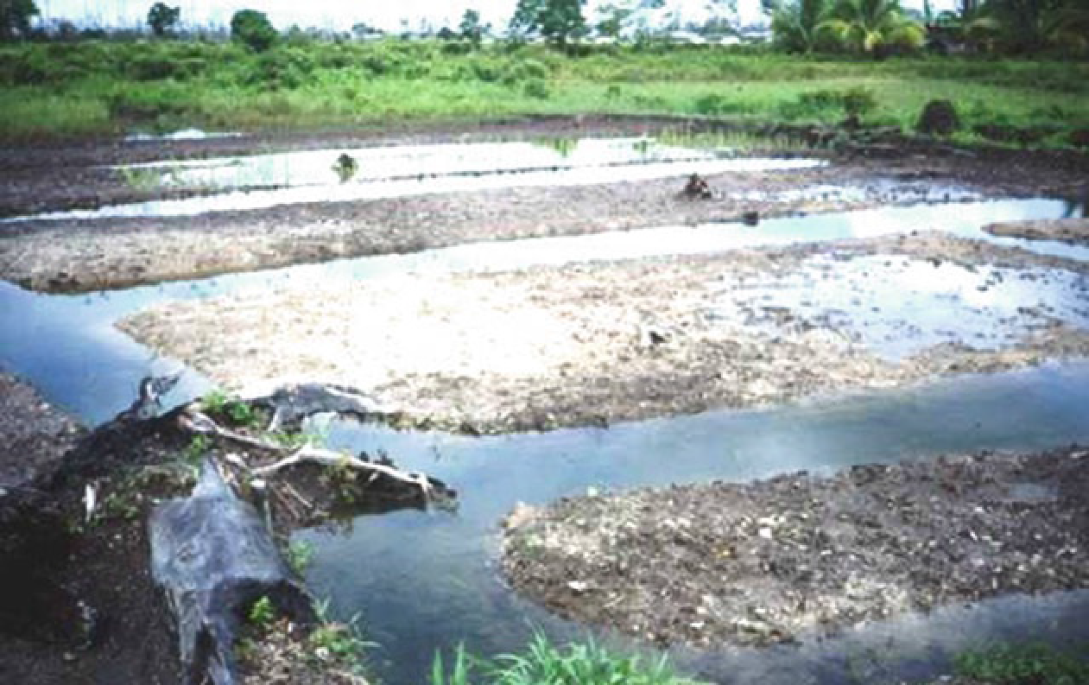
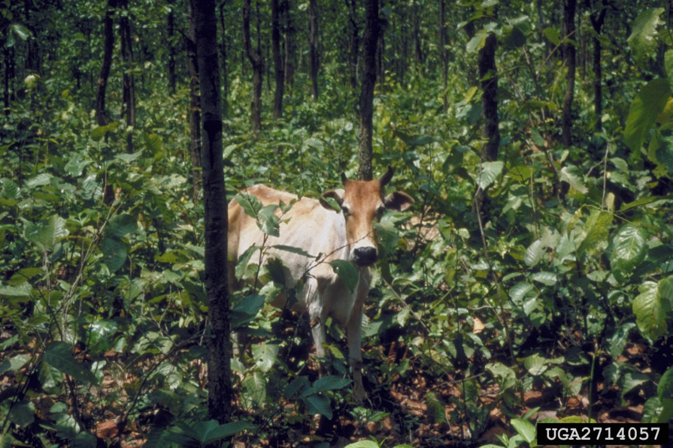
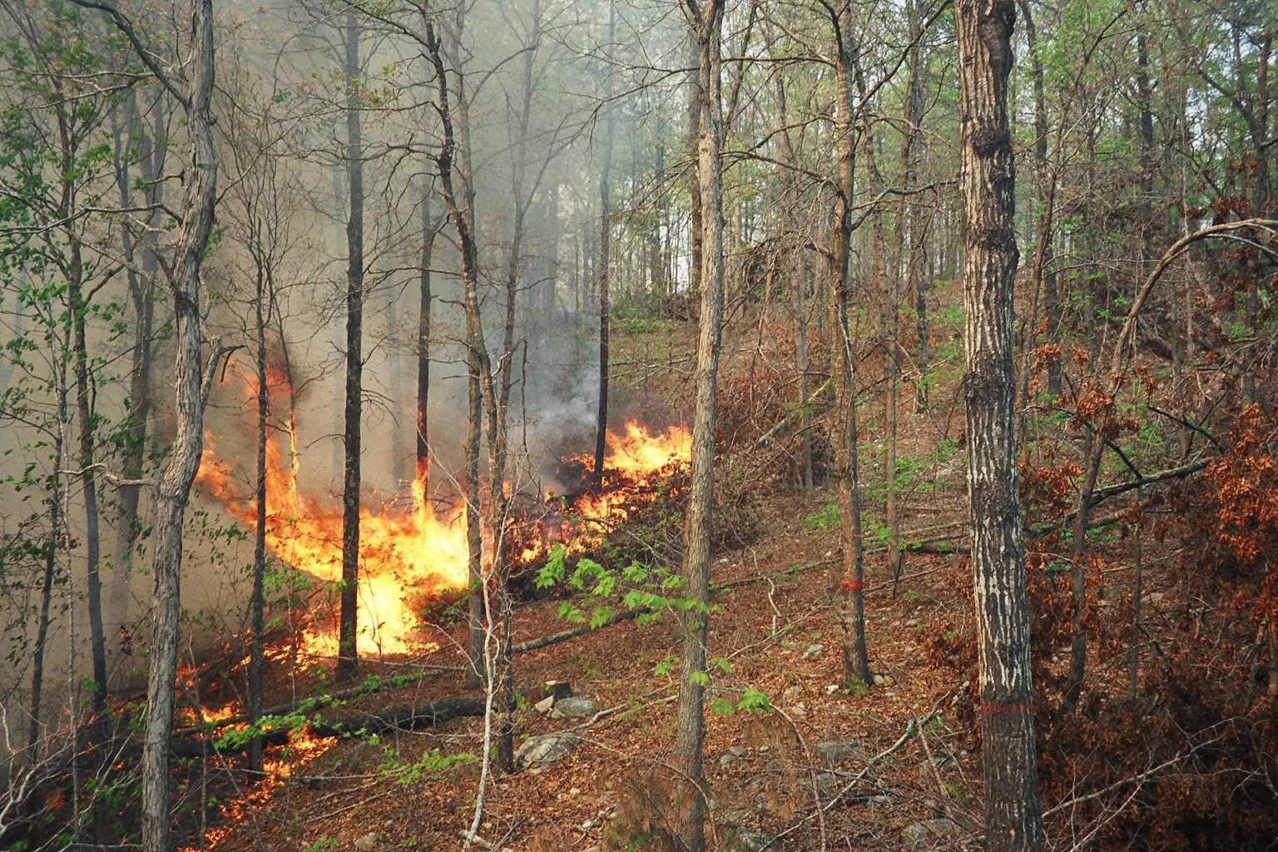
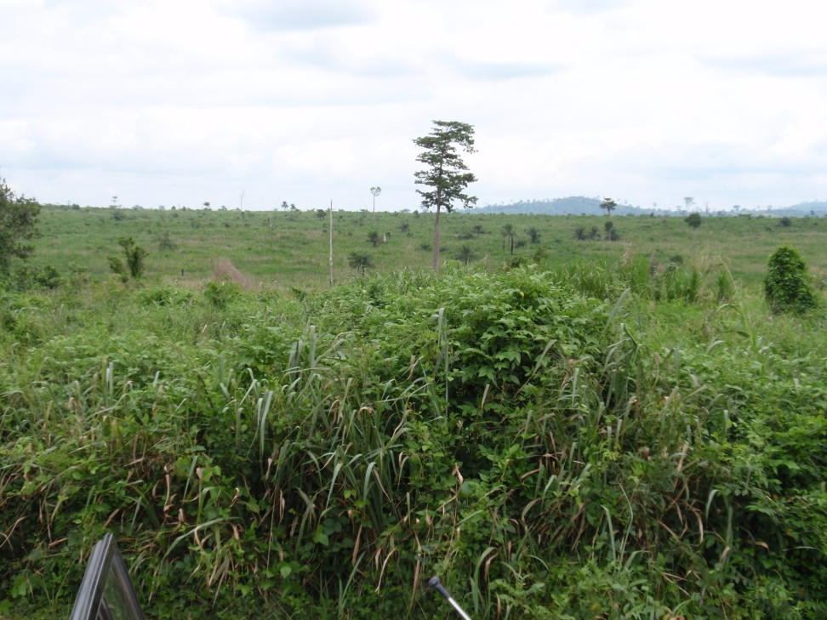
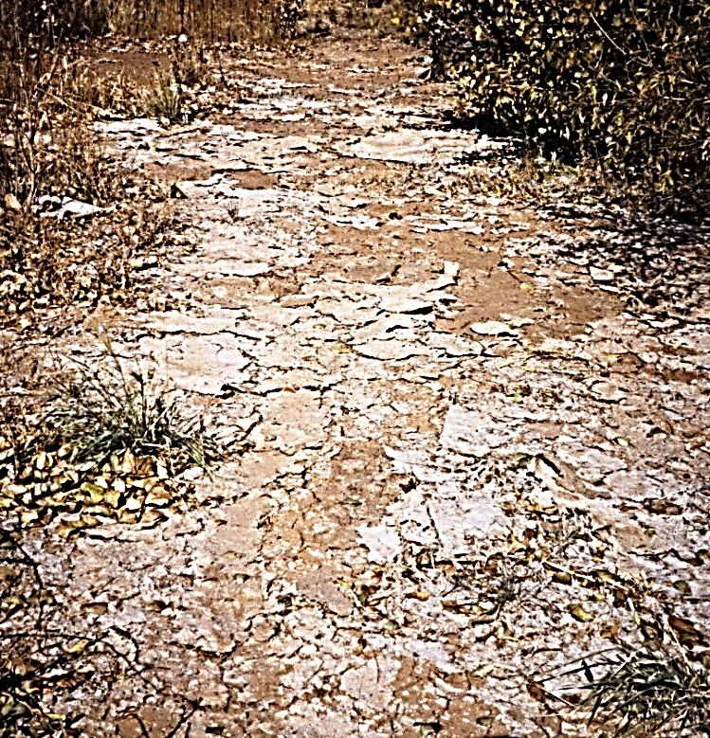
Topic 1:
Salinized Soils
Topic 1::
Underlying causes of degradation
Livestock
Source: Doug Maguire, Oregon State University, Bugwood.org
Accelerated Erosion Source: USDA Forest Service
Potential Acid Sulphate Soils
Source: : Peter R. Burbridge, Newcastle University
Saline Soil
Source: Richard Harper, Murdoch University
Altered Fire Regime
Source: Thomas Waldrop, USDA Forest Service
Invasive Vegetation
Source: John A. Stanturf
Over Grazing
Notes:
The proximate (immediate) drivers of deforestation and forest degradation are usually linked to unsustainable land use practices as well as large scale ecological disturbances.
Drivers may include accelerated erosion due to the removal of vegetation, coupled with easily erodable soil conditions and increased precipitation extremes (such as the case of the southern edge of the Meghalaya Plateau, which experiences the World’s largest amount of rain).
Unfavourable soil conditions can not only accelerate erosion, but also restrict vegetation growth, such as saline soils and acid sulphate soils.
Large scale disturbances operating at extended spatial scales as a result of climate change and anthropogenic impacts, such as altered fire regimes or large scale insect outbreaks can lead to widespread mortality and degradation of forests over vast areas.
Invasive species are a serious threat globally, but they particularly threaten islands.
Livestock grazing at high intensity effectively prevents regeneration of forests, particularly in sub-tropical and temperate regions.

Slide 6
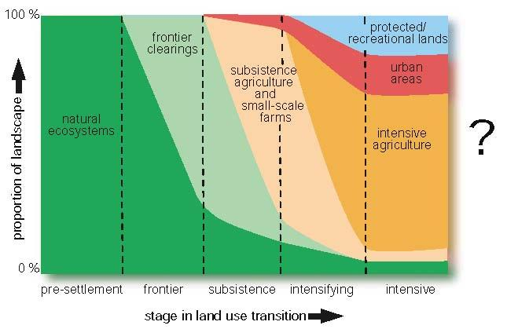
Topic 1:
1.1 Landscape dynamics
Drivers of land use transition
Globalization
Emerging social needs
Demographic pressure
Land degradation
Climate change
Government policy
Land use transition
Threats of land use transition
Weakened land tenure
Continued land degradation
Loss of culture & traditions
Growing inequality
Increased vulnerability
Source: Foley et al. 2005
Notes:
The conceptualized process of land use transition includes five stages. It starts with the presettlement stage, where only natural ecosystems are present. In this stage humans form part of the ecosystem or are not present.
Next, the land transitions into the frontier stage as settlers arrive and start to clear land for agriculture. The proportion of natural ecosystems rapidly declines across the landscape.
The next stage is the subsistence stage, which is increasingly dominated by subsistence agriculture and small-scale farms. In this stage the proportion of both natural ecosystems and frontier clearings decline. At the same time urban areas appear as a new land use type, but they are restricted to land areas of negligible size.
Next, the intensifying stage arrives in which subsistence agriculture gives way to intensive agriculture. Frontier clearings and natural ecosystems decline simultaneously, while urban areas expand. At the same time, a new land use priority of protected and recreational areas arises, primarily to cater to the needs of the increasing urban population.
Finally, the intensive stage of land use transition arrives, which is dominated by intensive agriculture and in which urban areas and protected and recreational areas also take up substantial proportions of land. The areas covered by natural ecosystems and frontier clearings is negligible.
What drives land use transition?
These include underlying causes, such as globalization, emerging social needs, population boom and the demographic pressure linked to it, land degradation, climate change and unfavourable government policies.
These trends can be exacerbated by weakened land tenure, particularly of communally-held land, continued land degradation due to unsustainable land use, loss of cultural and traditional attachment to the land, growing social and economic inequalities, and the increased vulnerability of communities and ecosystems to climate change.

Slide 7
Topic 1:
1.2 Characterise landscape: Landscape analysis
Driving forces
Demography, incl. labour availability
Historic development
Economic factors – livelihood strategies
Social change
Current situation
Biodiversity
Land parameters (productivity, erodibility, etc.)
Land use types, incl. cover
Associated problems
Projected situation
Land use trajectory - likely land use scenario after 10 years
Internal driving forces
vs.
External driving forces
Notes:
A landscape analysis is a very useful tool to describe the driving forces, the current situation and the projected development under a common framework.
First, driving forces for changes across the landscape need to be described. These may include changes in demographic conditions, including the availability of labour, as well as historic land use trends. At the same time, economic factors, including the main livelihood strategies pursued by the local population are important drivers. Changes in social conditions, lifestyles, educational aspirations, family sizes should not be underestimated either.
Next, the landscape analysis needs to describe the current situation. This is best done in terms of characterizing the landscape’s biodiversity, land parameters, including productivity and erodibility, as well as the current land cover and land use types. It is important to highlight all issues associated with certain land use types.
Finally, based on the driving forces and the current situation description, the landscape analysis arrives at the projected situation, which is described through the land use trajectory. This is a prediction according to best knowledge on what the landscape will look like in 10 years IN CASE NO FURTHER activities (no FLR interventions) are implemented.

Slide 8
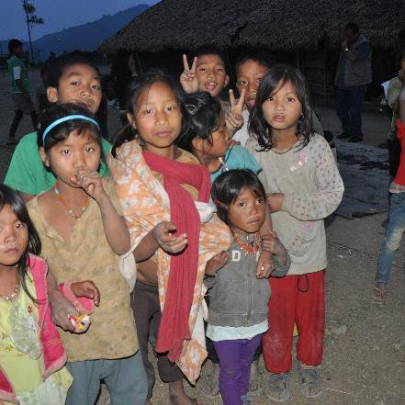
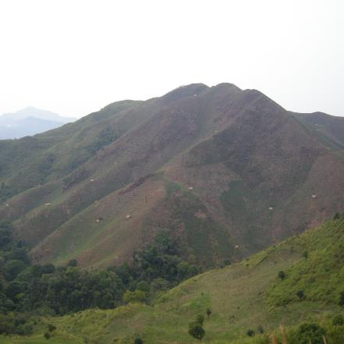
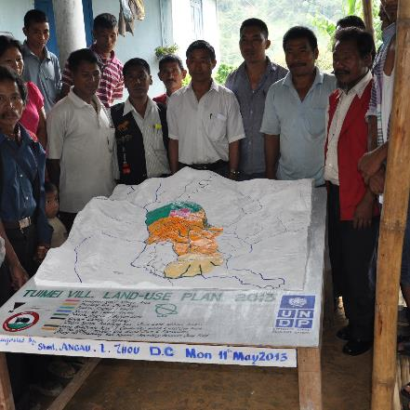
Topic 1:
1.3 Addressing drivers of degradation
Trends, conditions & response options
Pressure
State
Response
  Demographic change
  Social change
  Economic change
  Climate change
  Degraded land
  Reduced biodiversity
  Migration
  Insecure land tenure
  Reduced resilience
  Low carbon stocks
  Stakeholder engagement
  Planning approaches
  Restoration options
  Landscape connectivity
  Conflict resolution
Notes:
Assessing the drivers of degradation can also help to identify response options. The pressure-state-response conceptual framework can be a useful tool for this.
The pressure describes the driving forces as in case of the landscape analysis. In the presented situation this may include demographic, social, economic and climatic changes.
Next, the state describes the present situation.
Finally, the response describes the FLR actions necessary to address the pressures in the context of the given situation.

Slide 9
Topic 1:
References and resources
DeFries, R.S., Rudel, T., Uriarte, M., Hansen, M., 2010. Deforestation driven by urban population growth and agricultural trade in the twenty-first century. Nature Geoscience 3, 178–181.
Foley, J.A., et al. (2005) Global Consequences of Land Use. Science, 309, 570-574
IPBES, 2018. Summary for policymakers of the thematic assessment report on land degradation and restoration of the Intergovernmental Science-Policy Platform on Biodiversity and Ecosystem Services. In: Scholes, R., Montanarella, L., Brainich, A., Barger, N., Brink, B.t., Cantele, M., Erasmus, B., Fisher, J., Gardner, T., Holland, T.G., Kohler, F., Kotiaho, J.S., Maltitz, G.V., Nangendo, G., Pandit, R., Parrotta, J., Potts, M.D., Prince, S., Sankaran, M., Willemen, L. (Eds.). IPBES Secretariat, Bonn, Germany
Robinson, B.E., Holland, M.B., Naughton-Treves, L., 2014. Does secure land tenure save forests? A meta-analysis of the relationship between land tenure and tropical deforestation. Global Environmental Change 29, 281–293.

Slide 10

Topic 1:
Small group questions
What other drivers of land degradation and deforestation are known to you?
In which stage of the land use transition is your landscape in?
What are the main drivers of land degradation in your landscape?
Analyse the current situation in your landscape!
What will your landscape look like in 10 years in case current trends do not change and no restoration takes place?

Slide 11
Topic 1:
Student assignments
Apply the landscape analysis for your landscape / a landscape well-known to you:
Analyse drivers responsible for changes at the landscape level, including degradation and deforestation.
Identify and describe the current status of land degradation.
Visualize expected future trends and possible trajectories of how your landscape will evolve.

Slide 12
Topic 2:
Enabling environment for restoration
  Learning activities:
  Class presentation, small group questions and student assignments.
  Learning outcome:
  By the end of Topic 2, students will be familiar with the various aspects of an enabling institutional, regulatory and policy environment for forest landscape restoration as well as behavioural characteristics such as motivation, shared visions and new ways of learning to initiate change.

Slide 13
Topic 2:
2.1 Synthesized list of enabling conditions for FLR with reference to FLR Module 1: Principles 1 to 6
Engagement for common interests
Shared motivation & vision (Principle 3)
Stakeholder engagement (Principle 3)
Economic viability (Principle 5)
Clear rules
Enabling policy & regulatory framework (Principle 3 and 4)
Clear and secure tenure (Principle 3 and 4)
Effective governance (Principle 3)
Focus on landscapes
Landscape approach (Principle 1)
Landscape suitability for FLR (Principle 2)
Available knowledge and capacities
Accessible & efficient knowledge base (Principle 4)
Adequate capacities (Principle 4)
Change management
Negotiated change logic (Principle 6)
Flexible approach incorporating new learning (Principle 6)
Notes:
The enabling conditions of FLR have been synthesizes from international reviews of implementing FLR.
The 12 enabling conditions cluster around five themes. They include:
Engagement for common interests
Shared motivation & vision
Stakeholder engagement
Economic viability
Clear rules
Enabling policy & regulatory framework
Clear and secure tenure
Effective governance
Focus on landscapes
Landscape approach
Landscape suitability for FLR
Available knowledge and capacities
Accessible & efficient knowledge base
Adequate capacities
Change management
Negotiated change logic
Flexible approach incorporating new learning

Slide 14
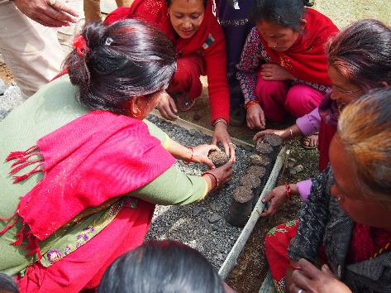
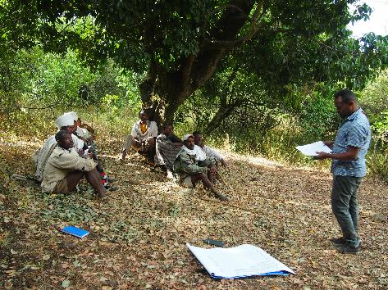
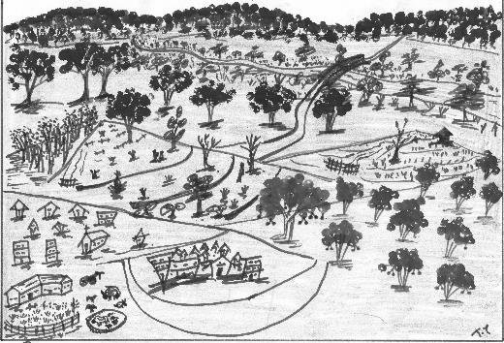

Topic 2:
2.2 Shared motivation & vision with reference to FLR Module 1: Principle 3
Shared motivation for restored landscapes
Common understanding of FLR
Common vision of the restored landscape
Notes:
Shared motivation:
Benefits: improved flow of ecosystem services at different scales expected by a wide range of stakeholders
economic: positive livelihood outcomes, market and non-market values should outweigh costs
social: preservation of cultural values, meeting of international commitments (e.g. NDC)
ecological benefits;
Awareness: knowledge on the benefits of restoration known, potential areas for restoration identified and communicated
Legal trigger: restoration is made a legal requirement (e.g. Hungary after WWI turned from a country rich in forests to a poor one and made afforestation a legal requirement, which raised the forest cover from 9 to 24% within 100 years)
Crisis events: Korea afforestation
Understanding:
Definition: FLR is not only tree planting, but restoration of landscape functions
Approach: Not a top-down centrally planned approach, but a combination of top-down and bottom-up approaches
Trans disciplinary: not only a foresters’ subject
Common vision of restored landscape: result of a visioning exercise documenting the wishes of stakeholders

Slide 15
Topic 2:
2.3 Stakeholder engagement with reference to FLR Module 1: Principle 3
Stakeholder | Involvement category | Role in project | Type of engagement | Frequency of engagement
Forest Department | Primary stakeholder | Technical implementer | Implementation, technical advisory | Monthly team meetings, capacity building
FLR facilitators | Primary stakeholder | Lead coordination | Coordination, facilitation, planning, monitoring | Intensive engagement full time
Local farmers | Primary stakeholder | Main beneficiaries | Implementation, labour | Quarterly coordination meetings, awareness programmes
Land owners | Primary stakeholder | Main enablers | Implementation | Awareness campaigns
Timber industry | Secondary stakeholder | Investors | Provide funding | Inform regularly, conduct advocacy

Slide 16
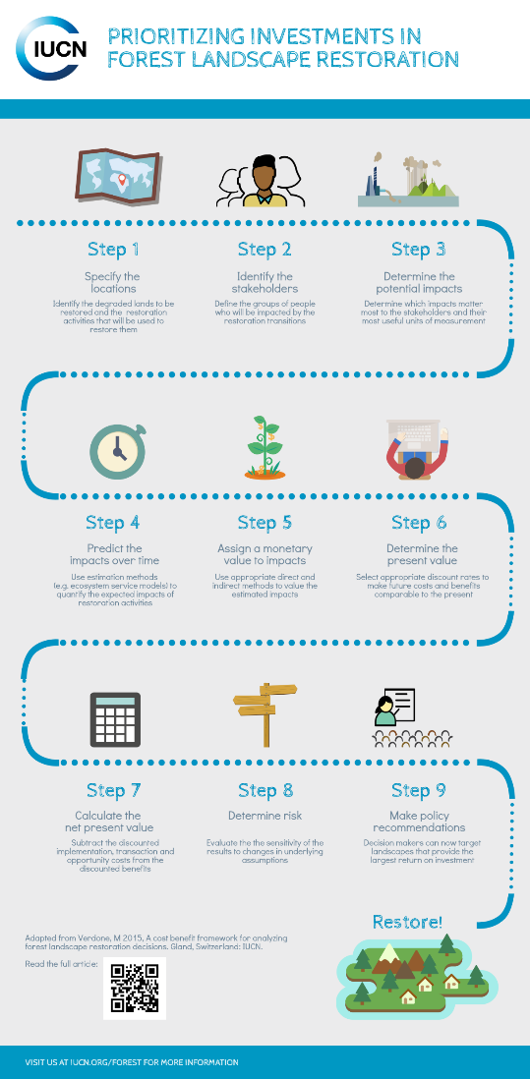
Topic 2:
2.4 Economic viability with reference to FLR Module 1: Principle 5
FLR needs to be economically attractive
Need to ensure early flow of benefits to communities
Public funding will remain insufficient to achieve global restoration targets
Need to increasingly engage private sector
Image caption Photo: [image source information]
Notes:
The economic aspects of the project need to be tackled in the development phase. financial analysis compares benefits and costs to the enterprise, while the economic analysis compares the benefits and costs to the whole economy. Main Difference is the consideration of non-market values (externalities) in the economic analysis.
Some activities will have costs, other will generate revenues. There should be a balance in costs and expected revenues on the overall scale of the project. Commercial restoration has the aim of creating a productive landscape, which can generate revenues and sustain itself and safeguard long-term environmental and social sustainability.
develop financing mechanisms and build an enabling policy and regulatory environment for investors in FLR, which participants viewed as a priority.
Also important, is local landscape coordination leading to more attractive economic returns. Today, there are already substantial annual investments into trees that could be partly shifted towards FLR. The seed capital assistance facility provides a risk‐sharing mechanism for early‐stage FLR development, thus addressing and ultimately overcoming early stage investment barriers.
All in all, embedding FLR in a broader development agenda and looking at FLR as a means to achieve a wide range of development objectives would attract more funding need to integrate forest landscape restoration into the whole value chain of products and servicescreating productive landscapes including agriculture, agroforestry, production forests, and protection of native forests so as to achieve sustainability

Slide 17
Topic 2:
2.5 Enabling policy & regulatory framework with reference to FLR Module 1: Principles 3 and 4
Regulatory instrument | Minimum contents to enable FLR
Policies | Specify FLR as a government priority, possibly linking it to international commitments Define the country’s policy on FLR
Laws | Define & enable FLR Specify jurisdictional hierarchy responsible for FLR Establish tenure rights Enable benefit sharing and dispute resolution mechanisms Incentives for restoration
Regulations | Rules & regulations for implementing FLR Guidelines Additional administrative requirements
Notes:
The enabling policy and regulatory framework consists of three fundamental levels of regulatory instruments
Policies (including strategies, strategic plans, etc.)
Specify FLR as a government priority, possibly linking it to international commitments
Define the country’s policy on FLR
Laws
Define & enable FLR
Specify jurisdictional hierarchy responsible for FLR
Establish tenure rights
Enable benefit sharing and dispute resolution mechanisms
Incentives for restoration
Regulations
Rules & regulations for implementing FLR
Guidelines
Additional administrative requirements

Slide 18
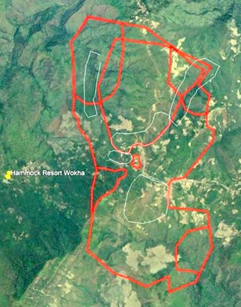
Topic 2:
2.6 Clear and secure tenure with reference to FLR Module 1: Principles 3 and 4
Basis for the sustainability of all land-based interventions, incl. FLR
Unclear tenure:
  Governance challenge
  Conflicts over benefit distribution
  Long-term investments unlikely
Assess land-tenure and try to secure tenure, especially for local stakeholders, as a key issue to allow investments in FLR
Image caption Photo: [image source information]
Notes:
Clear and secure tenure is a key enabling condition for FLR:
Basis for the sustainability of all land-based interventions, incl. FLR
Unclear tenure:
Governance challenge
Conflicts over benefit distribution
Long-term investments unlikely
Assess land-tenure and try to secure tenure, especially for local stakeholders, as a key issue to allow investments in FLR

Slide 19

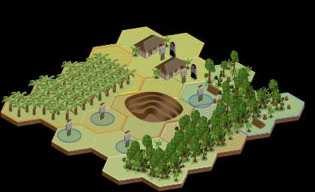

Topic 2:
2.7 Effective (landscape) governance with reference to FLR Module 1: Principle 3
Multiple actors
Multiple functions
Multiple scales
Source: shutterstock.com
Source: Echecopar, Global Comparative Study on REDD+, cifor.org
National level
Provincial level
Sub-basin
Catchment
Sub-watershed
District level
Basin
Watershed
Block level
Village level
Challenge engaging multiple diverse stakeholders
Challenge of sectoral integration
Challenge of crossing administrative boundaries
The concept of landscape governance tries to overcome these challenges by facilitating spatial and integrated decision-making which is multi-actor, multi-sector and multi-scale (GLF Landscape Academy).
Notes:
Multi-functionality of landscapes
Competing claims on the user rights of landscape functions between stakeholders
Range of overlapping claims across the landscape
Governance systems (administrative boundaries) do not match with socio-ecological systems boundaries
Partial/sectoral policies
Policy conflicts
Sectoral silos
Issues across the landscape are dealt with in isolation
Sectoral governance does not provide integrated & spatially explicit landscape solutions!
Spatial segregation
Traditional governance systems address parts/elements of the landscape and do not allow for recognizing interconnectedness

Slide 20
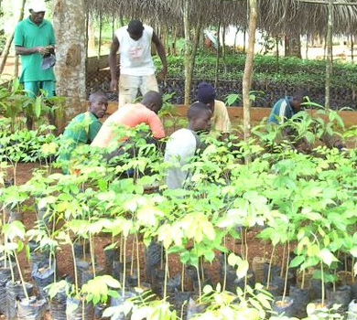
Topic 2:
2.8 Landscape suitability for FLR with reference to FLR Module 1: Principle 2
Source: Louis Bernard
Landscape suitable for restoration:
Ecologically (climate, soils, hydrology, competing vegetation) suitable for restoration
Indigenous planting material available
Empowered local communities
Market forces do not promote competing land use
Existing markets for products from restored areas
Source: Louis Bernard
Image caption Photo: [image source information]
Notes:
Landscapes need to have the following features to be suitable for restoration
Ecologically (climate, soils, hydrology, competing vegetation) suitable for restoration
Indigenous planting material available
Empowered local communities
Market forces do not promote competing land use
Existing markets for products from restored areas

Slide 21
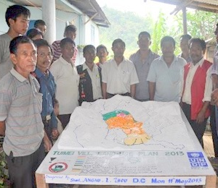
Topic 2:
2.9 Negotiated change logic with reference to FLR Module 1: Principle 6
FLR needs to be tailored to local conditions
Discuss trade-offs & compensation
Refer international best practice guidelines (e.g. IUFRO FLR Practitioner’s Guide)
Landscape-level FLR planning (e.g. through land use planning)
  Determine availability of land for FLR
  Zoning to define spatial location of FLR activities
  Action planning to define roles and responsibilities, resources and timelines
  By-laws to define rules
Notes:
Refer to multiple scales – national, regional, landscape
Negotiated planning for FLR needs to consider
Root causes of forest degradation -> often governance failures.
Scaling up – more actors = further complexity in governance matters.
Tenure and rights – In landscapes , often a range of tenure and rights systems (or even unclear tenure)
Competing land use – Allocating land for forest restoration signifies that land can’t be used for other purposes (e.g. food production or mining) -> unclear or poor governance exacerbates conflicts.
New value is generated - by returning trees and forests to the landscape -> potential for powerful actors taking over landscapes are complex and unique social constructs and as such, integrated landscape and forest landscape approaches require adequate planning and monitoring tools at the national and local levels. Past experience with broad‐scale restoration has shown the importance of defining and reconciling multiple objectives, a process that begins with well‐defined goals.
There are many available tools for project planning at different scales, but in many cases these may need to be adapted to support FLR implementation. Key messages on FLR project planning and monitoring approaches include the need for local involvement and integration of national, sub‐national and local planning with implementation in a flexible and adaptive manner in order to achieve long‐term success

Slide 22

Topic 2:
References and resources
Mansourian, S., 2017. Governance and forest landscape restoration: A framework to support decision-making. Journal for Nature Conservation 37, 21–30.
Mansourian, S. (2021). Disciplines, Sectors, Motivations and Power Relations in Forest Landscape Restoration. Ecological Restoration 39(1), 16-26. https://www.muse.jhu.edu/article/793656
Stanturf J.A., Kleine M., Mansourian S. et al. (2017/2019/2020). Implementing Forest Landscape Restoration: A Practitioner’s Guide (EN, FR, SP). Available at: https://www.iufro.org/science/special/spdc/netw/flr/flr/pract-guide/

Slide 23
Topic 2:
Small group questions
Which enabling conditions proved to be crucial in your FLR project / an FLR project known to you?
Do all enabling conditions need to be present for FLR to be successful?
Analyse your FLR situation in the context of the different enabling conditions!
Can you initiate FLR in case of insecure land tenure?

Slide 24
Topic 2:
Student assignments
Analyse your FLR project / an FLR project well-known to you in terms of the 12 enabling conditions:
To what extent do local conditions for each of the 12 categories enable / hamper the FLR intervention?
Are there any knock-out conditions which must be in place for your FLR intervention to be successful?
How can you overcome weaknesses in certain enabling conditions in your FLR project?

Slide 25
Topic 3:
Designing an FLR project
  Learning activities:
  Class presentation, small group questions and student assignments.
  Learning outcome:
  By the end of Topic 3, students will be able to understand and design an FLR project applying the project cycle management approach involving phases such as visioning, conceptualising, acting and sustaining. In this way, FLR as an intervention into a social-ecological system becomes more transparent and manageable.

Slide 26
Topic 3:
Designing an FLR project
FLR is a cyclic process with constant feedback loops between:
  Conceptualization
  Implementation and
  Impact assessment of an FLR process
This cycle may be pursued at various scales
Notes:
FLR translates global policy goals into restoration achievements on the ground
FLR is a cyclic process with constant feedback loops between conceptualization, implementation and impact assessment of an FLR process
This cycle may be pursued at various scales
FLR consists of four phases, which are visioning, conceptualizing, acting and sustaining

Slide 27
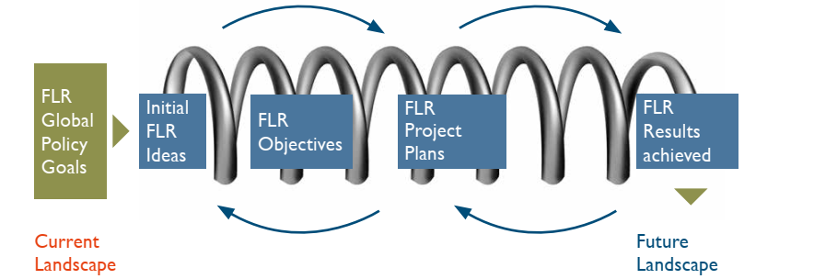





Topic 3:
Designing an FLR project
Source: Stanturf et al. IUFRO 2017
1. Visioning
2. Conceptualising
3. Acting
4. Sustaining

Slide 28
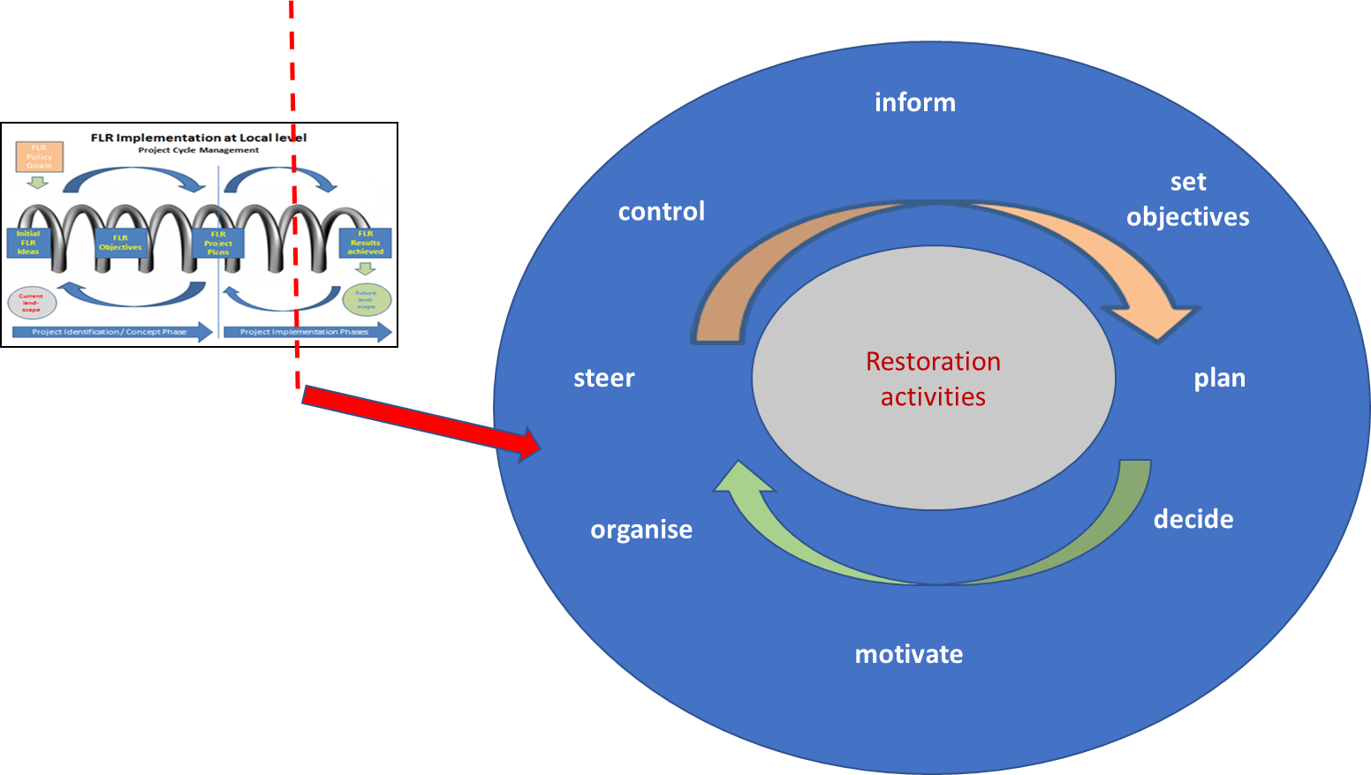
Topic 3:
Designing an FLR project
FLR and the project cycle management framework:
The project cycle management approach provides a useful framework for FLR to account for a constantly evolving socio-economic, political and natural environment
FLR requires constant stakeholder engagement for planning, coordination, and adaptive management
Source: Stanturf et al. IUFRO 2017
Notes:
The project cycle management approach provides a useful framework for FLR to account for a constantly evolving socio-economic, political and natural environment
FLR requires constant stakeholder engagement for planning, coordination, and adaptive management
Monitoring, learning, and redefining targets is a continuous process throughout the FLR project cycle

Slide 29

Topic 3:
3.1 Visioning FLR
Key points to consider for an FLR vision:
Scale - national or landscape
National commitments - Bonn Challenge, LDN Targets, etc.
Context - e.g. tenure
Baseline conditions - landscape “suitability”
Social & Ecological Goals - national or landscape
Notes:
There are Key points to consider for developing an FLR vision
Scale is the vision at the national or the landscape scale?
National commitments does the vision contribute to achieving Bonn Challenge, LDN Targets, etc.
Context is the vision adequate for the context, e.g. tenure?
Baseline conditions How is the landscape “suitability” for FLR?
Social & Ecological Goals Does the vision contribute to national or landscape social and ecological goals?

Slide 30
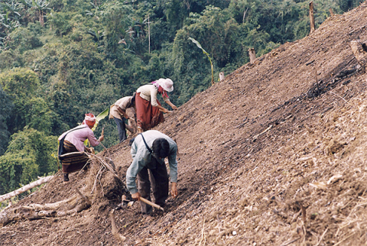
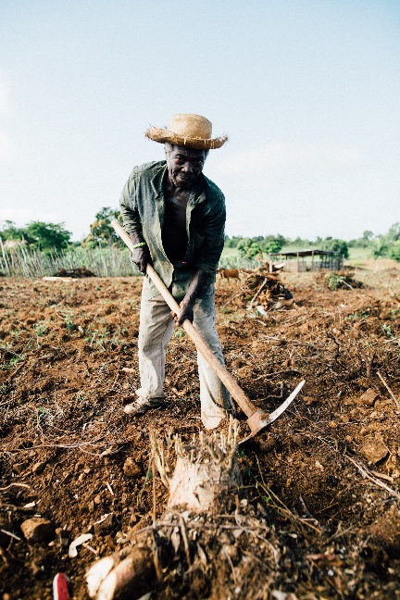
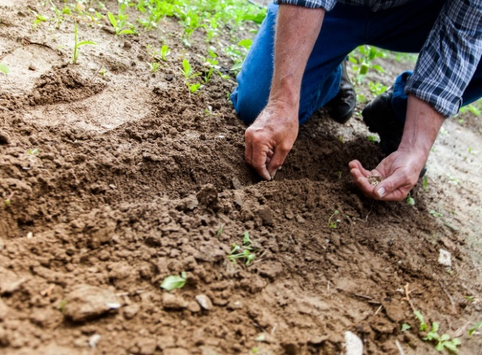
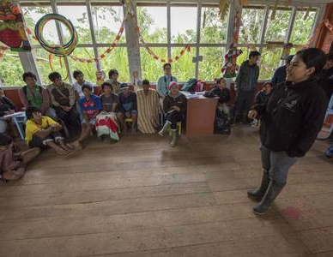
Topic 3:
3.1 Visioning FLR
Source: journals.openedition.org
Tenure
Governance
Job Creation
Alternative Livelihoods
Ecosystem Services
Source: Kelly Lacy, Pexels.com
Free Prior Informed Consent
Participatory Planning
Co-Management
Source: Binyamin Mellish, Pexels.com
Source: FZS Peru
Notes:
In terms of the social context, the need to emphasize local community members is very important.
The FLR vision should ideally pursue livelihood development targets, such as job creation and alternative livelihoods emerging from the FLR process (e.g. new jobs in ecotourism, nurseries, NTFP processing. etc.)
Engagement of local communities needs to follow the principle and procedures of Free, Prior, Informed Consent and the planning of FLR activities needs to engage local communities. In case of government dominated land tenure, comanagement arrangements with local communities are ideal.
The governance and tenure aspects of FLR are essential features. FLR needs to be responsive to local tenure and the setting up of multistakeholder governance arrangements early in the process is important.

Slide 31
Topic 3:
3.2 Conceptualising FLR
Key points to consider for conceptualizing FLR:
Prioritize landscapes & units within landscapes
Turn goals into objectives
Connect starting point with the ending point
Define the causal connection “how to get from point A to B”
Notes:
There are a few key points to consider for conceptualizing FLR
Prioritize landscapes & units within landscapes - this needs to be done along a hierarchic set of criteria in a manner transparent to all stakeholders
Turn goals into objectives - objectives need to be long-term, but measurable in terms of impacts
Connect starting point with the ending point - this is to define the FLR project’s storyline from its starting point to its end point.
Define the causal connection “how to get from point A to B”, also called “Theory of Change”, or “change logic”

Slide 32
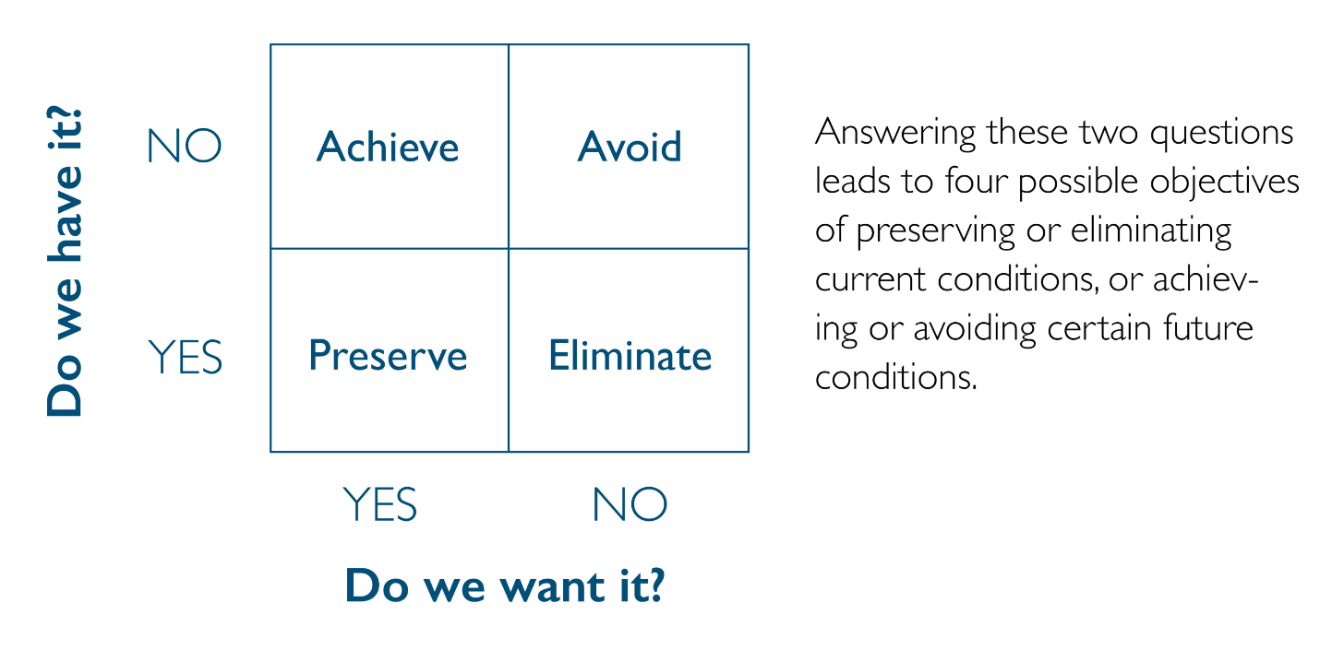
Topic 3:
3.2 Conceptualising FLR
Defining objectives for FLR:
What is the ecosystem baseline and what are the social characteristics?
What needs to be repaired or improved?
What needs to be maintained or preserved?
What are feasible interventions?
Focus on two questions:
Do we have the conditions we want?
Do we want a given condition?
Notes:
When defining objectives, one needs to ask a few helpful questions. These include:
What is the ecosystem baseline and what are the social characteristics?
What needs to be repaired or improved?
What needs to be maintained or preserved?
What are feasible interventions?
It is particularly helpful to focus on two issues:
Do we have the conditions we want?
Do we want a given condition?
The answers to these two questions define the type of objective setting we need. For example, if we have invasive alien species, it is a condition we have, but probably don’t want. This puts us into the category “eliminate” in the small matrix at the bottom right of the slide. So it is helpful to start your objective with the word “Eliminate”.

Slide 33
Topic 3:
3.2 Conceptualising FLR
Example of defining project goals & objectives in the overall project context – South Pacific
 | Goal | Objective | Activity
Meaning | Purpose of FLR project | Accomplishment | Activities that result in accomplishment
Measure | Not measurable/tangible | Measurable | Sequenced list of what, where, when, by whom, at what cost
Timeframe | Long-term | Short to mid-term | Short to mid-term
FLR example | Secure the unique biodiversity of Gau Island, continued provision of ecosystem goods and services from forest ecosystems and build climate change resilience | Restore 20 ha of key riparian and coastal areas around Sawaieke and Navukailagi villages | Activity.1.1 Conduct feasibility study on sites for reforestation (with communities involving Conservation officers, Provincial Office and Ministry of Forestry)

Slide 34

Topic 3:
3.3 Acting FLR
Develop a detailed plan for FLR:
What will be done
Where will it be done?
When will it be done?
By whom will it be done?
At what cost and from whose resources will it be done?
“Action Plan”
Notes:
Next, we get to the “Acting” stage of FLR. Here is where most of the action happens.
The helping questions for the “Acting” phase help you to Develop a detailed planning for FLR
What will be done?
Where will it be done?
When will it be done?
By whom will it be done?
At what cost and from whose resources will it be done?
Once you have the information together to answer all these questions related to one or more specific overarching objectives, you can easily put together an FLR action plan. This will be your blueprint for implementing activities on the ground.

Slide 35
Topic 3:
3.3 Acting FLR
Example of an action plan
Sl. No. | Action | Lead implementer | External assistance | Timeframe
1 | Establish Multi Purpose Tree Nursery for 10000 seedlings | Local community | Forestry Department | December 2020
2 | Carry out contour bunding on 20 ha against soil erosion | Local community | Department of Horticulture Department of Soil and Water Conservation | February 2021
3 | Carry out afforestation on 150 ha | Forest Department Local community Land owners | Department of Soil and Water Conservation NGO | June 2021
4 | Plant leguminous trees in shifting cultivation fallows on 15 ha | Land owners Department of Horticulture | Forest Department | June 2021
5 | Establish horticulture plantation for income generation on 30 ha | Land owners Department of Horticulture | Private investors | June 2022
6 | Avenue Plantation and Landscaping along 5 km of roads | Department of Roads | Forest Department Community Council | June 2021
Notes:
We have just spoken of the FLR action plan. On this slide you can see a simplified version of such an FLR action plan. This contains an overview of activities that need to be implemented, clarifies the area of interventions, responsibilities, collaboration and timeframe. In addition, it is useful to list the proposed budget and the source of funding to this table. Each activity, particularly the larger ones will require subordinate more detailed planning.

Slide 36
Topic 3:
3.3 Acting FLR
Example of defining project activities in the overall project context – South Pacific
 | Goal | Objective | Activity
Meaning | Purpose of FLR project | Accomplishment | Activities that result in accomplishment
Measure | Not measurable/tangible | Measurable | Sequenced list of what, where, when, by whom, at what cost
Timeframe | Long-term | Short to mid-term | Short to mid-term
FLR example | Secure the unique biodiversity of Gau Island, continued provision of ecosystem goods and services from forest ecosystems and build climate change resilience | Restore 20 ha of key riparian and coastal areas around Sawaieke and Navukailagi villages | Activity.1.1 Conduct feasibility study on sites for reforestation (with communities involving Conservation officers, Provincial Office and Ministry of Forestry)

Slide 37
Topic 3:
3.4 Sustaining FLR
Key aspects of sustaining FLR:
Monitoring
Adaptive management
Evaluation
Knowledge management
Capacity development
Notes:
Next, we get to the “Sustaining” phase of FLR. This phase has a temporal overlap with the Conceptualization and Acting phase, given that monitoring, adaptive management, capacity development and knowledge management are continuous processes that need to accompany implementation. It is not sufficient to think of monitoring once implementation has started or worse, once it has ended.

Slide 38
Topic 3:
3.4 Sustaining FLR
Example of sustaining in the overall project context – South Pacific
 | Goal | Objective | Activity
Meaning | Purpose of FLR project | Accomplishment | Activities that result in accomplishment
Measure | Not measurable/tangible | Measurable | Sequenced list of what, where, when, by whom, at what cost
Timeframe | Long-term | Short to mid-term | Short to mid-term
FLR example | Secure the unique biodiversity of Gau Island, continued provision of ecosystem goods and services from forest ecosystems and build climate change resilience | Restore 20 ha of key riparian and coastal areas around Sawaieke and Navukailagi villages | Activity.1.1 Conduct feasibility study on sites for reforestation (with communities involving Conservation officers, Provincial Office and Ministry of Forestry)
FLR monitoring | Impact monitoring | Output monitoring | Process monitoring

Slide 39
Topic 3:
References and resources
European Commission, 2004. Project Cycle Management Guidelines. Europe Aid Cooperation Office. 158 p. (available online at https://ec.europa.eu/international-partnerships/system/files/methodology-aid-delivery-methods-project-cycle-management-200403_en.pdf) [accessed on 27 June 2021]
Stanturf J.A., Kleine M., Mansourian S. et al. (2017/2019/2020). Implementing Forest Landscape Restoration: A Practitioner’s Guide (EN, FR, SP). Available at: https://www.iufro.org/science/special/spdc/netw/flr/flr/pract-guide/
Stanturf J. A., Mansourian S., Darabant A. et al. (2020). Occasional Paper No. 33 - Forest Landscape Restoration Implementation: Lessons learned from selected landscapes in Africa, Asia and Latin America, pp 63. Available at: https://www.iufro.org/publications/series/occasional-papers/article/2020/02/14/occasional-paper-no-33-forest-landscape-restoration-implementation-lessons-learned-from-selected/

Slide 40
Topic 3:
References and resources
Example for visioning from Peru titled „Sustained water supply for Apurimac Region”
https://www.youtube.com/watch?v=T152nbRYGcM&feature=youtu.be
Example for sustaining from Ghana:
https://www.youtube.com/watch?v=1kcVIDEN31Q

Slide 41
Topic 3:
Small group questions
What capacities / skills are needed for successful implementation of each of the four phases of designing and implementing FLR?
How would you develop an action plan for implementing your FLR project and what specifically would it contain?
At what stage and in which form do you need to design the monitoring component of your FLR project?
How can you use monitoring in adjusting the actions you implement in your FLR project?

Slide 42
Topic 3:
Student assignments
Design a hypothetical FLR project for your landscape along the four phases of FLR:
Identify a vision for your restored landscape
Define goals and objectives and think of the theory of change for your landscape
Prepare an FLR action plan, taking into account the actions necessary to achieve the targeted objectives
Define monitoring procedures to keep track of progress and impacts

Slide 43
Topic 4:
Innovative technical restoration approaches
  Learning activities:
  Class presentation, small group questions and student assignments.
  Learning outcome:
  By the end of Topic 4, students will have obtained a good overview about the spectrum of technical approaches, methods and tools available to support forest landscape restoration in tropical regions.

Slide 44
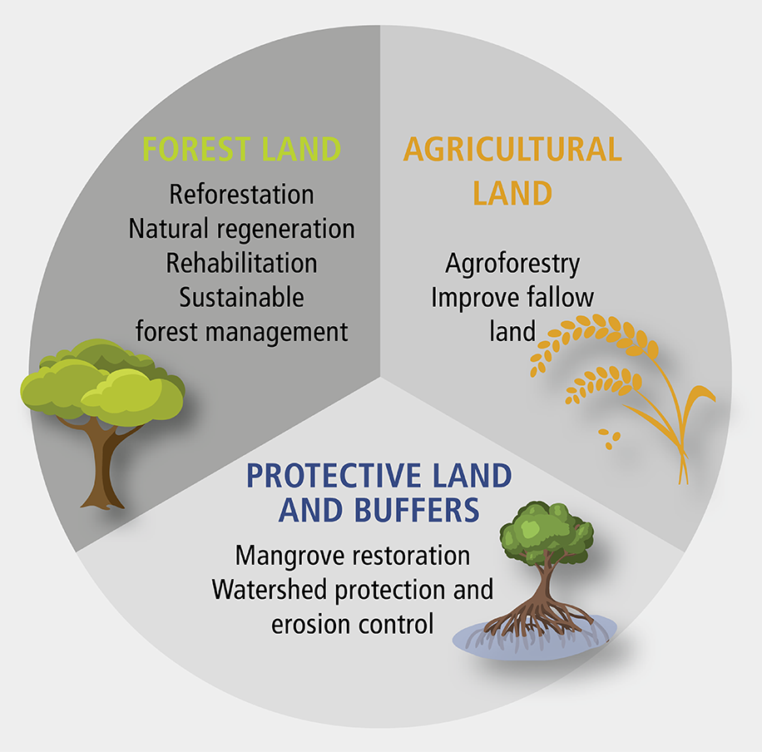
Topic 4:
4.1 Context: Alternative Future Land Use
for Restoring Mosaic Landscapes
Productive agriculture
Mixed agroforestry with woody perennials integrated into crop and livestock systems
Actively managed, productive forests
Passively managed, protected forests
Source: www.globalnpo.org
Notes:
We need to orient ourselves in the context of landscape mosaics to identify options for restored landscapes, which in turn inform viable FLR techniques.
Fundamental distinction needs to be made between forest land, agricultural land and land fulfilling general protective and buffer functions.
Based on our location in the matrix landscape, our targeted restored land use types may include:
Productive agriculture
Mixed agroforestry with woody perennials integrated into crop and livestock systems
Actively managed, productive forests
Passively managed, protected forests, and others.

Slide 45
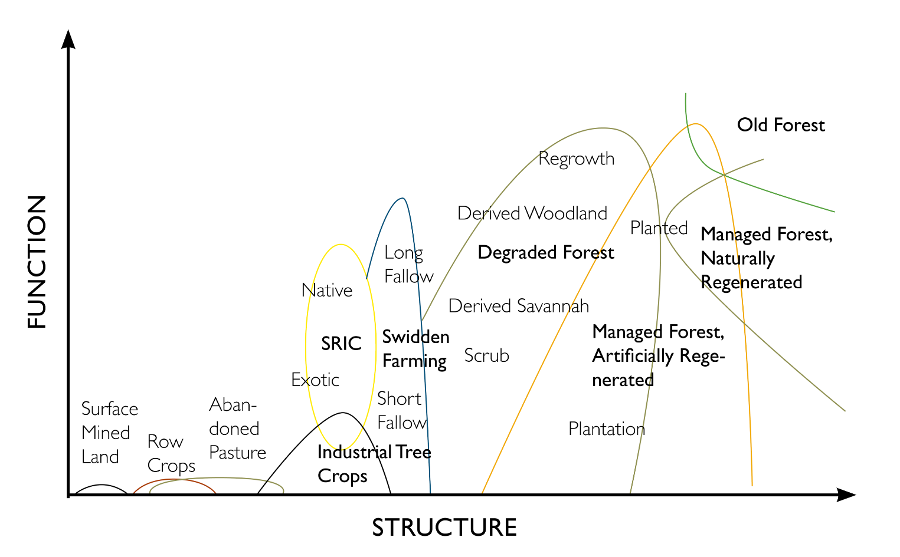
Topic 4:
4.2 Starting Point: Where to Begin,
What to Restore?
Soil/site degradation
% cover
Species composition
Stand or landscape structure
Function
Source: Stanturf et al. IUFRO 2017
Notes:
We need to identify what we want to restore or rehabilitate. Is our intention to bring back the original native vegetation or are we looking at restoring ecosystem functions, possibly through the use of non-native species assemblages?
An assessment of the level of land conditions and of the land use type we are operating in is particularly helpful in this context.
To get an understanding of where we are we may identify the following information:
Soil/Site Degradation
% cover
Species composition
Stand or Landscape Structure
Function
This will help us to determine our starting point from where it is easier to define our target point.
We may for example be in a managed forest that is artificially regenerated and our target may be to transition to natural regeneration. Or we may be in a landscape of intensive swidden farming that we may want to restore through extended fallow periods into degraded forest.

Slide 46
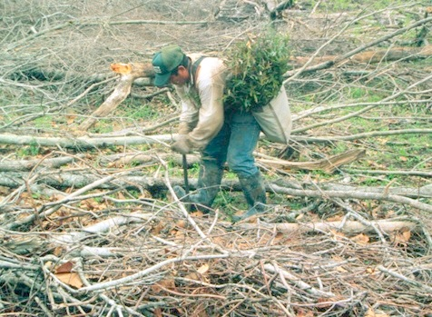
Topic 4:
4.3 Passive vs. active techniques
Passive Approaches:
Natural Regeneration
Farmer Assisted Natural Regeneration
Active Approaches:
Artificial Regeneration (planting)
No forest cover
  Agroforestation
  Afforestation
Degraded cover
  Manipulate structure
  Manipulate composition
How much of the landscape to be treated
Planting designs vary
Source: Brian Lockhart, USDA Forest Service, Bugwood.org
Notes:
FLR technologies can be classified into passive and active approaches.
Options for passive approaches include:
Natural Regeneration
Farmer Assisted Natural Regeneration
Active approaches on the other hand include
Artificial Regeneration (planting)
No forest cover
Agroforestation
Afforestation
Degraded cover
Manipulate structure
Manipulate composition
How much of the landscape to be treated
Planting designs vary

Slide 47
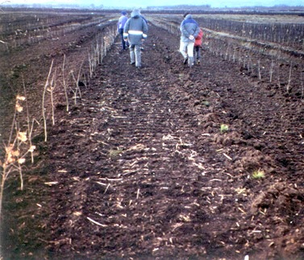
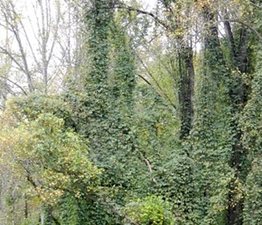
Topic 4:
4.4 Manipulating Vegetation
Remove unwanted vegetation
Add vegetation by passive means
  Natural regeneration/native recolonization
Add vegetation by active means
  Direct seeding
  Planting
  Combination
Source: Patricia M. Ciesla, Forest Health Management International, Bugwood.org
Source: John A. Stanturf
Notes:
Most FLR interventions will include manipulation of vegetation. There are several conceptual options for this that include techniques to:
Remove unwanted vegetation
Add vegetation by passive means
Natural regeneration/native recolonization
Add vegetation by active means
Direct seeding
Planting
Combination

Slide 48
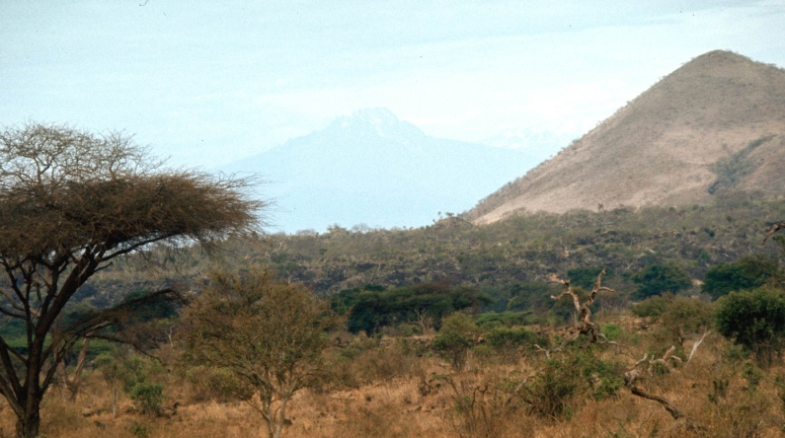
Topic 4:
4.5 Natural Regeneration
Positives:
Minimizes restoration costs
Secures locally adapted genotypes
Promotes development of natural biodiversity
Negatives:
Source of desired species has been eliminated or too far away
Altered edaphic, hydrologic or climatic conditions can prevent natural establishment of regeneration
Local genotypes may not be adapted to future climate
Lack of activity may be misinterpreted
Source: Kenneth M. Gale, Bugwood.org
Notes:
Natural regeneration and other nature-based solutions should be given preference to other methods for reasons of cost efficiency, environmental sustainability, adaptiveness and resilience against external stressors.
The advantages of natural regeneration include:
Minimizes restoration costs
Secures locally adapted genotypes
Promotes development of natural biodiversity
Natural regeneration also has disadvantages that include:
Source of desired species has been eliminated or too far away
Altered edaphic, hydrologic or climatic conditions can prevent natural establishment of regeneration
Local genotypes may not be adapted to future climate
Lack of activity may be misinterpreted

Slide 49
Topic 4:
References and resources
Stanturf J.A., Kleine M., Mansourian S. (Eds.), (2017/2019/2020). Implementing Forest Landscape Restoration: A Practitioner’s Guide (EN, FR, SP). Available at: https://www.iufro.org/science/special/spdc/netw/flr/flr/pract-guide/
Stanturf, J.A., Kleine, M., Mansourian, S., Parrotta, J., Madsen, P., Kant, P., Burns, J., Bolte, A., 2019. Implementing forest landscape restoration under the Bonn Challenge: A systematic approach. Annals of Forest Science 76.

Slide 50
Topic 4:
Small group questions
What restoration techniques are you familiar with in your landscape context?
What land use / land cover types exist across your landscape and what restoration techniques can be applied on them?
Please analyse the financial and economic costs and benefits of natural versus artificial regeneration in your FLR context!
What ecosystem functions would you like to restore in your landscape and what technologies are most appropriate to achieve these?

Slide 51
Topic 4:
Student assignments
Building on the landscape analysis exercise conducted under Topic 1, and the hypothetical FLR implementation plan prepared under Topic 4, identify the best suited restoration approaches and tools for each landscape element in your landscape
For each restoration approach / tool, list opportunities and challenges
Identify how to overcome the challenges for successful implementation of each of the approaches

Slide 52
Topic 5:
Monitoring short- and long-term restoration progress and impact
  Learning activities:
  Class presentation, small group questions and student assignments.
  Learning outcome:
  By the end of Topic 5, students will understand the rationale for monitoring FLR and be familiar with the methods and tools of cost effective monitoring. In addition, the role of monitoring in adaptive management as a means to gradually shift to more sustainable land use has been clarified.

Slide 53
Topic 5:
5.1 Purpose of monitoring
Need to keep track of progress to show success / failure
To determine whether further action is needed
Keep track of risks & negative impacts for mitigation
Build on knowledge for upscaling
Jointly generate information to build transparency & trust
Report to investors
Communicate results
Notes:
Purpose of monitoring:
Need to keep track of progress to show success / failure
To determine whether further action is needed
Keep track of risks & negative impacts for mitigation
Build on knowledge for upscaling
Jointly generate information to build transparency & trust
Report to investors
Communicate results

Slide 54
Topic 5:
5.2 Monitoring in FLR
Forest Landscape Restoration:
Slow – long-term
Dispersed – trees in pockets of landscape
Diverse goals – complex social-ecological systems
Need innovative approaches for monitoring, conventional forest monitoring won’t do
Source: Stanturf et al. 2019; WRI 2019
Notes:
Monitoring in FLR has few peculiarities that sets it apart from monitoring of other land-based interventions
FLR is
Slow – which means we look at long time frames
Dispersed – restoration activities are scattered across the landscape. For example, we may plant individual trees in pockets of landscape
Diverse goals – FLR pursues goals that may be of social, environmental and economic nature. FLR deals with natural mosaic landscapes including all its actors- These are complex social-ecological systems
As a result, FLR needs innovative monitoring mechanisms and conventional forest monitoring systems alone are not adequate to answer all monitoring questions of FLR

Slide 55
Topic 5:
5.2 Monitoring in FLR
FLR monitoring scales
National / regional level FLR monitoring
FLR project monitoring
Bonn Challenge commitment reporting
National strategic priorities tracking
Strategic allocation of resources
Strategic spatial planning
Achievement of local priorities
Process monitoring
Impact monitoring
Accountability towards funders
Tool for adaptive management
Notes:
There are two fundamental scales in FLR monitoring:
One deals with national or regional level monitoring of FLR and serves the following specific functions:
Bonn Challenge commitment reporting
National strategic priorities tracking
Strategic allocation of resources
Strategic spatial planning
The other deals with project level monitoring of FLR and we will devote substantially more attention to this latter aspect. This focuses on:
Achievement of local priorities
Process monitoring
Impact monitoring
Accountability towards funders
Tool for adaptive management

Slide 56
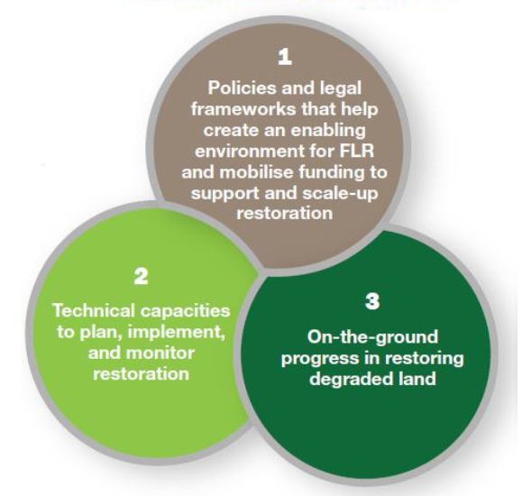
Topic 5:
5.3 National level in FLR monitoring
Example: IUCN Bonn Challenge Barometer
Monitors progress in terms of:
Policies & institutions
Financial flow
Technical planning
Restoration monitoring
Capacity assessment
Hectares under restoration
Climate mitigation
Biodiversity impacts
Socio-economic impacts
Source: IUCN 2017
Notes:
For monitoring of FLR at the national level a prominent examples is the IUCN Bonn Challenge Barometer, which tracks progress in terms of :
Monitors progress in terms of:
Policies & institutions
Financial flow
Technical planning
Restoration monitoring
Capacity assessment
Hectares under restoration
Climate mitigation
Biodiversity impacts
Socio-economic impacts

Slide 57
Topic 5:
5.4 Project monitoring in FLR
Capture results at different spatial and temporal scales:
Type | Contents
Impact Monitoring | Achievement of social, economic & ecological goals & objectives, including changes of biophysical conditions frequently based on surveys
Process Monitoring | Keeping track of implementing on-going project activities e.g. of implementing annual work plan
Goal
targets
Objectives
targets
Outcomes
Results chain
targets
Outputs
targets
!
Inputs / activities
targets
Notes:
At the scale of FLR project monitoring, monitoring captures results at different spatial and temporal scales along the results chain. The fundamental types of FLR project monitoring include impact monitoring and process monitoring. Impact monitoring tracks results at the level of Objectives, Outcomes and Outputs, whereas process monitoring mostly operates at the level of activities and to some extent at the level of Outputs.
Impact monitoring tracks the Achievement of social, economic & ecological goals & objectives, including changes of biophysical conditions frequently based on surveys
Process monitoring on the other hand keeps track of implementing on-going project activities e.g. of implementing annual work plan

Slide 58
Topic 5:
5.5 FLR Project Monitoring & RBM
Monitoring integral part of project implementation
Takes place continuously throughout project management cycle
Informs adaptive management
Notes:
Monitoring takes part throughout the FLR project cycle, lessons are continuously learned that lead to the setting of new objectives, the implementation of which once again is tracked and leads to new learning.
Monitoring integral part of project implementation
Takes place continuously throughout project management cycle
Informs adaptive management

Slide 59
Topic 5:
5.5 FLR Project Monitoring & RBM
 | Goal | Objective | Plan
Definition | Purpose of FLR project; not measurable; long-term | Accomplishment; measurable; mid-term | Activities; list of actions; short-term
FLR Example 1 | Restore degraded land along river basin | 20 m buffer along rivers | Plant 100 ha of native species along rivers in Kigali province by end of 2022 by local farmers
FLR Example 2 | Increased forest cover | 3000 ha of new forest established | Plant 100 ha Entrandophragma excelsum in block mixture in Kigali province by 2023
FLR monitoring type | Impact monitoring | Impact monitoring | Process monitoring
Notes:
The slide presents an example of FLR monitoring at various levels of the results hierarchy, consisting of goals, objectives and plans. Goals describe the purpose of the FLR project that is not measurable and has a long time frame.
Discrepancy between 3000 ha of new forest established and the planting of 100 ha results from the fact that only one exemplary activity is listed. The full FLR implementation plan will list several activities, which add up to the achievement of the objective

Slide 60
Topic 5:
5.6 Monitoring of FLR projects
Strategic monitoring integral part of FLR - informs adaptive management:
Agree on goods and services that forests should provide (impacts)
Identify what to monitor (develop criteria related to objectives)
Define indicators / metrics
Establish baseline & define targets
Establish threshold points where further intervention is needed (e.g. seedling survival)
Develop a sampling design (measure indicators of the selected criteria)
Collect data and analyze
Evaluate results and communicate to stakeholders
Re-evaluate the process for guiding future efforts – adaptive management
Notes:
Strategic monitoring integral part of FLR: informs adaptive management
Agree on goods and services that forests should provide (impacts)
Identify what to monitor (develop criteria related to objectives)
Define indicators / metrics
Establish baseline & define targets
Establish threshold points where further intervention is needed (e.g., seedling survival)
Develop a sampling design (measure indicators of the selected criteria)
Collect data and analyze
Evaluate results and communicate to stakeholders
Re-evaluate the process for guiding future efforts – adaptive management

Slide 61
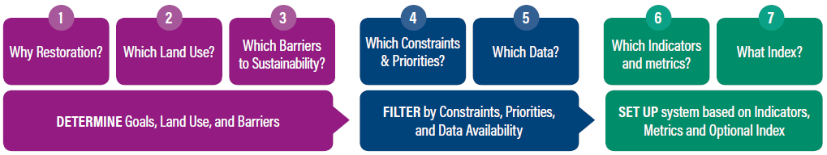
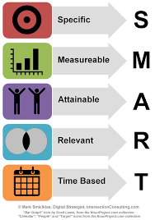
Topic 5:
5.7 Operationalization of monitoring
Steps to identify priorities & indicators for FLR monitoring:
Source: WRI 2019
Goals & objectives must be clear
Data availability, costs, human & technological constraints must be assessed
Indicators to be defined – need to be “SMART”
Notes:
Monitoring needs to be objective and therefore requires a transparent metric. Once clear objectives have been defined, the availability and usefulness of data needs to be considered. Based on this, indicators need to be defined that fulfil so-called SMART criteria.
Goals & objectives must be clear
Data availability, costs, human & technological constraints must be assessed
Indicators to be defined – need to be “SMART”
SMART stands for “specific”, “measurable”, “attainable”; “relevant”; and “timely”.

Slide 62
Topic 5:
5.8 Key FLR monitoring lessons
Explicitly state the objectives of monitoring
Engage stakeholders in design & implementation of monitoring
Provide adequate funding
Collect only as much data as needed and will be used for analysis
Use results to influence management decisions (i.e., adaptive management framework)
Don’t get confused with the many proposed frameworks out there – learn from them and devise the best for your situation!
Notes:
Key FLR monitoring lessons include:
Explicitly state the objectives of monitoring
Engage stakeholders in design & implementation of monitoring
Provide adequate funding
Collect only as much data as needed and will be used for analysis
Use results to influence management decisions (i.e., adaptive management framework)
Don’t get confused with the many proposed frameworks out there – learn from them and devise the best for your situation!

Slide 63
Topic 5:
References and resources
Restoration Opportunities Assessment Methodology (ROAM). Available at: https://www.iucn.org/theme/forests/our-work/forest-landscape-restoration/restoration-opportunities-assessment-methodology-roam
Forest Landscape Assessment Tool (FLAT), a set of tools for determining ecological conditions and potential threats to forest ecosystems. Available at: https://www.treesearch.fs.fed.us/pubs/53245
Stanturf J.A., Kant P., Lillesø J.-P.B., Mansourian S., Kleine M., Graudal L. and Madsen P., 2015. Forest landscape restoration as a key component of climate change mitigation and adaptation. Vienna: IUFRO World Series Volume 34. 72 p.
https://files.wri.org/d8/s3fs-public/mapping-together.pdf

Slide 64
Topic 5:
Small group questions
Can you list a few examples of SMART indicators?
How would you approach designing the monitoring framework for your FLR project?
What are examples for impact indicators in your FLR project?
What are examples for process indicators in your FLR project?

Slide 65
Topic 5:
Student assignments
For your hypothetical FLR implementation plan prepared under Topic 4, define a list of SMART indicators to keep track of the achievement of objectives.
For each indicator, define the mode and frequency of their measurement

Slide 66




Module 2:
Credits
Module 2 was developed for ITTO and IUFRO under the GEF-approved project “Fostering Partnerships to Build Coherence and Support for FLR”, which supports the Collaborative Partnership on Forests (CPF) Joint Initiative on FLR.
The following institutions and people collaborated on this module:
Institutions: International Union of Forest Research Organizations (IUFRO)
Contributors: Dr. Andras Darabant, Janice Burns (MSc.), Prof. Dr. John A. Stanturf
Layout supporter: Shona Smith
Reviewer: Dr. Michael Kleine
Suggested citation: ITTO-IUFRO FLR learning modules (2021)

