Slide 1
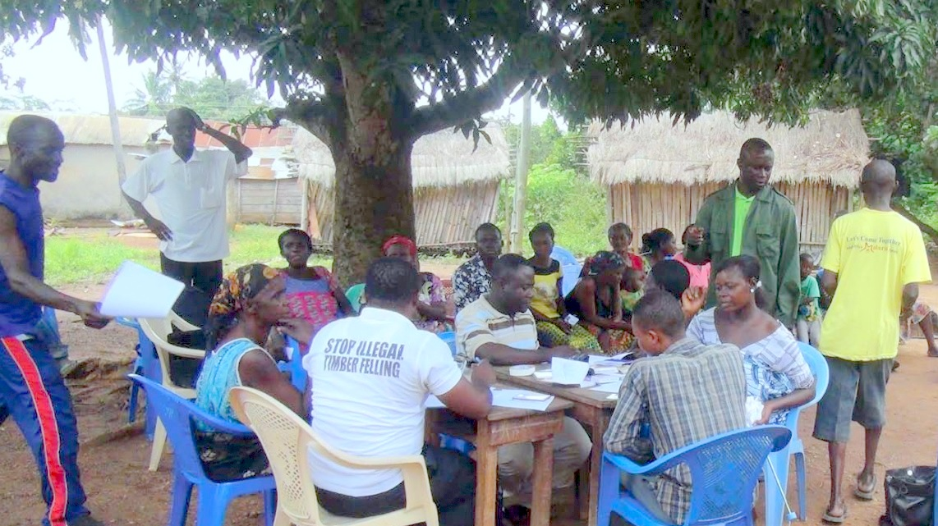
Module 3 |
Forest Landscape Restoration (FLR) Facilitation and Capacity Development
ITTO-IUFRO: FLR Learning Modules

Slide 2


Module 3:
Objective
  Learning level:
  Students at high schools, training centres and universities.
  Learning objective:
  Present the capacities at all levels required for successful FLR, and share promising approaches to capacity building programmes targeting different audiences involved in restoration activities.

Slide 3

Module 3:
Outline
Overview
TOPIC 1: International FLR initiatives
TOPIC 2: Capacities for FLR
TOPIC 3: Operating spaces in FLR
TOPIC 4: Governance
TOPIC 5: Field implementation
TOPIC 6: FLR facilitation
Summary
Credits

Slide 4
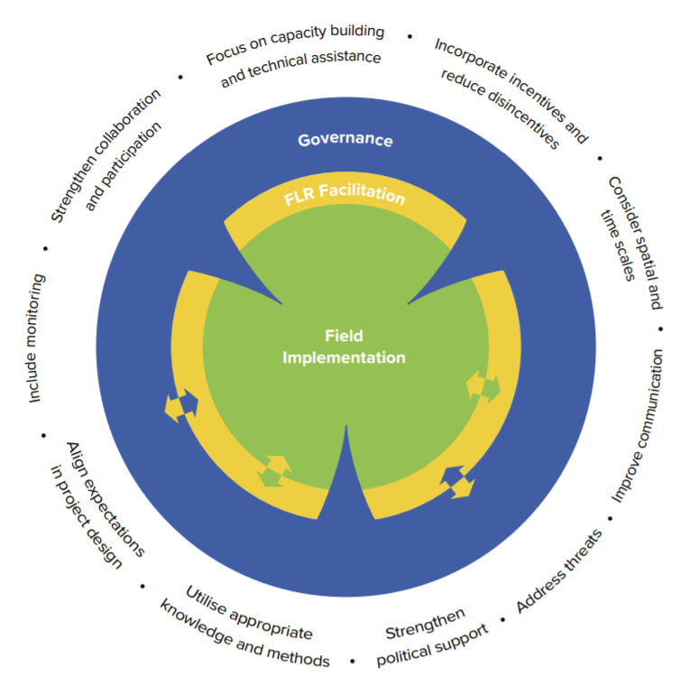
Module 3:
Overview
Ten global lessons learned in FLR implementation
Implications for practice in three operating spaces:
  Governance
  FLR Facilitation
  Field Implementation
Three operating spaces help to better frame the overall challenge of FLR implementation
Source: Stanturf et al. 2020
Notes:
This module is structured around IUFRO’s global snapshot study of FLR implementation on the ground, published in Stanturf et al. 2020. The study synthesizes 10 lessons learned in FLR implementation from 9 countries across the globe and their implications for practice in three operating spaces of FLR: governance, FLR facilitation and field implementation
Viewing capacity needs and interventions in FLR in the framework of three operating spaces can help to better frame the overall challenge of FLR implementation

Slide 5
Topic 1:
International FLR initiatives
  Learning activities:
  Class presentation, small group questions and student assignments.
  Learning outcome:
  By the end of Topic 1, students will be familiar with the global context for FLR related to land use, climate change and biodiversity conservation agendas.

Slide 6
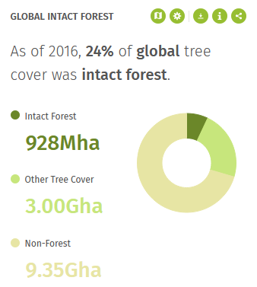
Topic 1:
International FLR initiatives
Rationale for ecosystem restoration:
Restoration as a global answer to address
Climate Change:` Paris Agreement
Biodiversity loss: Post-2020 GBF
Land degradation: LDN targets
Socio-economic impacts: SDGs
Large areas theoretically available for restoration
Source: Global Forest Watch, 2016

Slide 7
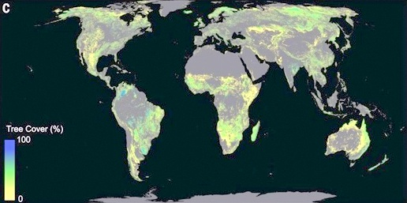
Topic 1:
International FLR initiatives
Source: Robin Chazdon & Pedro Brancalion, Science 05 July 2019

Slide 8


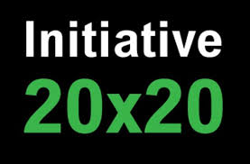


Topic 1:
1.1 FLR as a global movement
Bonn Challenge: Global commitment to restore 150 million ha by 2020 and 350 million ha by 2030
Regional offsprings in Africa, Asia, and Latin America
Global Partnership on Forest and Landscape Restoration
Examples of Initiatives

Slide 9



Topic 1:
1.2 UN Decade on Restoration 2021-2030
Emerged out of Bonn Challenge: 2018 El Salvador proposed UN Decade on Restoration in Bonn Challenge high level meeting
Global movement to ramp up restoration and put the world on track for a sustainable future by 2030 (coinciding with SDGs)
Balance ecological, social and developmental priorities in landscapes where different forms of land use interact, fostering long term resilience
Source: unep.org
Source: decadeonrestoration.org
Source: fao.org

Slide 10

Topic 1:
References and resources
Discover #GenerationRestoration and the United Nations Decade on Ecosystem Restoration 2021-2030: https://www.decadeonrestoration.org/
Learn about the Bonn Challenge and various regional restoration initiatives: https://bonnchallenge.org/
Find out how members of the Global Partnership on Forest and Landscape Restoration (GPFLR) act to achieve restoration goals: https://www.forestlandscaperestoration.org/

Slide 11
Topic 1:
References and resources
Watch this 2 minute video showing how GLF Chapters empower communities to connect, share, learn and accelerate action towards sustainable landscapes:
https://youtu.be/Xig4CM8tY2I
Watch this 1 minute video introducing the United Nations Decade on Ecosystem Restoration 2021-2030:
https://youtu.be/2VqZLqyYh44

Slide 12

Topic 1:
Small group questions
Has your country made any commitments under the Bonn Challenge or any of its regional offsprings?
How do you judge the theoretical and practical availability of land for restoration in your country?

Slide 13
Topic 1:
Student assignments
Find out where the fulfilments of commitments under the Bonn Challenge stands right now!

Slide 14
Topic 2:
Capacities for FLR
  Learning activities:
  Class presentation, small group questions and student assignments.
  Learning outcome:
  By the end of Topic 2, students will understand the types of capacities and skills required in FLR.

Slide 15
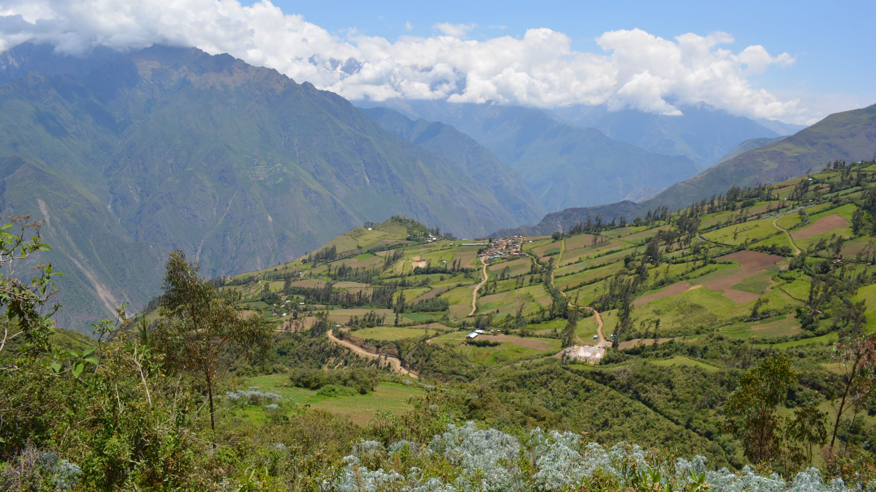

Topic 2:
Capacities for FLR
Leadership
Knowledge
Skills
Communication
Attitude
Institutions
Photo: Peru - HELVETAS Swiss Intercooperation
Notes:
Identify capacity-development needs at the individual and organizational level and propose relevant strategies to meet these needs.
Build capacity-development programmes for relevant stakeholders to undertake planning, implementation and evaluation of FLR efforts.
Develop networks/knowledge platforms (national/regional) between practitioners and extension services in order to disseminate good practices.
Support the establishment and continued capacity strengthening of networks of practitioners and extension services

Slide 16
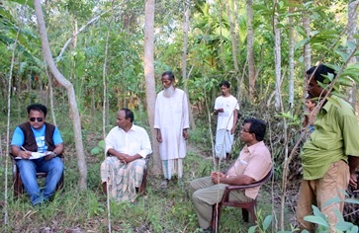
Topic 2.1:
2.1 Forms of Capacity Development
Forms of Capacity Development include:
Multi-stakeholder platforms at local level,
Technical training (e.g. Farmer Field Days)
Field practice in tertiary education
Awareness raising among policy makers and investors
Mentorship programmes for FLR Facilitators
Photo: Bangladesh -- Institute of Forestry and Environmental Sciences, University of Chittagong
Participation of all stakeholders at all levels is critical to the implementation of FLR. Not all stakeholders, however, have the requisite knowledge, resources or systems in place to fully participate and commit to long-term involvement in the transition towards a future non-degrading land use providing more benefits to people and nature.

Slide 17
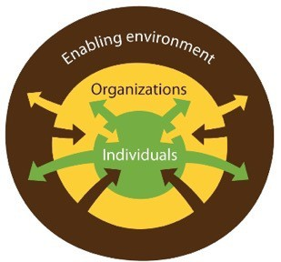
Topic 2:
2.2 System-Wide Restoration Capacities
Individual Capacities
Awareness / Understanding, Knowledge/ Skills / Attitudes
Organizational Capacities
Coordination mechanisms (horizontal and vertical) / Networks / Mandates /
Multi-Sectoral and Stakeholder Dialogue/ Collective Action
Capacity Development
Enabling Environment
Governance (formal and informal)/ implicit and explicit rules / laws and policies / incentives and investments / institutional political economy
Field Implementation/Upscaling
Best land use practices and approaches
based on new and indigenous knowledge,
co-developed by stakeholders
Impact
Source: Adapted from Kalas et al. 2021

Slide 18
Topic 2:
References and resources
Patrick P. Kalas, Cora Van Oosten and Bas van der Schalie. “Unlocking Pathways for System-Wide Capacity Development in African Drylands”. Global Landscapes Forum Africa Session. 2-3 June 2021. Available at: https://www.globallandscapesforum.org/presentation/unlocking-pathways-for-system-wide-capacity-development-in-african-drylands/
Schweizer D. and Ghazoul J. (eds) (2021) “Forests for the future: Restoration success at landscape scale - what will it take and what have we learned?” Prince Bernhard Chair Reports (issue 1). Series editors Almond, R.E.A., Grooten, M. and Van Kuijk, M., WWF-Netherlands, Zeist and Utrecht University, Netherlands. Available at: https://www.uu.nl/en/news/forests-for-the-future-moving-from-paper-commitments-to-real-restoration-impact-at-landscape-scale
Yale Environmental Leadership and Training Initative (Yale ELTI) webinar series entitled “Capacity Development for Forest Landscape Restoration”. Available at: https://www.youtube.com/playlist?list=PLvGT0Qj12s0f9RFxlVtxGWT y8ZH7c2DXW
Notes:
Identify capacity-development needs at the individual and organizational level and propose relevant strategies to meet these needs.
Build capacity-development programmes for relevant stakeholders to undertake planning, implementation and evaluation of FLR efforts.
Develop networks/knowledge platforms (national/regional) between practitioners and extension services in order to disseminate good practices.
Support the establishment and continued capacity strengthening of networks of practitioners and extension services

Slide 19
Topic 2:
References and resources
Gain a deeper understanding of the capacities needed for successful forest landscape restoration in Africa by watching this 90 minute video:
https://youtu.be/Ze63GKE1Edo

Slide 20
Topic 2:
Small group questions
What are key capacities necessary for successful FLR in your context?
What is the distribution of these capacities across key stakeholders?
Which essential capacity gaps can you identify?
Are there any institutions in your country / region that conduct capacity development for FLR?

Slide 21
Topic 2:
Student assignments
How can you build these capacities?
What forms of capacity development could be used?
Develop a mock capacity development plan for FLR that is suitable for your context!

Slide 22
Topic 3:
Operating spaces in FLR
  Learning activities:
  Class presentation, small group questions and student assignments.
  Learning outcome:
  By the end of Topic 3, students will be familiar with three operating spaces for FLR implementation: governance, FLR facilitation; and field implementation. They will be able to identify actors in each operating space and aware of interactions between actors in different spaces.

Slide 23
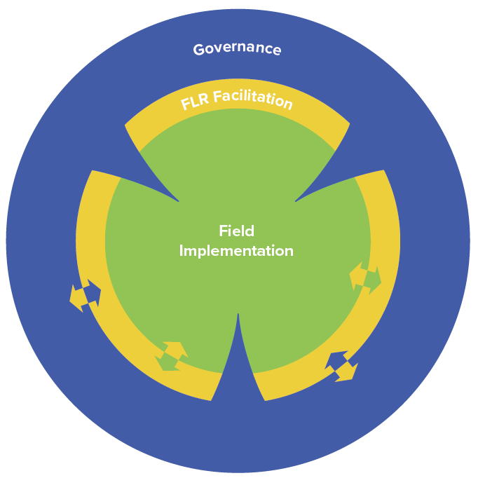
Topic:
3.1 Governance space in FLR
Fundamental to creating the long-term enabling conditions for FLR
Local to international levels
Comprised of actors and institutions involved in decision-making
Source: Stanturf et al. 2020
Image caption Photo: [image source information]
Notes:
Developing capacities in the governance space is key to sensitizing policymakers for the right mix of regulations and policies that need to be in place for local actors to successfully restore land. This helps to create enabling conditions for moving towards sustainable land management practices. The governance space for FLR is fundamental to creating the long-term conditions for FLR. It extends from local through international levels and is comprised of actors and institutions involved in decision-making.
Decision-makers and institutions shape the environment for FLR initiation and implementation. This operating space (indicated in blue) extends from local, regional and national institutions and actors (both governmental and non-governmental; formal and informal) to the international level of the Bonn Challenge and potential funding sources such as the Global Environment Facility (GEF), the Green Climate Fund (GCF), or donor governments.

Slide 24
Topic 3:
3.2 Facilitation space in FLR
Critical intermediary to leverage change
FLR facilitation requires landscape leadership skills
Mentorship programs for FLR facilitators useful
Source: Stanturf et al. 2020
Image caption Photo: [image source information]
Notes:
Developing capacities in the FLR facilitation space helps to prepare FLR facilitators to assist stakeholders in organizing platforms for interaction, reconciliation of conflicting views and planning FLR activities, as well as gathering information, linking actors and monitoring progress.
FLR facilitators are working as change agents in this operating space (indicated in yellow) and may include staff of existing local governmental and non-governmental organisations, such as agricultural extension services, forest and wildlife departments, water departments, forest and agriculture plantation companies, farmers’ associations/cooperatives as well as environmental non-governmental organisations (NGOs) and advocacy groups. They initiate FLR projects and assist actors in the field implementation space and governance space by applying best practices in FLR implementation such as those described in the FLR process guidelines developed by IUFRO (Stanturf et al., 2017).
The facilitation space is a critical intermediary where change agents – FLR facilitators – can leverage and multiply actions. Mentorship programs for FLR facilitators provide hands-on learning opportunities that grow confidence, competence, and connections needed to accelerate action on the ground and the shift to long term sustainable land use.

Slide 25
Topic 3:
3.3 Field implementation space in FLR
Various stakeholders act to restore landscapes
Role, interest and preferences of local stakeholders are fundamental
Incentives must outweigh disincentives
Source: Stanturf et al. 2020
Image caption Photo: [image source information]
Notes:
The field implementation space is where local communities act to restore landscapes. The role, interest and preferences of local stakeholders are fundamental to the long-term success of restoration. In this space (indicated in green) local actors are those working in, using, and benefitting from the landscape. In many landscapes, these are members of different communities that may represent different ethnicities or cultures. Governance, tenure, and power relationships may differ, even in neighbouring communities, so that lessons may be perceived differently by stakeholders. Stakeholders, even within a community, commonly differ in their interests and preferences; reaching consensus on actions to take or changes to make requires participatory, systematic procedures to reconcile conflicting interests and objectives.
The ability to share information, articulate interests, reconcile conflicting views and recognise that landscape-level decisions require compromise are fundamental capacities to be developed among participating local actors. Besides developing social skills, the FLR process also aims at learning and information sharing on ecosystem functioning, new agriculture/forest cultivation technologies and management methods, products, markets and job opportunities. Local actors participating in the FLR process obtain better insights into many aspects of their local ecosystem and social environment, learn from each other and gradually agree on restoration actions to be implemented.
Field implementation space of FLR
Communities, landowners and other stakeholders act to restore landscapes
Role, interest and preferences of local stakeholders are fundamental to the long-term success of restoration
Incentives must outweigh disincentives to ensure local buy-in

Slide 26
Topic 3:
References and resources
Schweizer D. and Ghazoul J. (eds) (2021) “Forests for the future: Restoration success at landscape scale - what will it take and what have we learned?” Prince Bernhard Chair Reports (issue 1). Series editors Almond, R.E.A., Grooten, M. and Van Kuijk, M., WWF-Netherlands, Zeist and Utrecht University, Netherlands. Available at: https://www.uu.nl/en/news/forests-for-the-future-moving-from-paper-commitments-to-real-restoration-impact-at-landscape-scale
Stanturf J. A., Mansourian S., Darabant A. et al. (2020). Occasional Paper No. 33 - Forest Landscape Restoration Implementation: Lessons learned from selected landscapes in Africa, Asia and Latin America, pp 63. Available at: https://www.iufro.org/publications/series/occasional-papers/article/2020/02/14/occasional-paper-no-33-forest-landscape-restoration-implementation-lessons-learned-from-selected/

Slide 27
Topic 3:
References and resources
Watch this 3 minute video about capacity development in governance, FLR facilitation and field implementation spaces in Malawi:
https://www.youtube.com/watch?v=Zbrpqb2HIYU
Notes:
Watch video (Duration 3 Minutes)
Dr. Steve Makungwa presents: CAPACITY BUILDING IN FOREST LANDSCAPE RESTORATION IMPLEMENTATION: A KEY TO SUCCESSFUL RESTORATION IN LILONGWE, MALAWI.
https://youtu.be/Zbrpqb2HIYU
Forest landscape restoration is basically driven by actors in three different operating spaces: governance; FLR facilitation; and field implementation. Viewing capacity needs and interventions in FLR in the framework of three operating spaces can help to better frame the overall challenge of FLR implementation. Given the diversity of actors involved in FLR, it is important to consider the interactions between these operating spaces. More specifically, exchange of information between actors in the three operating spaces and mutual learning are fundamental elements in the FLR process, eventually leading to desired changes in land management.

Slide 28
Topic 3:
Small group questions
Key questions to be asked for each FLR stakeholder:
Why interact with certain stakeholders in each of the three operating spaces? Why are they important for FLR within a defined local context? What can they contribute to the big picture?
How could their actions contribute to FLR? How might their individual goals be integrated with social goals? How might they be equipped with tools that help them reach their goals?

Slide 29
Topic 3:
Student assignments
What main messages should be conveyed to exemplary actors in each of the three operating spaces?
How might you approach different actors in each operating space?
Which media, means of communication could be suitable?
Which type of language (formal/complicated/simple), scope and conceptualisation are relevant for engaging with them about issues relevant to their day-to-day life?

Slide 30
Topic 4:
Governance
  Learning activities:
  Class presentation, small group questions and student assignments.
  Learning outcome:
  By the end of Topic 3, students will be able to describe how decision makers can:
  Strengthen participation and collaboration
  Incorporate incentives and reduce disincentives, and
  Strengthen political support.

Slide 31
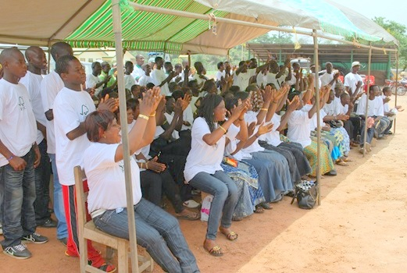
Topic 4:
Governance
Global key lesson 1: Strengthen participation and collaboration
Acknowledge and engage local leaders
Establish and promote collaborative platforms
Engage with stakeholders across multiple sectors
Form strategic partnerships and define roles and areas of collaboration
Negotiate trade-offs and compromises
Photo: Ghana - Form Ghana/ Forestry Research Institute of Ghana
Image caption Photo: [image source information]
Notes:
Collaboration and participation are the cornerstones of FLR as multiple stakeholders share an interest in the landscape to be restored. Engaging stakeholders to collaborate and negotiate tradeoffs and compromises, especially when restoration requires changes in land use, requires effort and skill (Jones and Dudley, 2005; Emborg et al. ,2012). For FLR to be successful, many actors at different levels must be motivated to collaborate towards joint objectives.
Global key lesson 1: Strengthen participation and collaboration
Acknowledge and engage local leaders
Establish and promote collaborative platforms of stakeholders with interest in the landscape
Engage with stakeholders across multiple sectors, particularly through institutionalised stakeholder platforms
Form strategic partnerships, to build trust among stakeholders and to define roles and areas of collaboration
Negotiate trade-offs and compromises, especially when restoration requires changes in land use

Slide 32
Topic 4:
Governance
Global Key Lesson 1: Strengthen participation and collaboration
Example: Telangana (India) State Reforestation Programme:
Robust institutional arrangements
State-level coordination committee provided coordination and oversight of village level committees to implement and monitor restoration
Image caption Photo: [image source information]
Notes:
Global Key Lesson 1: Strengthen participation and collaboration
Example: Telangana (India) State Reforestation Programme
Robust institutional arrangements were made for implementation of the FLR programme
State-level coordination committee provided coordination and oversight of Haritha Rakshana Committees (green protection committees) at the village level to implement restoration and monitor the maintenance and survival of the plantations

Slide 33
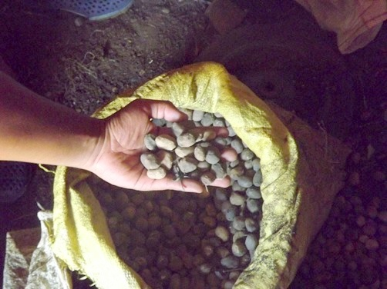
Topic 4:
Governance
Global Key Lesson 2: Incorporate incentives and reduce disincentives
Identify conflicting state-level incentives and address them
Recognise that local level by-laws can secure buy-in from communities
Short-term monetary benefits AND long-term and non-monetary benefits are important
Photo: Madagascar -- ESSA-Forêts/ University of Antananarivo
Image caption Photo: [image source information]
Notes:
Incentives and disincentives for FLR take many forms. Direct benefits are used to motivate participation and mitigate losses. Many direct benefits are financial, however ecological and social benefits are also important. Benefits may be symbolic, such as awards to recognise FLR champions or the contributions of individuals. Improved ecological conditions resulting from FLR can be a strong incentive in addition to direct economic activities.
Global Key Lesson 2: Incorporate incentives and reduce disincentives
Identify conflicting state-level incentives (typically lack of cross-sectoral integration) and work with relevant government bodies to address them
Recognise that local level by-laws can be an effective way of securing buy-in from communities
Direct, short-term monetary benefits receive the greatest attention; however, long-term and non-monetary benefits such as improved ecological conditions represent important incentives

Slide 34
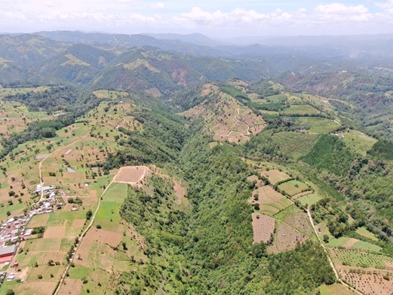
Topic 4:
Governance
Global Key Lesson 2: Incorporate incentives and reduce disincentives
Example: Guatemala
FLR Board created to incorporate diverse stakeholders
Restoration plans must be approved by a registered professional
Communities and small holders struggle with bureaucracy and costs
Photo: Guatemala -- Private Institute for Climate Change Research/ National Forestry Institute
Image caption Photo: [image source information]
Notes:
In Guatemala the creation of an FLR Board and the incorporation of diverse stakeholders have been successful but smallholder forest owners are required to engage registered foresters to prepare the documentation and validation of restoration projects, posing a significant financial barrier. Bureaucracy and costs are a disincentive for participation. Offering technical support or subsidies to smallholders to prepare restoration plans could help to maintain participation and incorporate additional stakeholders. Active participation will be critical to achieving the strategic goals and fulfilling the Bonn Challenge and 20x20 Initiative commitments.
Global Key Lesson 2: Incorporate incentives and reduce disincentives
Example: Guatemala
Restoration plans must be approved by a registered professional at some cost to the community
Communities and small holders struggle with bureaucracy and costs
No government schemes to support funding for preparation of formally required restoration plans

Slide 35
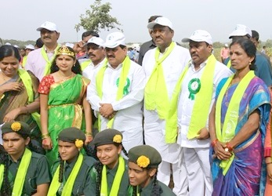
Topic 4:
Governance
Global Key Lesson 3: Strengthen political support
Operating at large-scale requires strong political support
Secure political support for FLR as a cross-sectoral approach
Match appropriate budget allocations with political support
Express political commitment in favour of FLR
Create enabling policy environment for FLR
Photo: India- Forest College & Research Institute, Telangana
Image caption Photo: [image source information]
Notes:
FLR operates at large-scale; as such, strong political support at all levels is necessary for FLR to be initiated and especially for long-term sustainability of FLR initiatives. Political supports signifies, among others, providing an enabling policy framework, ensuring alignment of policies across sectors and ministries, providing timely financial support and more generally, ensuring that the governance framework facilitates rather than hinders FLR implementation. Because landscapes rarely match jurisdictional scales, political support needs to come from the national level, but also from the local level, and requires coordination across these different administrative scales.
Global Key Lesson 3 Strengthen political support
FLR operates at large-scale; as such, strong political support at all levels is necessary
Secure political support for FLR as a cross-sectoral approach
Match appropriate budget allocations with political support
Express political commitment in favour of FLR
Create enabling policy environment for FLR

Slide 36
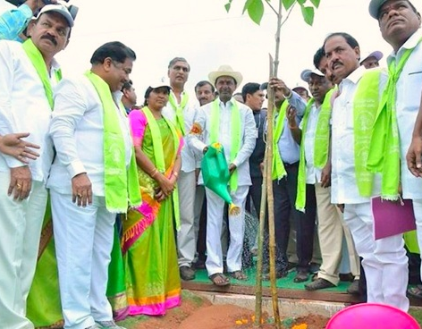
Topic 4:
Governance
Global Key Lesson 3:
Strengthen political support
Example: Telangana
Political “champion” motivates and ensures financing
Personal leadership and commitment of Chief Minister ensured full cooperation
Follow-up by the Chief Minister removed inter-sectoral roadblocks
Political support was mobilised and expressed in statements, through a tree planting campaign, and with planting ceremonies.
Photo: India- Forest College & Research Institute, Telangana
Image caption Photo: [image source information]
Notes:
Global Key Lesson 3: Strengthen political support
Example Telangana
Political “champion” at highest level motivates government agencies and civil society through financing to initiate FLR activities
Personal leadership and commitment of Chief Minister to greening of the state and setting up robust institutional arrangements ensured full cooperation by all government levels
Regular and frequent monitoring of the restoration programme by the Chief Minister helped to quickly remove inter-sectoral roadblocks
Political support was mobilised and expressed in statements by politicians, a tree planting campaign, and with planting ceremonies.

Slide 37
Topic 4:
References and resources
Emborg, J., Walker, G., Daniels, S., (2012). “Forest landscape restoration decision-making and conflict management: applying discourse-based approaches”. In: Stanturf, J., Lamb, D., Madsen, P. (Eds.), Forest Landscape Restoration. Springer, Dordrecht, pp. 131–153.
Djenontin I.N.S., Foli S. and Zulu L.C. (2018). “Revisiting the Factors Shaping Outcomes for Forest and Landscape Restoration in Sub-Saharan Africa: A Way Forward for Policy, Practice and Research”. Sustainability 2018, 10, 906. DOI: 10.3390/su10040906.
Höhl et al. (2020). “Forest Landscape Restoration—What Generates Failure and Success?”. Available at: https://www.mdpi.com/1999-4907/11/9/938.
Jones, S., Dudley, N., (2005). “Negotiations and conflict management. Forest Restoration in Landscapes”. Springer, pp. 126–135.
Mansourian S. (2020). “Enabling factors to scale up forest landscape restoration: the roles of governance and economics”. Available at: https://wwf.panda.org/?1092966/Local-community-engagement-strong- policy-signals-and-long-term-financing-key-ingredients-for-forest-restoration

Slide 38
Topic 4:
References and resources
See this course:
Global Landscapes Forum, Landscape Academy course “Landscape Governance”: https://academy.globallandscapesforum.org/
Watch these videos and interviews:
Guatemala (Reduce disincentives): https://youtu.be/14EDCkZwiv8
India (Strong political support): https://youtu.be/ZvqzoMJbifw
Madagascar (Tenure): https://youtu.be/HBqLLUmVArg

Slide 39
Topic 4:
Small group questions
What are the priorities?
Which policies are supporting the enabling environment?
How can you locate and secure the buy-in of political “champions” for FLR in your context?
Which obstacles exist?
Which capacities could be developed to address the needs?

Slide 40
Topic 4:
Student assignments
What could be some strategies to turn governance challenges into opportunities in your local context?
Describe how decision makers can:
  Strengthen participation and collaboration
  Incorporate incentives and reduce disincentives, and
  Strengthen political support.

Slide 41
Topic 5:
Field implementation
  Learning activities:
  Class presentation, small group questions and student assignments.
  Learning outcome:
  By the end of Topic 5, students will be able to describe how local actors can:
  Align expectations in project design
  Address threats
  Utilise appropriate knowledge and methods

Slide 42
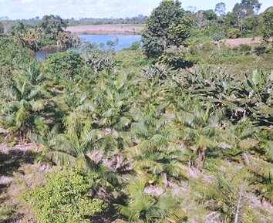
Topic 5:
Field implementation
Global Key Lesson 4:
Align expectations in project design
Stakeholders need to express priorities and constraints to develop realistic land management scenarios
Define and negotiate FLR objectives that incorporate equity, inclusiveness, accountability and transparency
Legitimate claims to resources need to be accommodated or compensated
Divergent interests to be reconciled and managed
Photo: Brazil -- Embrapa Amazônia Oriental, INIAMA
Image caption Photo: [image source information]
Notes:
Different stakeholders within landscapes will have different expectations concerning their use of the land and forests, benefits that they can derive and crucially, concerning the purpose of restoration. Aligning and managing expectations in the design and implementation of an FLR project must balance competing interests and differing priorities for livelihoods versus biodiversity (Maron et al. 2021). Projects must be designed from a comprehensive perspective, addressing the challenges facing local communities embedded in a landscape approach, while at the same time aligning with national goals and commitments.
Global Key Lesson 4: Align expectations in project design
Wide range of stakeholders need to express priorities and constraints to develop realistic future land management scenarios
Define and negotiate FLR objectives that incorporates equity (including gender), inclusiveness (including of vulnerable and disadvantaged groups), accountability and transparency
Legitimate claims to resources need to be considered, accommodated or compensated
Divergent interests to be reconciled and managed through participatory land use planning and conflict management tools

Slide 43
Topic 5:
Field implementation
Global Key Lesson 4: Align expectations in project design
Example: Goa (India)
Cashew trees favoured by communities for income and alcoholic beverages
Cashew was technically not the best species for stabilizing slopes of mining overburden
Cashew nevertheless included in combination with other species to accommodate local expectations
Image caption Photo: [image source information]
Notes:
Sometimes, meeting local expectations for livelihoods requires diverging from an “optimal” technical design. For example, in Goa (India), cashew trees were planted even though cashew was technically not the best species for stabilising slopes of mining overburden. Neighbouring communities wanted as many cashew trees as possible included in the project design because of the income they derived from feni, a locally brewed liquor using cashew fruit. The project planners acceded to this demand and included cashew along with other species more suitable for mine reclamation such as Acacia spp.
Global Key Lesson 4: Align expectations in project design
Example Goa (India)
Cashew trees were favoured by communities because of the income they derived from feni, a locally brewed liquor using cashew fruit
Cashew was technically not the best species for stabilizing slopes of mining overburden
Cashew nevertheless included in combination with other species to accommodate local expectations

Slide 44
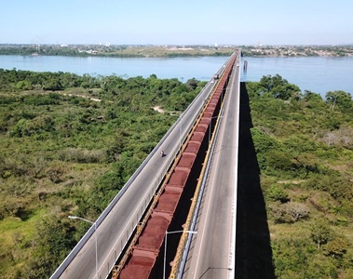
Topic 5:
Field implementation
Global Key Lesson 5:
Address Threats
Ensure addressing the underlying causes of deforestation and degradation
Establish pilot projects to demonstrate alternatives
Set up barriers to degrading activities
Work with authorities to combat exploitative uses of resources
Photo: Brazil -- Embrapa Amazônia Oriental, INIAMA
Image caption Photo: [image source information]
Notes:
Successful FLR requires addressing the underlying causes of deforestation and degradation. Commercial agriculture is the most important proximate driver of deforestation and forest degradation on all continents, but particularly in Latin America. Timber extraction is another important driver, particularly in Latin America and Southeast Asia, while charcoal production has a similar impact in Africa. Ongoing degradation is difficult to overcome but direct threats may actually be easier to reverse in the short-term if underlying threats are absent.
Global Key Lesson 5: Address Threats
Ensure addressing the underlying causes of deforestation and degradation
Establish pilot projects to demonstrate the benefits of alternatives to degrading practices
Help set up temporary or permanent barriers to degrading activities such as grazing, illegal harvesting, unsustainable use of non-timber forest products (NTFPs), etc.
Work with authorities to combat illegal logging, arson fires, and other exploitative uses of resources

Slide 45
Topic 5:
Field implementation
Global Key Lesson 5: Address Threats
Example: Lower Mequi Landscape, Ethiopia
Grazing exclusion agreements with local communities proved essential
Communities agreed to exclude grazing from restored areas
Hired local guards for enforcement
Grass used as fodder in a cut-and-carry system
Image caption Photo: [image source information]
Notes:
Global Key Lesson 5: Address Threats
Example: Lower Mequi Landscape, Ethiopia
Grazing exclusion agreements with local communities proved essential for the success of the restoration activities
Communities reached internal agreements to keep restored areas off limits for grazing and additionally hired local guards who ensured that no cattle trespassed into restored areas
Grass was used as fodder by the local community members in a cut-and-carry system

Slide 46
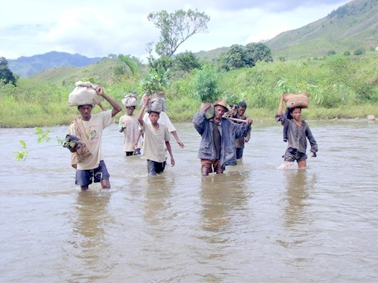
Topic 5:
Field implementation
Global Key Lesson 6:
Utilise appropriate knowledge and methods
Ensure that their indigenous and traditional knowledge is shared and utilised
Combining both western and traditional knowledge can provide a sustainable approach
Photo: Madagascar -- ESSA-Forêts/ University of Antananarivo
Image caption Photo: [image source information]
Notes:
There is an ever-growing resource of western knowledge available for forest landscape restoration. At the same time, traditional knowledge related to forests and restoration, handed down from generation to generation, continues to be relevant, particularly in tropical regions (Lake et al., 2018). Combining both in many cases can provide a more comprehensive approach, that is grounded in local practice and therefore more likely to be accepted and applied in the long term.
Global Key Lesson 6: Utilise appropriate knowledge and methods
Ensure that their indigenous and traditional knowledge related to FLR is shared and appropriately utilised in the design and implementation of FLR interventions
In many cases, combining both western and traditional knowledge can provide a more comprehensive approach, that is grounded in local practice and therefore more likely to be accepted and applied in the long term

Slide 47
Topic 5:
Field implementation
Global Key Lesson 6: Utilise appropriate knowledge and methods
Example: Goa (India)
Benches and terraces of mine dump areas required the expertise of professional geologists
Dump slopes were covered with geotextiles or jute mats for quick stabilisation
Proper drainage of rainwater into settling ponds further prevented runoff and soil erosion
Planting drought-resistant, fast-growing crops varieties accelerated the reclamation process
Once soil fertility improved, native grass species were sown.
Image caption Photo: [image source information]
Notes:
Subtopic 4.3 Utilise appropriate knowledge and methods
Example: Goa (India)
Benches and terraces of mine dump areas required the expertise of professional geologists
Dump slopes were covered with geotextiles or jute mats for quick stabilisation and to prevent soil erosion and gully formation
Proper drainage of rainwater into settling ponds further prevented runoff and soil erosion
Planting drought-resistant, fast-growing leguminous crop varieties accelerated the reclamation process
Once soil fertility improved, native grass species

Slide 48
Topic 5:
References and resources
DeFries, R.S., Rudel, T., Uriarte, M., Hansen, M., (2010). “Deforestation driven by urban population growth and agricultural trade in the twenty-first century”. Nature Geoscience 3, 178–181.
Lake, F., Parrotta, J., Giardina, C., Hunt-Davidson, I., & Uprety, Y. (2018). “Integration of Traditional and Western knowledge in forest landscape restoration”. In: Forest Landscape Restoration, (S. Mansourian and J. Parrotta, Eds.) pp 198–226. Routledge, London.
Maron, M., Hobbs, R.J., Moilanen, A., Matthews, J.W., Christie, K., Gardner, T.A., Keith, D.A., Lindenmayer, D.B., McAlpine, C.A., (2012). “Faustian bargains? Restoration realities in the context of biodiversity offset policies”. Biological Conservation 155, 141–148.

Slide 49
Topic 5:
References and resources
Watch these videos:
Brazil (Find common understanding): https://youtu.be/Z3AYdtJwIkM
Ethiopia (match plans with budget and capacity) https://youtu.be/6e0gzjGBhSw
Peru (start with local priorities): https://youtu.be/T152nbRYGcM

Slide 50
Topic 5:
Small group questions
Which stakeholders may raise unrealistic expectations towards FLR in your landscape and how can you deal with this?
What underlying drivers and main threats do you need to address for the success of FLR in your landscape?
What key knowledge and technologies are essential for successful FLR in your context?

Slide 51
Topic 5:
Student assignments
What could be some strategies to turn field implementation challenges into opportunities in your local context?
Describe how local actors can:
  Align expectations in project design
  Address threats
  Utilise appropriate knowledge and methods

Slide 52
Topic 6:
FLR facilitation
  Learning activities:
  Class presentation, small group questions and student assignments.
  Learning outcome:
  By the end of Topic 6, students will have be able to describe how FLR facilitators can:
  Improve communication
  Consider spatial and time scales
  Include monitoring

Slide 53
Topic 6:
FLR facilitation
Global Key Lesson 7: Improve communication
Include communication in restoration plans and budgets
Shape a communication strategy
Develop tailor-made communication products
Utilise existing communication channels, enriching them with new ones
Use intensive awareness raising programmes
Use local languages for communication
Image caption Photo: [image source information]
Notes:
Effective communication is a key element of successful multi-stakeholder processes. Communication needs to capture both, internal communication between the various stakeholders engaged in the process, as well as external communication to the general public. Communication also entails the pathways and communication products chosen to deliver key messages. Communication cannot be implemented through a one-size-fits-all approach but requires tailor-made pathways, tools, and substantial financial resources. Effectively communicating FLR also needs to ensure that processes are thoroughly documented; lessons learned are distilled and disseminated.
Global Key Lesson 7: Improve communication
Effective communication is a key element of successful multi-stakeholder processes and should be considered in planning and budgeting from the start, and continued throughout the FLR process
shape a communication strategy that identifies the range of stakeholders, assesses their interest and power, and devises specific key messages to be communicated to them.
identify the communication mix, which is the range of communication products used and the frequency and timing of their utilisation.
Develop communication products that are appropriate to the target audiences and carry the key messages that should reach them
Utilise existing traditional communication channels, enriching them with new communication pathways and products
Use intensive awareness raising programmes to orient local communities towards restoration and defuse potential conflicts
Use local languages for communication

Slide 54
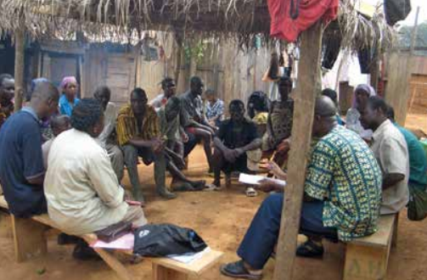
Topic 6:
FLR facilitation
Global Key Lesson 7:
Improve communication
Example: Ghana
Relying on established traditional communication channels
Stakeholder-driven communication process to involve traditional leaders
Communication with and through traditional leaders
Photo: Stakeholder consultations in Offinso District, Ghana. © Ernest Foli
Image caption Photo: [image source information]
Notes:
Global Key Lesson 7: Improve communication
Example: Ghana
Relying on established traditional communication channels proved to be an asset for FLR in Ghana
Stakeholder-driven communication process involved traditional leaders
Communication with and through traditional leaders ensured high level of participation and ultimately the success of the restoration project.

Slide 55
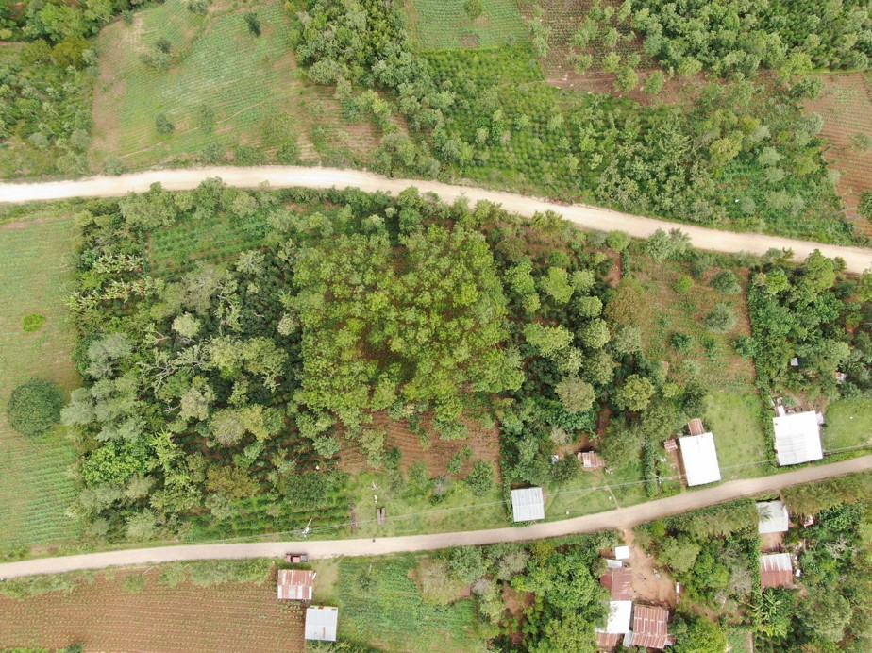
Topic 6:
FLR facilitation
Global Key Lesson 8:
Consider spatial and time scales
Work with institutions at different levels
Ensure that sufficient financing is available for the participatory FLR process and restoration interventions
Encourage donors to consider funding throughout the FLR process
Support effective extension services
Photo: Guatemala -- Private Institute for Climate Change Research/ National Forestry Institute
Image caption Photo: [image source information]
Notes:
Forest landscape restoration is a long-term process occurring at multiple spatial scales. Although the Bonn Challenge commitments run through 2030, restoration will require even longer in order to develop fully functioning landscapes. Spatial scale can be an issue; projects may be too small to be effective or too large to be manageable. Scaling up to landscape-level may require more planting material than is locally available, requiring development of nursery facilities, seed collection, etc. (Stanturf et al., 2017). Effective collaboration across administrative scales is important and frequently requires improvements. Impacts of decisions taken at one level (e.g., national) can be negative at another level (e.g., local village). FLR facilitators interact with frequently with actors in the governance and field implementation spaces to align expectations, match budgets and capacities, and find solutions across different spatial and time scales.
Global Key Lesson 8: Consider spatial and time scales
Work with institutions at different levels to implement long-term FLR processes in specific landscapes
Ensure that sufficient financing is available for both the participatory FLR process and restoration interventions in the field
Encourage donors to consider funding not only the set-up phase of FLR projects but also the management and maintenance phases for the longer term
Support extension workers to effectively reach their target audiences, especially in difficult local contexts

Slide 56
Topic 6:
FLR facilitation
Global Key Lesson 8: Consider spatial and time scales
Example: Brazil Rural Sustentável project
Spatial limitation of FLR projects can be challenging when projects are managed from distance
Project management was based in Brasilia with limited staff in the field, attending to local aspirations was challenging
The project targeted many beneficiaries over distant localities that limited contact time
Image caption Photo: [image source information]
Notes:
Global Key Lesson 8: Consider spatial and time scales
Example: Brazil Rural Sustentável project
spatial limitation of FLR projects can be challenging when projects are managed by an institution in the distant capital
Project management was based in Brasilia with limited staff in the field, attending to local aspirations was challenging
The project targeted a high number of beneficiaries spread over many distant localities that limited contact time between trainers, livelihood experts and participants

Slide 57
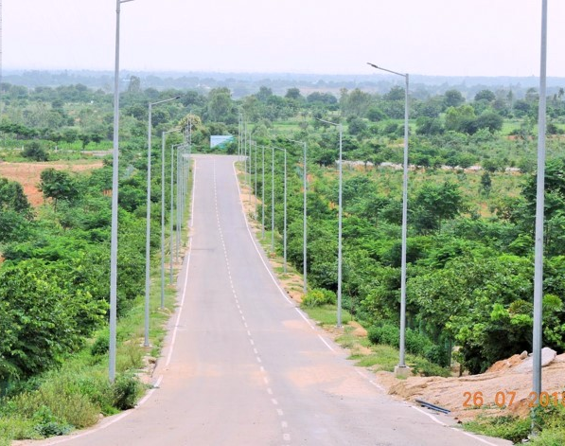
Topic 6:
FLR facilitation
Global Key Lesson 9:
Include Monitoring
Support training in monitoring approaches and techniques
Work with local stakeholders to identify appropriate indicators
Monitoring is essential but funds are often insufficient
Existing monitoring often focuses on process monitoring, more attention is needed to impact monitoring
Photo: India- Forest College & Research Institute, Telangana
Image caption Photo: [image source information]
Notes:
Monitoring short-term and long-term outcomes is essential for successful FLR, but too often, insufficient funds are dedicated to monitoring. Because FLR is a long-term process, success may be apparent only decades following the initial interventions thus long term monitoring is essential. Often process monitoring is implemented to ensure that project actions are carried out as financed, but more attention is needed to include social and cultural effects (Pandit et al., 2020).
Global Key Lesson 9: Include Monitoring
Support training in monitoring approaches and techniques
Work with local stakeholders to identify appropriate indicators to monitor
Monitoring short-term and long-term outcomes is essential for successful FLR, but too often, insufficient funds are dedicated to monitoring
Existing monitoring often focuses on process monitoring to ensure that project actions are carried out as financed, but more attention is needed to include social and cultural effects

Slide 58
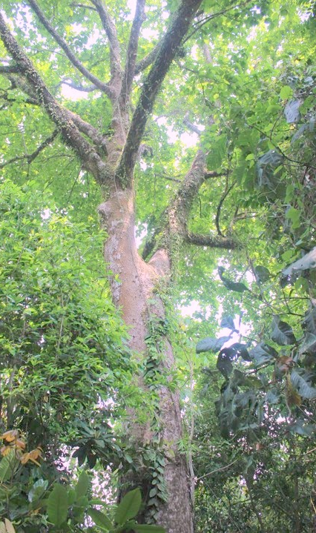
Topic 6:
FLR facilitation
Global Key Lesson 9: Include Monitoring
Example: Chittagong Hills, Bangladesh
Externally funded plantation projects were monitored by IUCN and a consulting firm
After the implementation phase, Forest Management Divisions took over monitoring responsibilities
Village-level monitoring by the panchayat heads and other public representatives assessed survival percentage and work quality
Participatory monitoring data were collected through monthly and annual meetings with the beneficiaries
Public participation in monitoring was instituted by constituting Green Brigades, which included many students, to monitor plantation survival
A tool was developed for periodic assessment of the participating community-based organisations
Photo: Bangladesh -- Institute of Forestry and Environmental Sciences, University of Chittagong
Image caption Photo: [image source information]
Notes:
Global Key Lesson 9: Include Monitoring
Example: Chittagong Hills, Bangladesh
Externally funded plantations projects were monitored by IUCN and a consulting firm that was assigned the task of providing quarterly monitoring reports and a completion report at the end of the project
After the implementation phase, Forest Management Divisions took over monitoring responsibilities
Village-level monitoring by the panchayat heads and other public representatives assessed survival percentage and work quality
Participatory monitoring data were collected through monthly and annual meetings with the beneficiaries
Public participation in monitoring was instituted by constituting Green Brigades, which included many students, to monitor plantation survival
A tool was developed for periodic assessment of strengths and weaknesses of the participating community-based organisations based on measurable indicators related to their legal status, functional dynamism, financial management, organisational management, gender equity, and assets

Slide 59
Topic 6:
References and resources
GLF Landscape Academy at https://academy.globallandscapesforum.org/
GLFx is a global community by the Global Landscapes Forum to enable and accelerate action towards more sustainable landscapes. Members can join independently organized chapters that meet locally to take action. They can also join online communities of practice (CoPs) to share knowledge and learnings.
Knowledge Base of the Forest and Landscape Restoration Mechanism (FLRM) http://www.fao.org/in-action/forest-landscape-restoration-mechanism/knowledge-base/en
Pandit, R., Parrotta, J.A., Chaudhary, A.K., Karlen, D.L., Vieira, D.L.M., Anker, Y., Chen, R., Morris, J., Harris, J., Ntshotsho, P., (2020). “A framework to evaluate land degradation and restoration responses for improved planning and decision making”. Ecosystems and People 16, 1–18.
Stanturf, J., Mansourian, S., Kleine, M. (Eds.), (2017). “Implementing forest landscape restoration, a practitioner’s guide”. International Union of Forest Research Organizations, Vienna, Austria

Slide 60
Topic 6:
References and resources
Watch these videos:
Ghana (communicate to motivate and engage): https://youtu.be/1kcVIDEN31Q
Bangladesh (share the benefits): https://youtu.be/0dGaHg5Eiog

Slide 61
Topic 5:
Small group questions
What steps can an FLR facilitator take to ensure good communication throughout a project?
Why are spatial and times scales important to consider throughout the FLR process?
How can an FLR facilitator help to overcome common weaknesses of monitoring efforts?
Give an example of how monitoring data can help to influence management decisions.

Slide 62
Topic 5:
Student assignments
What could be some strategies to turn FLR facilitation challenges into opportunities in your local context?
Describe how FLR facilitators can:
  Improve communication
  Consider spatial and time scales
  Include monitoring

Slide 63

Module 3:
Summary
Source: Stanturf et al. 2020
Governance space - fundamental to creating the long-term conditions for FLR; extends from local through international levels; involves actors in decision-making
Facilitation space - critical intermediary where FLR facilitators leverage and multiply actions; mentorship programs provide hands-on learning opportunities
Field implementation space - area where local communities act to restore landscapes; buy-in of local stakeholders is fundamental to the long-term success
Notes:
The governance space for FLR is fundamental to creating the long-term conditions for FLR. It extends from local through international levels and is comprised of actors and institutions involved in decision-making
The facilitation space is a critical intermediary where change agents – FLR facilitators – can leverage and multiply actions. Mentorship programs for FLR facilitators provide hands-on learning opportunities that grow confidence, competence, and connections needed to accelerate action on the ground and shift to long-term sustainable land use
The field implementation space is where local communities act to restore landscapes. The role, interest and preferences of local stakeholders are fundamental to the long-term success of restoration

Slide 64
Module 3:
Summary
Choice of intervention will be dictated by the local context and requires adaptive management
Tailor-made communication is needed to unite stakeholders behind a common challenge
Participation of stakeholders at all operating spaces is critical for FLR
Capacities of most stakeholders are limited and their distribution is uneven
FLR facilitators are important catalysers of successful FLR processes
Notes:
Choice of intervention will be dictated by the local context and requires adaptive management to achieve and maintain more resilient and sustainable landscapes in the long-term
Tailor-made communication is needed to bring people from different backgrounds together to address a common challenge
Participation of stakeholders at all operating spaces is critical for FLR
Capacities of most stakeholders are limited and their distribution is uneven
Not all stakeholders need to have all required capacities
FLR facilitators are key for institutional and individual capacity development and the amalgamation of capacities across stakeholders for optimal FLR results

Slide 65
Module 3:
References
Djenontin I.N.S., Foli S. and Zulu L.C. (2018). “Revisiting the Factors Shaping Outcomes for Forest and Landscape Restoration in Sub-Saharan Africa: A Way Forward for Policy, Practice and Research”. Sustainability 2018, 10, 906. DOI: 10.3390/su10040906.
Djenontin I.N.S., Zulu L.C. and Etongo D. (2020). “Ultimately, What is Forest Landscape Restoration in Practice? Embodiments in Sub-Saharan Africa and Implications for Future Design”. Available at: https://www.springerprofessional.de/en/ultimately-what-is-forest-landscape-restoration-in-practice-embo/18395760
Höhl et al. (2020). “Forest Landscape Restoration—What Generates Failure and Success? Results of IUFRO TF survey and insights from Africa”. Available at: https://www.mdpi.com/1999-4907/11/9/938
Mansourian S. (2020). “Enabling factors to scale up forest landscape restoration: the roles of governance and economics”. Available at: https://wwf.panda.org/?1092966/Local-community-engagement-strong-policy-signals-and-long-term-financing-key-ingredients-for-forest-restoration
Schweizer D., Kuik M. and Ghazoul J. (2021). “Perceptions from non-governmental actors on forest and landscape restoration, challenges and strategies for successful implementation across Asia, Africa and Latin America”. Initiative 20x20. Journal of Environmental Management, Volume 286, 112251. Available at: https://initiative20x20.org/publications/perceptions-non-governmental-actors-forest-and-landscape-restoration-challenges-and
Stanturf J.A., Kleine M., Mansourian S. et al. (2019). “Implementing forest landscape restoration under the Bonn Challenge: a systematic approach”. Annals of Forest Science 76, 50. DOI: 10.1007/s13595-019-0833-z.
Stanturf J.A., Kleine M., Mansourian S. et al. (2017/2019/2020). “Implementing Forest Landscape Restoration: A Practitioner’s Guide” (EN, FR, SP). Available at: https://www.iufro.org/science/special/spdc/netw/flr/flr/pract-guide/
Stanturf J. A., Mansourian S., Darabant A. et al. (2020). Occasional Paper No. 33 – “Forest Landscape Restoration Implementation: Lessons learned from selected landscapes in Africa, Asia and Latin America”, pp 63. Available at: https://www.iufro.org/publications/series/occasional-papers/article/2020/02/14/occasional-paper-no-33-forest-landscape-restoration-implementation-lessons-learned-from-selected/

Slide 66




Module 3:
Credits
Module 3 was developed for ITTO and IUFRO under the GEF-approved project “Fostering Partnerships to Build Coherence and Support for FLR”, which supports the Collaborative Partnership on Forests (CPF) Joint Initiative on FLR.
The following institutions and people collaborated on this module:
Institutions: International Union of Forest Research Organizations (IUFRO)
Contributors: Dr. Andras Darabant, Janice Burns (MSc.), Prof. Dr. John A. Stanturf
Layout supporter: Shona Smith
Reviewer: Dr. Michael Kleine
Suggested citation: ITTO-IUFRO FLR learning modules (2021)

