Slide 1
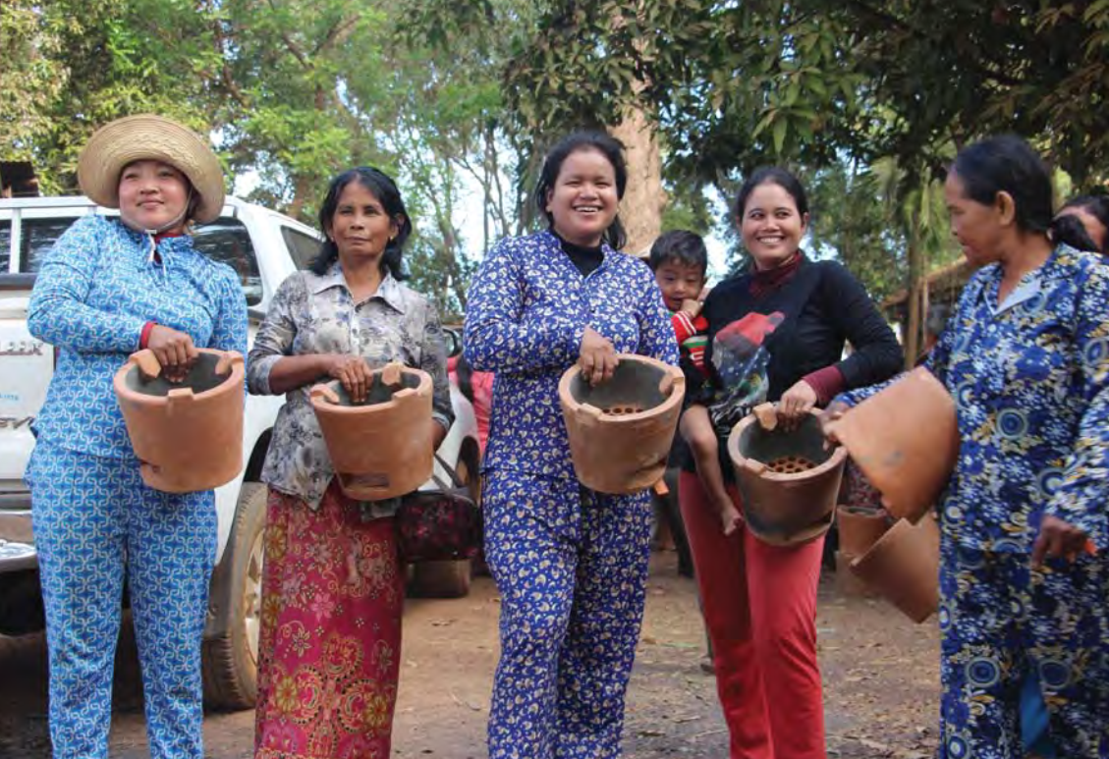
Module 4 |
Securing Forest Landscape Restoration (FLR) Finances
ITTO-IUFRO: FLR Learning Modules

Slide 2


Module 4:
Objective
  Learning level:
  Students at high schools, training centres and universities.
  Learning objective:
  By the end of Module 4, students will understand the type, nature, scale, and sources of domestic and international financing available for forest restoration and allied activities that mitigate climate change and enable adaptation to it.

Slide 3

Module 4:
Outline
Overview
TOPIC 1: FLR Overview
TOPIC 2: Cost of FLR
TOPIC 3: FLR investors
TOPIC 4: Types of financing sources
TOPIC 5: Climate finance for FLR
TOPIC 6: Case studies
Summary
Credits

Slide 4
Module 4:
Overview
Large-scale restoration initiatives are underway to counter global forest loss and degradation
Bonn Challenge (150 million ha by 2020), the New York Declaration on Forests (350 million ha by 2030), and land net degradation neutrality (LDN) by 2030.
New and more effective approaches needed with local communities as primary stakeholders
Partnerships need to be created and consolidated - global and local, public and private, business and civil society, community and government
Task is humongous and so are the costs - the affected countries can not afford the costs

Slide 5
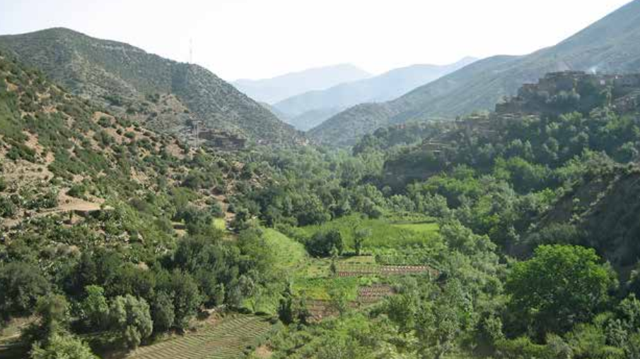
Module 4:
Overview
A landscape reaping the fruits of restoration. Thousands of such small and big initiatives are underway to counter global loss and degradation of the world’s forests promoted through global efforts like the Bonn Challenge (150 million ha by 2020) and the New York Declaration on Forests (350 million ha by 2030).
Source: Stanturf, J., Mansourian, S. & Kleine, M., eds. 2017. Implementing forest landscape restoration: a practitioner‘s guide. IUFRO. Vienna, Austria. Photo: © Alexander Buck

Slide 6
Topic 1:
FLR Overview
  Learning activities:
  Class presentation, small group questions and student assignments.
  Learning outcome:
  By the end of Topic 1, students will comprehend the extent of deforestation and forest degradation, and the broad range of FLR activities that can mitigate climate change, help adapt to it, conserve biodiversity and lead to sustainable development.
Notes:
This section introduces FLR, its definition, why it is so important, its links to the mitigation and adaptation to climate change, to soil and moisture conservation, to increased productivity of forests and surrounds, and enhanced wellbeing of the people who live within and around the forests.

Slide 7
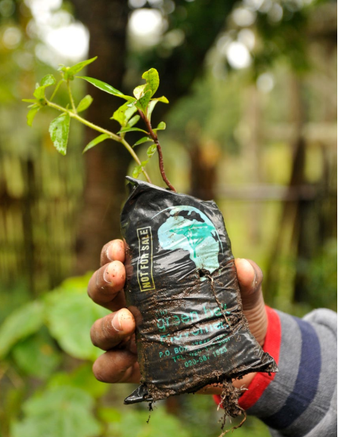
Topic 1:
FLR Overview
Deforestation and forest degradation:
World's forest area covers 4.06 billion ha - 31% of total land area of earth
About half of forests are in the Tropics of which half are either deforested or significantly degraded
Forest Landscape Restoration reverses this degradation with the complete involvement of local communities
Mitigates climate change and helps in adapting to it
Conserves biodiversity and enhances land degradation neutrality
Thereby regaining ecological functionality which leads to human wellbeing across the landscape
Source: Hanson et al. (2015)
Notes:
World's forest area covers 4.06 billion ha which is 31% of total land area of earth. About 1.8 billion ha of forests are in the Tropics of which 0.8 to 1 billion ha are either deforested or in varying stages of significant degradation. Forest Landscape Restoration is the “process of regaining ecological functionality and enhancing human wellbeing” on the deforested and degraded forest landscapes. It builds up carbon storage in vegetation and soils, increase moisture retention, and add to productivity. It is a whole-of-landscape approach involving local communities that helps reverse land degradation, restores biodiversity while creating sustainable livelihoods.
FLR mitigates climate change and enables communities to adapt to it. It conserves biodiversity and enhances land degradation neutrality thereby regaining ecological functionality which leads to human wellbeing across the landscape

Slide 8
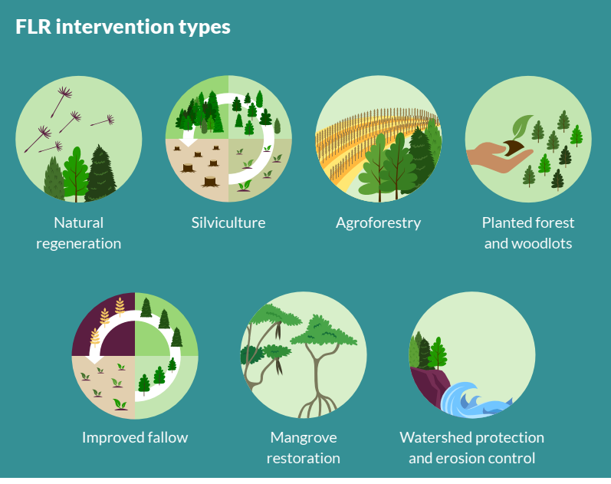
Topic 1:
FLR Overview
FLR activities:
Afforestation and reforestation on lands without forests
Assisted Natural Regeneration on degraded forests
Planting and soil and moisture conservation in watershed areas
Restorative management of secondary forests
Agroforestry and farm forestry
Restoration of grasslands, small waterbodies, and eroded stream banks
Source: IUCN. 2018.
Notes:
FLR process includes activities that lead to restoration of tree and other natural vegetation on deforested and degraded forest lands, restoration of eroded stream banks and of small waterbodies, tree planting on agriculture lands and other non-forested lands, avenue tree planting, restoration of bushes, and herbs and grasslands on lands that supported such vegetation previously. Restorative practices over secondary forests that take these forests towards their original ecological status also constitute FLR.

Slide 9
Topic 1:
FLR Overview
Climate change mitigation and adaptation:
Forests act as sink of CO2 by sequestering it from atmosphere
Forests are reservoirs of CO2 that gets released back in atmosphere through deforestation and degradation
Paris Agreement Art 5(1): Countries expected to conserve and enhance forests that act as sinks and reservoirs of CO2
Paris Agreement Art 5(2): Countries encouraged to implement and support REDD+
IPCC Special Report 1.5: Forests and trees are important constituents of Carbon Dioxide Reduction approaches
Forests help in adapting to the changing climate
Notes:
Forests sequester CO2 from atmosphere and store huge amounts of carbon stock in vegetation and in soils. Deforestation, forest degradation, conversion of dense primary forests to managed forests, and unsustainable forest management result in carbon dioxide emissions. Conversely, afforestation and forest management sequester carbon dioxide away from atmosphere. Carbon storage in long-lived wood products used in house construction and in furniture and use of wood products to substitute for steel and aluminium that are emissions-intensive also contribute to mitigation objectives. reforestation in non-forest lands, restoration of degraded forests, and sustainable.
Paris Climate Agreement Art 5(1) requires countries to conserve and enhance sinks and reservoirs of greenhouse gases including forests and Art 5(2) encourages countries to implement and support REDD+ (which stands for reducing emissions from deforestation and forest degradation in developing countries, and the role of conservation, sustainable management of forests, and enhancement of forest carbon stocks in developing countries).
IPCC Special Report 1.5 recognizes afforestation and reforestation, bioenergy and carbon capture and storage (BECCS), soil carbon sequestration and bio char as effective Carbon Dioxide Reduction (CDR) approaches.
Forests help in adapting to the climate change, too. They are a stabilising force for the climate by regulating ecosystems and protecting biodiversity against disruptive changes. They support livelihoods and supply goods and services providing communities resources to stand up to adverse conditions brought about by the changing climate.

Slide 10
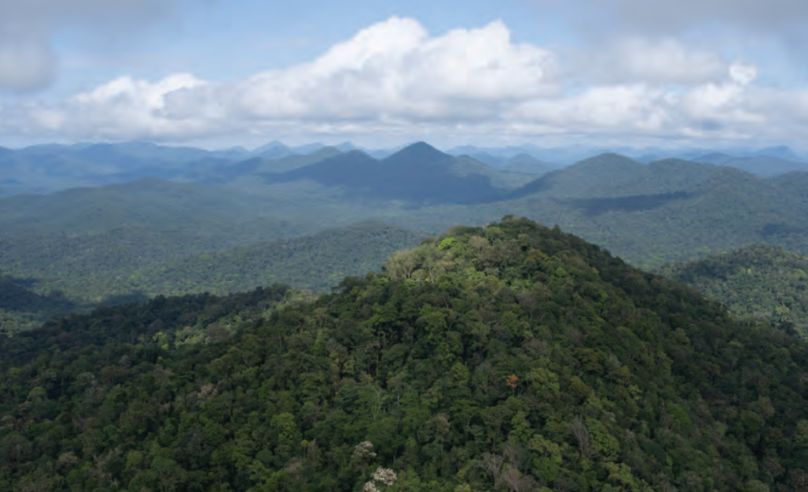
Topic 1:
FLR Overview
PRISTINE: Guyana’s vast tropical forests are attracting increasing numbers of tourists, and many Guyanese women are providing ecotourism services.
Source: ITTO, TFU 29/2 2020. Photo: GFC.

Slide 11
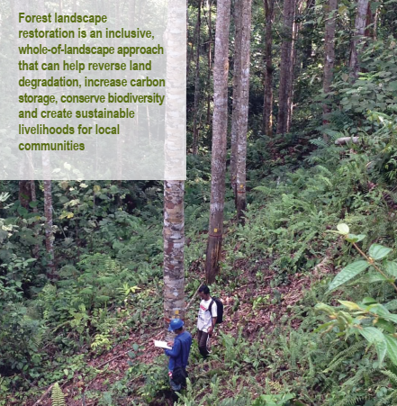
Topic 1:
FLR Overview
FLR helps in biodiversity conservation and land degradation neutrality:
FLR activities bring the floral biodiversity back over time
Faunal biodiversity follows to considerable extent
Micro flora and microfauna also build up as soil fertility and moisture retention increases
Leaf litter and root decomposition adds nutrients to the soil
Increased nutrient and moisture availability in the soil leads to enhanced land productivity
Source: ITTO (2020)
Notes:
SDG 15 aims to: “Protect, restore and promote sustainable use of terrestrial ecosystems, sustainably manage forests, combat desertification, and halt and reverse land degradation and halt biodiversity loss.”
Target 15.3 seeks to “combat desertification, restore degraded land and soil, including land affected by desertification, drought and floods, and strive to achieve a land degradation-neutral world” by 2030.
LDN works in a well-considered response hierarchy: avoid degradation, reduce degradation, and restore degraded land. These three aspects of LDN’s approach are also core part of the FLR approach which is the process of regaining ecological functionality and enhancing human well-being across deforested and degraded landscapes.
FLR should work for LDN, and finances meant for LDN should hasten FLR. This would require effective coordination mechanism. National coordination platforms would help in enabling synergies between sustainable agriculture, forestry, grasslands, and other relevant sectors.

Slide 12
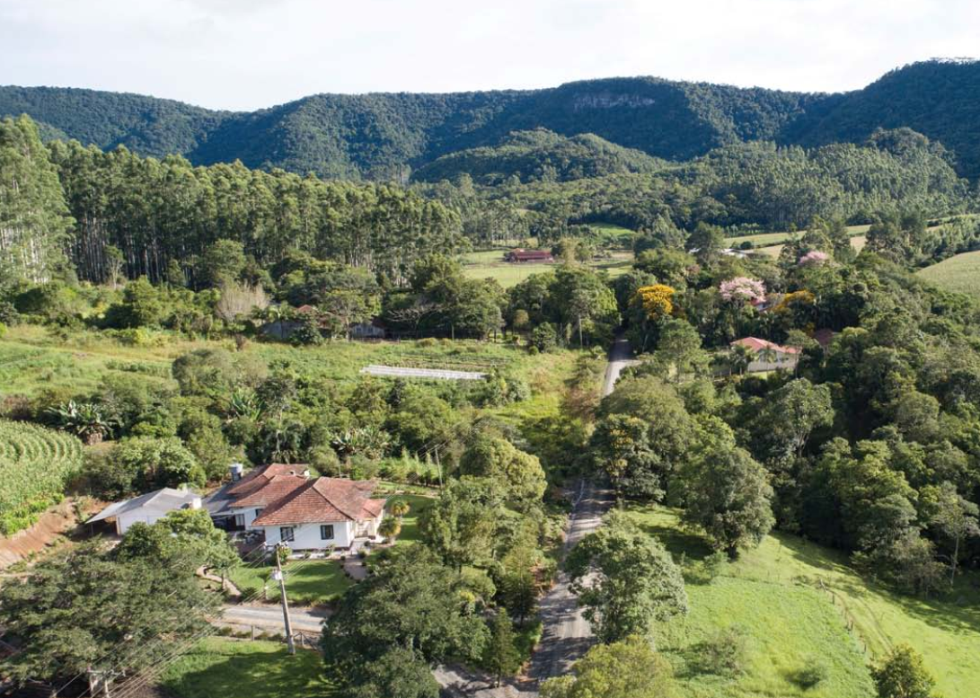
Topic 1:
FLR Overview
FLR leads to sustainable development:
FLR builds Natural Capital
FLR builds Social Capital
FLR builds Financial Capital
FLR creates future possibilities of Capital build up
FLR is thus an important step towards sustainable development
A healthy forest landscape in the Alto Vale do Itajaí region, Brazil
Source: ITTO, TFU 29/3 2020. Photo: © Wigold Schaffer.
Notes:
FLR builds Natural Capital through enrichment of trees and other vegetations, soils and soil moisture, biodiversity
FLR builds Social Capital by enabling communities work together for common goals, creating jobs, enhancing incomes
FLR builds Financial Capital by creating tree and other plant assets, increase return on investment and thereby enhancing financial performance
FLR builds future possibilities of Capital build up by inspiring communities towards innovation and seeing opportunities in the natural environment around them

Slide 13

Topic 1:
Resources
Gichuki, L. et al. 2019. Reviving land and restoring landscapes policy convergence between forest landscape restoration and land degradation neutrality. Gland, Switzerland. IUCN.
UNFCCC. 2021. Land Use, Land-use Change and Forestry. https://unfccc.int/topics/land-use/workstreams/land-use--land-use-change-and-forestry-lulucf. Downloaded on 12.06.2021
FAO & Global Mechanism of the UNCCD. 2015. Sustainable financing for forest and landscape restoration: Opportunities, challenges, and the way forward. Discussion paper. Rome.

Slide 14
Topic 1:
Resources
Watch this 4 minute video about Forest Landscape Restoration (FLR) in Ethiopia by CIFOR:
https://www.youtube.com/watch?v=AIZ0Qz3jICg
Watch this 3 minute video titled ‘Forest Landscape Restoration (FLR) in a nutshell’ by Federal Ministry of Economic Cooperation and Development, Germany
https://www.youtube.com/watch?v=nIvPovNus2w

Slide 15

Topic 1:
Questions
What is the significance of the word ‘landscape’ in FLR?
Discuss the importance of FLR to mitigation of climate change in developing countries
Think of a district in your country and enumerate five most important FLR activities you would like to undertake for FLR there.
Does FLR has any role to play in realizing the Nationally Determined Contributions committed by your country under the Paris Agreement?
How does FLR help build up Social Capital?
Notes:
Please keep the above questions in mind while discussing slides 6 to 14 above but do not provide a direct answer to them in your talk.

Slide 16
Topic 1:
Assignments
What is FLR?
What FLR activities would be most appropriate in a dry savannah type of forest landscape a large part of which has become degraded due to excessive grazing and repeated fires?
What role can FLR play in adapting to the changing climate?
Discuss the role of FLR in reaching Land Degradation Neutrality with specific examples from your country.
Can FLR play significant role in sustainable development of a well populated district that has one third of its land under forest cover a significant part of which is degraded?
Notes:
Encourage the participants to combine the theoretical knowledge they gained in the class with practical examples from their own surrounds.

Slide 17
Topic 2:
Cost of FLR
  Learning activities:
  Class presentation, small group questions and student assignments.
  Learning outcome:
  By the end of Topic 2, students will learn how to estimate unit cost of FLR, importance of opportunity costs and transaction costs, and estimates of global and regional targets of FLR and costs.
Notes:
Discuss average unit cost of FLR and then make local, national and global estimates of funds needed for FLR

Slide 18
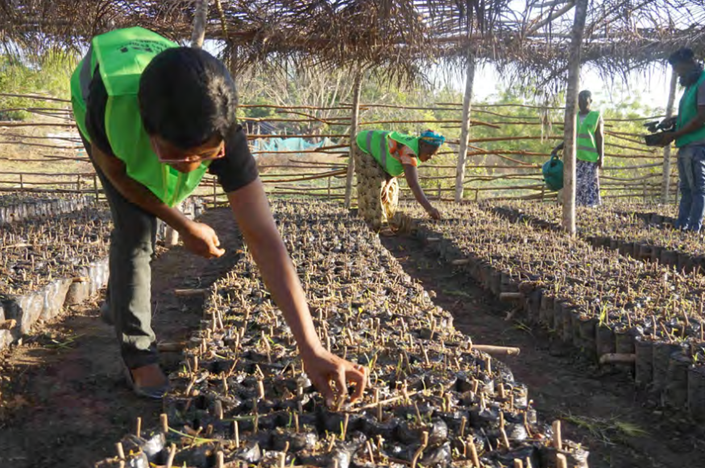
Topic 2:
Cost of FLR
Unit cost of FLR:
Operation costs
Opportunity costs
Implementation costs
Transaction costs
Total: $ 3450/ha for tropical forests
Source: TEEB Climate Issues Update, Sept 2010
Members of the women's’ association - MALEBI - in Dimbokro,Côte d’Ivoire, tend cuttings that will later be outplanted as part of forest restoration efforts.
Source: ITTO, TFU 28/1 2019.
Photo: R. Carrillo.
Notes:
Operation costs include cost of seed collection, storage and transport, nursery, planting, tending, protection, materials, and supplies associated with these activities etc.
Opportunity costs is assessed from the value of the next- highest-valued alternative use of the land and labour resource, and the direct and indirect costs of forest restoration option compared to alternatives
Implementation costs are the cost of planning and training, related administration, and governance costs, etc.
Transaction costs include the cost of negotiation, monitoring, measurement, reporting, verification, certification, validation etc.
These costs total up to $ 3450/ha for tropical forests (Source: TEEB Climate Issues Update, Sept 2010)

Slide 19
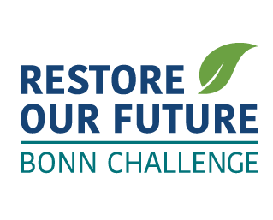
Topic 2:
Cost of FLR
Global FLR targets:
Bonn Challenge, established 2011, 150 million ha by 2020
New York Declaration on Forests of 2014, 350 million ha by 2030
Initiative 20x20 of Latin America and Caribbean, established 2015, 20 million ha – increased to 27.5 million ha - to be restored by 2020
AFR100, African Forest Landscape Restoration initiative to restore 100 million ha of degraded forests in Africa by 2030.
Land Degradation Neutrality (SDG 15.3), 2000 million ha by 2030
Notes:
Bonn Challenge was established by the German Government in 2011. It calls for the restoration of 150 million hectares of deforested and degraded lands by 2020. Later it was extended to 350 million hectares by 2030 to accord with the New York Declaration on Forests. It is increasingly being projected by IUCN as one of the ‘Nature based solution’ for the many problems of human society.
The New York Declaration on Forests (NYDF) is a non-legally binding political declaration that grew out of dialogue among governments, companies, and civil society under the aegis of the UN Secretary General’s Climate Summit. It seeks to cut natural forest loss in half by 2020 and strive to end it by 2030. It also calls for restoring forests and croplands over 350 million ha. Meeting these goals would cut CO2 emissions between 4.5 and 8.8 billion tons every year which is the size of current emissions of the United States. Incorporates Bonn Challenge within.
Initiative 20x20 of Latin America and Caribbean, established 2015, aimed at 20 million ha to be restored by 2020 outside the Amazon region. It has by now secured commitments to restore 27.7 million hectares of land by 2020 with private impact investors earmarking $730 million to support restoration projects in the region. These 27.7 million hectares will directly contribute to NYDF.
African Forest Landscape Restoration Initiative is a country led effort to restore 100 million hectares of deforested and degraded landscapes across Africa by 2030 aimed at enhancing food security, increase climate change resilience and mitigation, and combat rural poverty. It responds to the political declaration endorsed by the Africa Union in October 2015 for the creation of the umbrella Africa Resilient Landscapes Initiative. Included within NYDF
UN Decade on Ecosystem Restoration 2021-2030: On 1 March 2019, the UN General Assembly officially adopted the resolution through which the governments have recognized the need to prevent, halt and reverse the degradation of ecosystems worldwide for the benefit of both people and nature. Though there is no specific declared target the estimated extent of degraded ecosystems worldwide is about 1 billion ha.

Slide 20

Topic 2:
Cost of FLR
Global cost estimates of FLR and availability:
New York Declaration on Forests, 350 million ha between 2014 to 2030, and
UN SDG 15.3 – Land Degradation Neutrality – 2000 million ha between 2015 to 2030
Total requirement during 2015-2030 would be 2350 million ha x $3450/ha = $8108 billion, $ 540 billion annually
Since 2015 only $41 billion of Public finance and $10 billion of private finance has been invested annually
$780 billions per year needed each year till 2030
Notes:
New York Declaration on Forests, 350 million ha between 2014 to 2030,
UN SDG 15.3 – Land Degradation Neutrality – 2000 million ha between 2015 to 2030
Total requirement during 2015-2030 would be 2350 million ha x $3450/ha = $8108 billion, $ 540 billion annually
WRI estimate since 2015 only an average of $41 billion of Public finance and $10 billion of private finance has been invested annually. Annual shortfall $489 billion
With barely $ 306 billions invested thus far since 2015, atleast $(8108-306) billion or $ 7802 billion are needed more over the ten years period
Or $ 780 billions per year each year till 2030

Slide 21
Topic 2:
Cost of FLR
Do not ignore the opportunity costs in FLR:
Lands degrade because people are dependent upon them for livelihood
Project design should care for livelihood dependence in short and medium term
Opportunity costs is assessed from the value of the next- highest-valued alternative use of the land and labour resource, and the direct and indirect costs of forest restoration option compared to alternatives
Assess opportunity cost in consultation with local communities
Fuel-efficient wood stoves have helped reduce wood consumption in the forest communities of Kampong Thom province, Cambodia.
Source: ITTO, TFU 29/2 2020. Photo: S. Sineth/Forestry Administration.
Notes:
Almost all lands that require restoration have reached this stage of degradation because people are dependent upon them for livelihood
Unless the livelihood dependence of local people is compensated adequately in short and medium term through project design the FLR will not get people’s support and will fail
Opportunity costs is assessed from the value of the next- highest-valued alternative use of the land and labour resource, and the direct and indirect costs of forest restoration option compared to alternatives
Opportunity cost assessment is best made in consultation with local communities

Slide 22
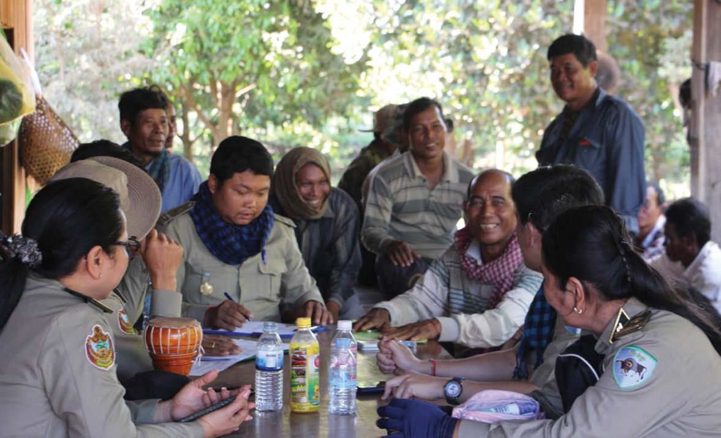
Topic 2:
Cost of FLR
Reduce transaction costs in FLR:
High transaction costs can cripple FLR projects financially
These costs can become astronomical in climate mitigation projects involving result based payments
State intervention can reduce these costs through institutional support
Remote sensing facilities are very useful in MRV
A group discussion between Forestry Administration officials, community forestry management committee members and local authorities in Veal Okdey, Santuk district, Kampong Thom province, Cambodia. Source: ITTO, TFU 29/2 2020. Photo: Chhorn Vireak.
Notes:
Transaction costs include the cost of negotiation, monitoring, measurement, reporting, verification, certification, validation etc.
In some developing countries with poor legal and physical infrastructure these costs can be very high
The burden of some of these transaction costs like certification and validation can be reduced by institutional support from concerned Government departments like the Forest Departments
Monitoring and measurement costs can be reduced by using available state funded remote sensing facilities
Co-financing options may be explored for Monitoring, Reporting, Verification, Certification, Validation etc.

Slide 23
Topic 2:
Resources
TEEB. 2009. TEEB Climate Issues Update. September 2009.
TEEB. 2010. The Economics of Ecosystems and Biodiversity: Mainstreaming the Economics of Nature: A synthesis of the approach, conclusions and recommendations of TEEB.

Slide 24
Topic 2:
Resources
Watch this 2 minute video about restoring our future with forest landscape restoration by IUCN:
https://www.youtube.com/watch?v=mN6v_OqAtR8

Slide 25
Topic 2:
Questions
What is the unit cost of undertaking restoration in your country? Why is opportunity cost component of total cost important?
What is Initiative 20x20?
Describe SDG 15.3. How does it relate to FLR?
What is the total annual requirement of funds for FLR?
Notes:
Please keep the above questions in mind while discussing slides 17 to 24 above but do not provide a direct answer to them in your talk.

Slide 26
Topic 2:
Assignments
Explain how you would arrive at unit cost of forest landscape restoration in your district?
Describe the New York Declaration on Forests of 2014 in details.
Describe Land Degradation Neutrality. How much money would be needed for achieving it in your district?
Notes:
Encourage the participants to combine the theoretical knowledge they gained in the class with practical examples from their own surrounds.

Slide 27
Topic 3:
FLR Investors
  Learning activities:
  Class presentation, small group questions and student assignments.
  Learning outcome:
  By the end of Topic 3, students will be able to appreciate that FLR involves multi-sectoral activities that can be financed by many sources beyond the immediately visible, different stages of FLR are often best financed by different sources, investors have widely different motives and time preferences

Slide 28
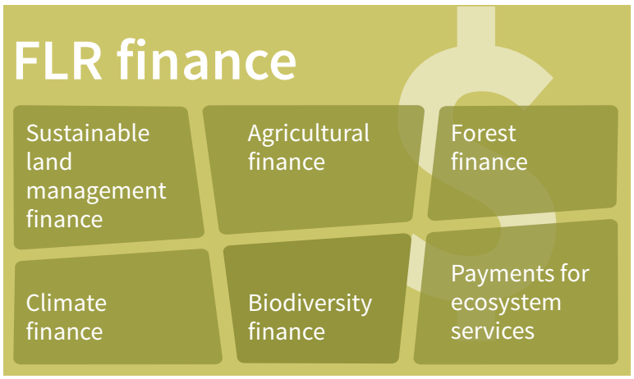
Topic 3:
FLR Investors
FLR can attract finance from multiple sectors:
Go beyond forest finance. FLR has multi-sectoral aspects.
International finance for climate, LDN, and biodiversity
Agriculture and rural development finance
Mountain, watershed, and coastal protection finance
Ecotourism finance
Urban area development finance
Source: FAO & UNCCD. 2015.
Notes:
Accessing a mosaic of financing sources requires a deep understanding of the mosaic of direct and indirect, and immediate and deferred, benefits from the intended FLR project. While Forest landscape restoration is mostly related to forests and therefore forest sector is a major source for finance of FLR the good thing about FLR is that it has positive overlaps with several sectors including climate change mitigation and adaptation, Land Degradation Neutrality, and biodiversity conservation for which international finance is available. Other sectors with significant overlap are agriculture, rural development, mountain protection, watershed protection and coastal area protection, ecotourism, and urban and roadside development finance. This opens opportunities for accessing global finances for climate change mitigation and adaptation, Land Degradation Neutrality, and biodiversity conservation for which the developed countries are mandated to provide funds as part of their legal commitments under related international agreements. And this overlap also opens access to national and provincial budget finance for agriculture, rural development, mountains, rivers, power projects and watershed protection, coastal zone development, transport infrastructure, urban development, and tourism sectors among others.

Slide 29
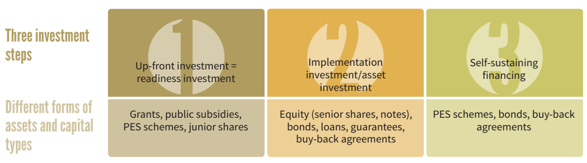
Topic 3:
FLR Investors
Sustainable investments in FLR have to be well planned involving several stages:
Initial readiness investment covering transaction costs and FLR project design;
Implementation-related investment, covering operational costs for implementation of the project;
Self-sustaining financing of long-term running costs.
Each step involves different practical measures and potentially different types of investors, donors and financing instruments.
Source: FAO & UNCCD. 2015.
Notes:
For FLR investments to be successful they should be carried out in at least three stages:
Initial readiness investment: Restoration opportunities assessment, identifying and engaging stakeholders, planning specific strategies (like REDD, climate-smart agriculture etc.), resource assessment and baselines, monitoring, reporting and verification design, safeguards, initial capacity building of staff and communities
Implementation investment: policy reforms, strengthening of land tenure regime, institution building and strengthening, organizing stakeholders into well informed functional groups, scaled-up capacity building in focus areas, extension for specific interest groups, infrastructure development, restoration of degraded lands and forests, innovations in silviculture, harvesting, and utilization etc., implementation of monitoring, reporting and verification systems
Sustained financing: organizing harvesting and marketing of agricultural and food products, timber and NWFP, value addition, Payment for ecosystem services schemes, Carbon offset, Biodiversity offsets, Watershed conservation offsets, Bundled services, Certification schemes for organic agriculture and ethical bio-trade, etc.

Slide 30
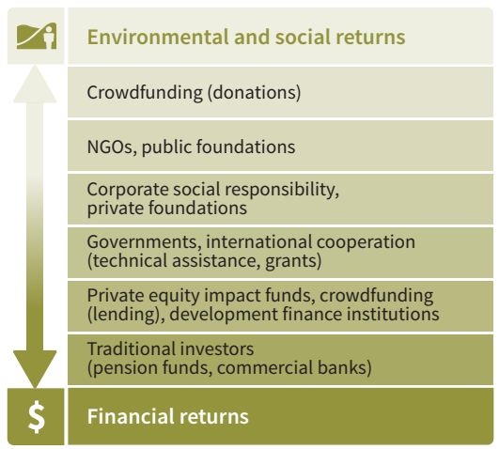
Topic 3:
FLR Investors
Types of investors:
Value investors that seek a good return on investment
Social investors that seek to promote a set of desirable social objective even at the cost of return on their investments
Conservation investors want to protect or restore a specific landscape, habitat or species and are tolerant of low return on their investments
Impact investors aim at solving social or environmental challenges while generating financial profit
Source: FAO & UNCCD. 2015.
Notes:
There are four main categories of investors depending on their goals, approaches and expected returns:
Value investors seek an attractive financial return and certainly do not expect to lose their money. They are usually guided by direct benefits arising out of their investments that can be monetized. But sometimes they can also be motivated by indirect benefits like enhancing their corporate image for marketing purposes, or to meet international or national commitments on sustainability goals.
Social investors typically aim at promoting one or more well defined social development goals, willing to accept higher risks with lower rates of return, tolerant towards economic inefficiency in earning returns on their investments, even expecting no return at all. Social investors attempt to change the circumstances of less fortunate people and communities through their investments, and they understand that markets often fail to deliver outcomes that are either efficient or equitable.
Conservation investors utilize their capital for protecting or restoring a specific landscape, habitat, or species. Their interest in earning a financial return on their investment is only marginal to their primary motive. They view loss of wilderness or wild species or degradation of environment as an outcome of market’s failure to internalize the value of natural capital and ecosystem goods and services and want to use their capital investment to correct such market distortions. Some hard-core conservation investors may also hold the view that market can only cause damage to the natural world and may thus ignore profit motive altogether.
Impact investors aim at solving social or environmental challenges while also generating financial profit. Some of them are satisfied with preserving the principal capital while some on the other end may also look for market-beating financial returns. Impact investors seek to invest their capital in projects that can harness the positive power of enterprise while also significantly contributing to social or environmental goals.

Slide 31
Topic 3:
FLR Investors
Types of capital used for investing:
Grants
Equity
Loans and Bonds
Subsidies and compensations
Guarantees
PES
Source: FAO & UNCCD. 2015.
Notes:
Capital for investment can come in many shapes. The usual ones are grant, equity, loan and bonds that carry their normal dictionary meanings. Other forms are guarantees, subsidies, compensations, and Payment of Ecosystem Services (PES). Equity allows higher level of entrepreneurial risk acceptance by investors that is relevant in the forestry and agriculture sector, given their market volatility. Bonds can be issued to raise a large amount of capital for investment in big FLR projects with multiple objectives. Payment for ecosystem services (PES) schemes, public subsidies and compensation payments provide appropriate incentives to attract investors in placing their capital in FLR contributing to building an enabling environment. Guarantees cover investors’ risks catalysing investments in ambitious projects. Often a mix of these is used to finance FLR projects.

Slide 32
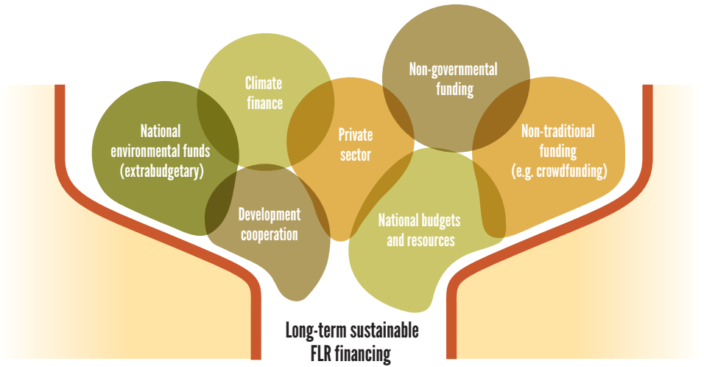
Topic 3:
FLR Investors
Type of financing sources for FLR:
National, provincial, or local government Budgets
International development finance
Climate finance
Private investment
National Environmental Funds (non-budgetary)
Non-traditional and NGO finance
Source: FAO & UNCCD. 2015.
Notes:
Budgetary provisions of the National, provincial, and even local governments are often the biggest source of FLR in non-LDC tropical countries. Major source of FLR finance in LDCs is international development finance that comes through multilateral organizations like the WB, Asian Development Bank, Africa Development Bank etc. or from bilateral development aid organizations like the USAID, DFID, GIZ, JAICA etc. In the recent years Climate finance (such as from GCF, GEF etc.) has also shown much promise.
Private investment in commercial plantations including agroforestry is also a major source of FLR finance. Some private investment is of philanthropic nature, too, which is often routed through NGOs. The NGOs are also able to organize crowd funding for small, short duration forest restoration tasks.
Non-budgetary National Environmental Funds like the Compensatory Afforestation Fund Management and Planning Authority (CAMPA) finance of India are also important sources of FLR finance.

Slide 33
Topic 3:
Resources
FAO & Global Mechanism of the UNCCD. 2015. Sustainable financing for forest and landscape restoration: Opportunities, challenges and the way forward. Discussion paper. Rome
Gichuki, L., Brouwer, R., Davies, J., Vidal, A., Kuzee, M., Magero, C., Walter, S., Lara, P., Oragbade, C. and Gilbey, B. (2019). Reviving land and restoring landscapes: Policy convergence between forest landscape restoration and land degradation neutrality. Gland, Switzerland: IUCN. viii + 34pp

Slide 34
Topic 3:
Resources
Watch this 6 minute video about financing forest landscape restoration by IUCN:
https://www.youtube.com/watch?v=uziAonznmQ0

Slide 35
Topic 3:
Questions
How can coastal protection finance be utilized for financing FLR?
Why does it often become necessary to finance FLR in stages?
Who are Social Investors and how are they different from Value Investors?
What are the different types of capital used for investing in FLR?
What are the different types of financing sources accessed for investing in FLR?
Notes:
Please keep the above questions in mind while discussing slides 27 to 34 above but avoid providing a direct answer to them in your talk.

Slide 36
Topic 3:
Assignments
Explain why FLR can attract finance meant for agriculture sector
Different stages of financing in a large FLR project
Explain different types of investors in FLR
Differentiate between various types of capital used in financing FLR
Explain the role of international development finance in FLR
Notes:
Encourage the participants to combine the theoretical knowledge they gained in the class with practical examples from their own surrounds.

Slide 37
Topic 4:
Types of financing sources
  Learning activities:
  Class presentation, small group questions and student assignments.
  Learning outcome:
  By the end of Topic 4, students will be able to learn about the various domestic and international sources of financing FLR including parliament approved budgets, ODA, and climate change specific funds.

Slide 38
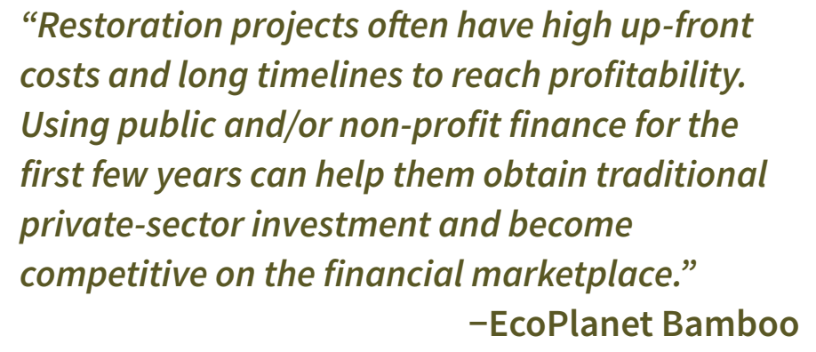
Topic 4:
Types of financing sources
Budgetary provisions of National, Provincial and Local governments:
Usually, the biggest source of funds for FLR except in LDCs
In underdeveloped countries forests get low priority in funding
Budgets also provide loans and subsidies to private operators to promote FLR
Funds from international agencies also routed through budgets
Unspent funds are not carried over without fresh approvals
Source: FAO & UNCCD. 2015.
Notes:
In most developing countries with organized forestry departments budgetary finance is usually the biggest source of funds for FLR
The annual budgetary allocations must be utilized within the financial year; unspent funds are not carried over without fresh approvals
In underdeveloped countries forests usually get low priority and funds are often diverted to higher priority sectors
Grants and loans from bilateral and multilateral international financing agencies are also routed through budgets
Budgets also provide for loans and subsidies to private operators to promote specific aspects of FLR

Slide 39

Topic 4:
Types of financing sources
International development finance:
90% of ODA is provided by top ten international development banks and international cooperation agencies
WB, EC, AfDB, ADB, CAF, AFD, DFID, JICA, KfW, USAID
Zero to low-interest loans to developing countries and grants to least-developed countries in their geographic focus areas
Sovereign and non-sovereign loans
Microfinance schemes
Grants and guarantees
Notes:
Top ten international development banks and international cooperation agencies providing financial assistance for FLR are World Bank Group, European Commission, African Development Bank (AfDB), Asian Development Bank (ADB), Latin American Development Bank (CAF), French Development Agency (AFD), United Kingdom’s Department for International Development (DFID), Japan International Cooperation Agency (JICA), German KfW Development Bank, United States Agency for International Development (USAID). Together they provide more than 90 percent of global net ODA.
They provide zero to low-interest loans to developing countries and grants to least-developed countries in their geographical focus areas. They also co-finance projects with local governments, other multilateral or bilateral institutions, commercial banks, and private sector investors.
They provide sovereign loans to a State or a public entity backed by a state guarantee (see Box). Non-sovereign loans can be allocated to a private or public entity business. These institutions can also support microfinance as in women empowerment schemes in Bangladesh.
These agencies commonly provide grants to FLR in LDCs. Some programmes specifically provide small grants such as the GEF Small Grants Programme. Guarantees are also provided to the private sector for financing FLR as in the guarantee agreement between Ecoplanet Bamboo and the Multilateral Investment Guarantee Agency of the World Bank Group. Another guarantee mechanism example is the Latin American Development Bank supporting private capital funds involved in Initiative 20×20.

Slide 40
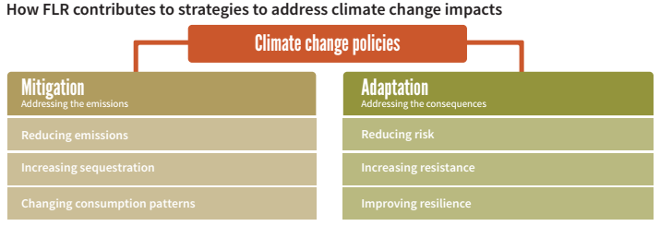
Topic 4:
Types of financing sources
Climate finance:
Broadly three types: climate mitigation finance, adaptation finance, Joint mitigation-cum-adaptation finance
Compliance market based mitigation like CDM
Voluntary markets
Source: FAO & UNCCD. 2015.
Notes:
Following the signing of UNFCCC a number of climate financing instruments have been established that have been supporting FLR initiatives. These can be categorised as those based on mitigation, those based on adaptation, and those that link adaptation with mitigation. Among the mitigation based financing instruments two broad categories are Compliance carbon markets and the Voluntary carbon markets.
Compliance markets assist in fulfilling treaty based quantitative mitigation targets. Carbon credits generated under the Clean Development Mechanism (CDM) allows developing countries to generate credits that can be sold for compliance by developed countries towards their emission reduction targets under the Kyoto Protocol. Examples are Sirsa Small Scale Cooperative afforestation project on shifting sand dunes in Sirsa, India; Reforestation of degraded forests in Himachal Pradesh, India; a river basin forestry project in Colombia; assisted natural regeneration of degraded lands in Albania. Very high transaction costs in CDM have been a major deterrence. Now under the Paris Agreement the ITMOs under development are likely to offer similar NDC compliance market.
Voluntary carbon markets enable business corporations like Airlines and others purchase carbon offsets to mitigate greenhouse gas emissions from their business operations. From the beginning forestry and land-use related projects have contributed a major part of voluntary carbon credits. Besides the international voluntary market there are also domestic voluntary markets in China where credits are produced, traded, and purchased by actors within the country. More recently bilateral voluntary markets have also been established arising from bilateral agreements between a carbon credit user country and a carbon credit producer country.

Slide 41

Topic 4:
Types of financing sources
Climate finance - REDD+:
Reducing Emissions from Deforestation and Forest Degradation plus conservation or forests, sustainable management of forests and enhancement of forest carbon stocks in developing countries
Three stage financing
Achievements measured against reference levels
REDD+ at local level, CBR+
UN-REDD, FCPF, Bio-Carbon Fund Initiative for Sustainable Forest Landscapes
Governors’ Climate and Forests Fund
Notes:
REDD+ stands for Reducing Emissions from Deforestation and Forest Degradation plus conservation or forests, sustainable management of forests and enhancement of forest carbon stocks in developing countries. Mitigation of climate change is achieved both through reducing emissions and enhancing CO2 sequestration. Implementing country should be able to demonstrate the measure of its reductions in emissions and enhance in CO2 sequestration against a previously set and approved reference level. It is implemented in three main phases (1) a readiness phase focused on development of strategies, action plans, policies, measures and capacity building; (2) implementation of these strategies, policies, measures, and results-based pilot activities; (3) results-based actions that should be fully measured, reported and verified for received of payments against the achievements. Any non-Annex 1 country may take up REDD+ in any one or more of the REDD+ activities at any point in time.
For the first phase of readiness a suitable financing mechanism is the United Nations Collaborative Programme on Reducing Emissions
from Deforestation and Forest Degradation in Developing Countries (UN-REDD). This is a collaboration between FAO, UNDP, and UNEP.
Another program is the Forest Carbon Partnership Facility (FCPF) is a global partnership of governments, businesses, civil society and indigenous peoples with the World Bank as trustee and secretariat. It has both a Readiness Fund, which supports tropical and subtropical developing countries’ preparations to participate in a future large-scale system of positive REDD+ incentives, and a Carbon Fund for second phase for piloting incentive payments for REDD+ policies and measures in a few countries.
The Global Environment Facility (GEF) is also involved in REDD+ financing in a limited manner along with its other objectives under Objective 5 of the GEF Climate Change Mitigation Strategy to “promote conservation and enhancement of carbon stocks through sustainable management of land use, land-use change, and forestry”.
REDD+ at the local level:
UN-REDD and the GEF Small Grants Programme have a joint Community-Based REDD+ (CBR+) programme for providing grants up to $50000 to support REDD+ at the local level for communities to address drivers of deforestation and build capacity for participation in REDD+ processes and improve land and use rights, benefit sharing and the application of safeguards. In the pilot phase CBR+ is being implemented in Cambodia, Democratic Republic of the Congo, Nigeria, Panama, Paraguay and Sri Lanka.
The BioCarbon Fund Initiative for Sustainable Forest Landscapes, a multilateral fund managed by the World Bank, engages private sector to innovate and mobilize capital for supporting activities that lead to reduced greenhouse gas emissions from LULUCF sector - from deforestation and forest degradation, from agriculture – and encouraging smarter land-use planning, policies and practices. It incentivizes changes at the landscape level using results-based finances, successful land-use practices and green supply chains.
The Governors’ Climate and Forests Fund is a non-governmental funding facility set up in 2008 by the Governors of California and nine other provinces of USA, Brazil and Indonesia to respond to the problem of tropical deforestation, biodiversity loss, rural poverty and climate change. It has now grown beyond its initial nine subnational participants. It supports REDD initiatives that aim at low emission rural development.

Slide 42

Topic 4:
Types of financing sources
Adaptation based climate finance:
UNFCCC Adaptation Fund
Special Climate Change Fund
GEF
GEF-Small Grants Programme
International Climate Initiative
Notes:
Adaptation Fund under the UNFCCC is financed by 2% of CER proceeds under the CDM a part of which is made available for adaptation promoting forestry activities. Special Climate Change Fund supports adaptation in all developing country parties to UNFCCC. GEF is the trustee of the fund.
GEF provides funding for Sustainable Land Management in rural areas , under its Strategy to Combat Land Degradation for balancing short-term economic gains with longer term sustainability. This can be used for managing competing land uses and exploitation of natural resources; and adaptation to climate change.
GEF’s Small Grants Programme (SGP) focuses on community-based adaptation projects bringing available funds from various sources. An example is the Bolivian Water Source Protection and Soil Conservation through Reforestation in Batallas.
International Climate Initiative (IKI), an initiative by Germany, focuses on ecosystem-based adaptation through pilot projects that support innovative approaches in forest landscape restoration and developing tools and financing instruments for upscaling them. IUCN defines “Ecosystem-based adaptation integrates the use of biodiversity and ecosystem services into an overall strategy to help people adapt to the adverse impacts of climate change. It includes the sustainable management, conservation and restoration of ecosystems to provide services that help people adapt to both current climate variability, and climate change.”

Slide 43
Topic 4:
Resources
Climate Funds Update at https://climatefundsupdate.org/
Where climate cash is flowing and why it’s not enough at: https://www.nature.com/articles/d41586-019-02712-3
FAO & Global Mechanism of the UNCCD. 2015. Sustainable financing for forest and landscape restoration: Opportunities, challenges and the way forward. Discussion paper. Rome.

Slide 44
Topic 4:
Resources
Watch this 84 minute video from the Global Landscape Forum: Discussion Forum 15 titled ‘Financing Forest Landscape Restoration’:
https://www.youtube.com/watch?v=8UXQ2Qs5rFo

Slide 45
Topic 4:
Questions
What is the largest source of financing for forests in your country?
What is the biggest bilaterally financed forestry project in your country?
What are the three broad types of climate related finance mechanisms?
What does REDD+ stand for?
What is Adaptation Fund?
Notes:
Please keep the above questions in mind while discussing slides 37 to 44 above but do not provide a direct answer to them in your talk.

Slide 46
Topic 4:
Assignments
A note on forestry budget in your country
A short note on ODA for forestry in your country
A short note on compliance market based climate mitigation mechanism
A short note on Forest Carbon Partnership Facility
A short note on GEF-Small Grants Programme
Notes:
Encourage the participants to combine the theoretical knowledge they gained in the class with practical examples from their own surrounds.

Slide 47
Topic 5:
Climate finance for FLR
  Learning activities:
  Class presentation, small group questions and student assignments.
  Learning outcome:
  By the end of Topic 5, students will learn more about various funds dealing specifically with the requirement of finances for forest based climate change mitigation and adaptation

Slide 48
Topic 5:
Climate finance for FLR
Some important climate finance sources for FLR:
UN-REDD
Forest Carbon Partnership Facility
GEF
Community Based REDD+ Programme
Biocarbon Fund Initiative for Sustainable Landscape
Green Climate Fund

Slide 49
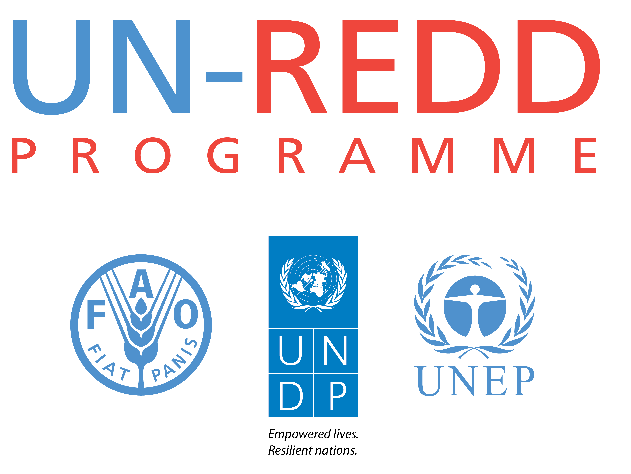
Topic 5:
Climate finance for FLR
UN-REDD:
United Nations Programme on Reducing Emissions from Deforestation and Forest Degradation
Flagship UN partnership between FAO, UNDP
and UNEP
Created in 2008 as a follow up on the Bali Action Plan and REDD.
Focusses on building technical capacities for implementing REDD+
Has no funds of its own, facilitates access to financing institutions across the world
Examples of UNREDD financing
Notes:
Created in 2008 in response to the UNFCCC CoP 13 decisions on the Bali Action Plan and REDD.
Flagship UN partnership between FAO, UNDP and UNEP for the protection of forests in the context of Paris Agreement and Sustainable Development Agenda.
Partners with developing countries for building technical capacities for implementing REDD+ and meet the requirements for REDD+ results-based payments.
Has no funds of its own but collaborates with a big range of multilateral and bilateral financing institutions to provide funds for REDD+ programmes that meet with UNREDD approval
After the devastating Indonesian peatland fires of 2015 the Govt of Indonesia took several preventive and remedial measures one of which was establishing community-based firefighter groups. In 2017, the UN-REDD Programme organized an intensive firefighting training by highly skilled South African firefighters for 66 community firefighting units in Central Kalimantan’s most fire-prone villages as part of the “Generating Anticipatory Measures for Better Utilization of Tropical Peatlands (GAMBUT)” project, which is funded by USAID and operated by the United Nations Office for Project Services (UNOPS).
Under their project “Sustainable Forest Trade in the Lower Mekong Region” the UN-REDD Programme supports countries in the Lower Mekong Basin and China increase their capacity to improve forest governance, reduce illegal and unsustainable trade, and increase investments in wood products across the Lower Mekong Basin and neighbouring regions of China.

Slide 50
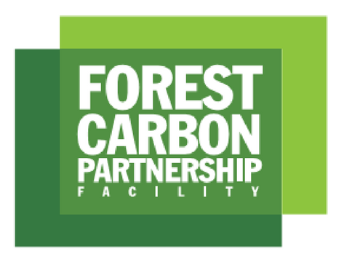
Topic 5:
Climate finance for FLR
Forest Carbon Partnership Facility:
Global partnership of governments, businesses, civil society, and Indigenous Peoples for promoting REDD+ in developing countries.
Presently FCPF works with 47 recipient and 17 donor countries
Total commitments $1.3 billion for Readiness and Carbon Fund
Readiness Fund supports designing strategies, developing REL, designing MRV, setting up REDD+ management system
Carbon Fund supports REDD+ pilots
Notes:
Established in 2008 the FCPF is a global partnership of governments, businesses, civil society, and Indigenous Peoples for promoting forest based climate change mitigation and adaptation across the developing world. It is focused on REDD+ which stands for reducing emissions from deforestation and forest degradation, forest carbon stock conservation, the sustainable management of forests, and the enhancement of forest carbon stocks in developing countries.
Presently FCPF works with 47 developing countries and 17 donor countries that have made contributions and commitments totalling $1.3 billion.
The FCPF supports REDD+ efforts through its Readiness Fund and Carbon Fund. The Readiness Fund supports designing national REDD+ strategies, developing reference emission levels, designing measurement, reporting, and verification systems and setting up national REDD+ management system, including the requisite environmental and social safeguards. The Carbon Fund supports demonstration projects for results-based payments to countries that have advanced through REDD+ readiness and implementation and have achieved verifiable emission reductions
in their forest and broader land-use sectors.

Slide 51

Topic 5:
Climate finance for FLR
Global Environment Facility:
GEF established in 1991 just before the Rio Earth Summit to facilitate financing of mitigation of pressing environmental issues
Funds are provided to developing countries and Economies in transition
GEF also administers Adaptation Fund, Special Climate Change Fund (SCCF), Least Developed Countries Fund (LDCF), Nagoya Protocol Implementation Fund (NPIF)
GEF-Small Grants Fund
Examples
Notes:
The Global Environment Facility (GEF) was established just before the Rio Earth Summit of 1992 to help finance mitigation of urgent environmental problems across the globe. Money for GEF Trust Fund is contributed by developed countries and made available to developing countries and countries with economies in transition to meet the objectives of the international environmental conventions and agreements. These financial contributions are replenished every four years by the GEF donor countries.
The World Bank serves as the GEF Trustee and administers the GEF Trust Fund. It mobilizes and disburses funds to beneficiary country governments and other agencies and monitors utilisation.
GEF provides secretariat services to the Adaptation Fund of the UNFCC under which funds are provided for adaptation to the climate change to developing countries.
GEF also administers SCCF which is meant for supporting adaptation and technology transfer in developing countries in water resources management, land management, agriculture, health, infrastructure development, fragile ecosystems, including mountainous ecosystems, and integrated coastal zone management.
Another important duty of GEF is administering the Least Developed Countries Fund (LDCF) to address the special needs of LDCs that are especially vulnerable to the adverse impacts of climate change. It focuses on reducing the vulnerability of sectors that are central to development and livelihoods, such as water, agriculture and food security, health, disaster risk management and prevention, infrastructure, and fragile ecosystems. LDCF is also responsible for financing the preparation and implementation of National Adaptation Programs of Action (NAPAs).
GEF’s Small Grants Programme (SGP) focuses on community-based adaptation projects.
For the conservation of biodiversity GEF administers the Nagoya Protocol Implementation Fund to support the implementation of the Nagoya Protocol on Access to Genetic Resources and the Fair and Equitable Sharing of Benefits Arising from their Utilization.
An example is the recently approved project titled “Building climate-resilient livelihoods and food systems” in Lesotho under their LDCF Fund. The grant component of this fund is $8.9 million and co-financing of $40 million.
Another example is the “Brazil Amazon sustainable landscapes project – phase 2” with focus on biodiversity conservation at the total cost of $140 million from the GEF Trust Fund.

Slide 52

Topic 5:
Climate finance for FLR
Community Based REDD+:
A creative partnership between UN-REDD and GEF-SGP
Enables indigenous communities in designing their own REDD+ complementing national strategies
Grants limited to $50000, given directly to communities
Country level CBR+ committees formed in 6 pilot countries to approve projects and guide
Overarching goal of CBR+ is improved rights and livelihood for indigenous peoples, adaptation to climate change, and biodiversity conservation.
Notes:
Community-based REDD+: A very creative partnership between the UN-REDD Programme and the GEF Small Grants Programme aimed at enabling indigenous peoples and communities in designing, implementation and monitoring of REDD+ readiness activities at local levels that can then become part of the larger subnational or national REDD+ programmes.
The grants are made directly to the indigenous peoples and communities and are limited to $50000. Presently CBR+ pilots are being implemented in Cambodia, Sri Lanka, Panama, Paraguay, Democratic Republic of the Congo and Nigeria.
The objectives of CBR+ are:
Encourage full and effective participation of indigenous peoples, communities and civil society in national-level REDD+ processes;
Build their capacities for engaging in REDD+ activities and processes;
Integrate community-based knowledge and ideas into national REDD+ processes;
Share knowledge and lessons learned from community-based experiences to inform national and international REDD+ policies;
An indirect but important goal of CBR+ is fulfilment of broader environmental and social goals, including improved rights and livelihood for indigenous peoples, their food security and adaptation to climate change, and biodiversity conservation.
Financing Arrangements:
CBR+ is co-financed by the UN-REDD Programme and Small Grants Programme (SGP) of the GEF. Grants are channelled through decentralized grant-delivery mechanism of the SGP.
For the pilot phase UN-REDD Programme’s contribution was $ 400,000 for community grants in each of the six pilot countries matched by similar co-financing from SGP.
First CBR+ Country Plans are developed in each pilot country to guide the selection of CBR+ projects that are aligned with national REDD+ readiness processes. Existing SGP National Steering Committees in the six pilot countries, after necessary changes in composition, also act as CBR+ National Steering Committees that approve CBR+ projects and also provide overall guidance.
CBR+ projects can be proposed by national NGOs, indigenous peoples, community-based organizations and grassroots organizations with special consideration to forest-based and impacted communities. Specific eligibility criteria for CBR+ grants is determined by each country’s Country Plan for CBR+.

Slide 53
Topic 5:
Climate finance for FLR
Biocarbon Fund Initiative for Sustainable Landscape:
WB managed Biocarbon Fund Initiative for Sustainable Landscape aims at sustainable land use in agriculture and forestry and other sectors that use land resources
It has two financial instruments BioCFplus and BioCF Tranche 3 that have a combined pledged capital of $335 million
BioCFplus focuses on creating the right policy environment for sustainable land use, builds relevant capacities, supports pilot activities, creates systems for monitoring, reporting and verification of GHG emissions from land use
BioCF Tranche 3 aims at providing result based finances by actual measurement of reductions in emissions from land use via Emission Reductions Purchase Agreements.
Currently donor base is limited to just 5 OECD countries and supports only 5 developing countries that have significant emissions from land use
Notes:
Biocarbon Fund Initiative for Sustainable Landscape is a multilateral fund operational since 2013, supported by donor governments (Germany, Norway, Switzerland, UK, USA) and managed by the World Bank. It has total pledged capital of $355 million. It promotes reducing greenhouse gas emissions from the land sector, including REDD+, sustainable agriculture, as well as smarter land-use planning, policies and practices.
Presently supports programs in Colombia, Ethiopia, Indonesia, Mexico, and Zambia enabling governments and private sector to adopt appropriate changes in land use practices, as well as informing them of policies made at the international level.
ISFL has two funding instruments:
1) BioCFplus supports grant-based technical assistance activities and capacity-building efforts in countries. It has a total pledged contribution of $ 133 million.
It provides the finance needed to create an enabling policy environment for sustainable land use.
It finances pilot activities.
It helps create and develop systems for monitoring, reporting, and verifying emission reductions.
It also directly finances advisory service projects aimed at attracting private sector interest in partnerships that benefit both farmers and private sector actors.
2) BioCF Tranche 3 provides results-based payments for verified reductions in GHG emissions through an Emission Reductions Purchase Agreement.
It provides incentives for countries to shift to sustainable development trajectories in sectors that involve use of land resources.
It has a total pledged contribution of $222 million.
The BioCFplus in combination with results-based finance from BioCF T3 allows ISFL programs to use tools and approaches tailored to a country’s specific context.

Slide 54
Topic 5:
Climate finance for FLR
Green Climate Fund:
GCF conceptualized in 2009 at Copenhagen, established at Cancun in 2010
Really took off after the Paris Agreement in 2015 for enabling implementation of NDCs by Developing countries
Invests in CC mitigation and adaptation in built environment; energy & industry; livelihoods and wellbeing; and land-use and forests
Works through transformational planning, and mainstreaming climate risks and opportunities into investment decision
Provides financial support through a combination of grant, concessional debt, guarantees and equity instruments
Invests 50% of its resources to mitigation and 50% to adaptation
Notes:
The Green Climate Fund (GCF) was conceptualised at the Copenhagen UNFCCC Conference of the Parties in 2009 and established in 2010 at Cancun UNFCCC Conference of the Parties but really took off only after the historic Paris Agreement of 2015. It is the world’s largest climate fund, mandated to support developing countries enhance and realize their Nationally Determined Contributions (NDC) ambitions towards low-emissions, climate-resilient pathways for economic development.
The GCF invests in reducing emissions from:
built environment;
energy & industry;
human security, livelihoods and wellbeing; and
land-use, forests and ecosystems
GCF employs a four-pronged approach:
Transformational planning and programming
Catalysing climate innovation
De-risking investment to mobilize finance at scale
4. Mainstreaming climate risks and opportunities into investment decision
A core GCF principle is to follow a country-driven approach under which the developing countries lead GCF programming and implementation. Country ownership of GCF financing decisions enables developing countries to turn NDC ambitions into climate action. Their capacity for this purpose is built under GCF’s Readiness Programme available to all developing countries.
GCF operates through a network of over 200 Accredited Entities and delivery partners that include UN agencies, commercial banks, development finance institutions, equity funds institutions, and civil society organizations. This helps create coalitions between private investors, development agencies and civil society organizations to achieve transformative change and support harmonization of standards and practices.
GCF provides financial support through a flexible combination of grant, concessional debt, guarantees or equity instruments enabling it to pilot new financial structures to support green market creation.
GCF is mandated to invest 50% of its resources to mitigation and 50% to adaptation in grant equivalent and at least half of its adaptation resources are required to be invested in the most climate vulnerable countries (SIDS, LDCs, and African States). The Fund tries to leverage synergies between adaptation and mitigation, and minimize trade-offs between them.
GCF enables developing countries to raise the ambition of their climate action by enhancing their risk taking capacity backed by a robust due diligence system.

Slide 55
Topic 5:
Resources
Climate Funds Update at: https://climatefundsupdate.org/
Where climate cash is flowing and why it’s not enough at: https://www.nature.com/articles/d41586-019-02712-3
FAO & Global Mechanism of the UNCCD. 2015. Sustainable financing for forest and landscape restoration: Opportunities, challenges and the way forward. Discussion paper. Rome.

Slide 56
Topic 5:
Resources
Watch this 13 minute video titled ‘Regreening Ethiopia's Highlands: A New Hope for Africa’:
https://www.youtube.com/watch?v=nak-UUZnvPI
Watch this 3 minute video titled ‘Restoring Landscapes’ by African Conservation Tillage Network (ACT):
https://www.youtube.com/watch?v=JO4K_XqfSeg
Notes:
This World Bank/TerrAfrica documentary showcases Ethiopia's success in sustainable land and water management. It highlights how a landscape approach was used to manage land, water and forest resources to meet the goals of food security and inclusive green growth. The lessons drawn are relevant for other countries in the region and other parts of the world fighting land degradation and climate change issues.
Thomas Loronjo, a successful small scale farmer in Northern Tanzania, inherited a totally degraded plot and over the years he managed to improve the plot into one of the best producing plots in the area. In this video Thomas shows how he designed a system that turns his degraded plot into fertile and drought resilient land. The images are provided by the African Conservation Tillage Network (ACT).

Slide 57
Topic 5:
Questions
Briefly explain what are the two Funds under FCPF and what are their mandates?
How does UN-REDD facilitate access to finance for REDD+ in developing countries?
How many Funds are administered by the GEF and what are their objectives?
What are the objectives of Community Based REDD+ and its financial limits?
What are the two financial instruments under the Biocarbon Fund Initiative for Sustainable Landscape and what do these instruments focus on?
Besides financial grants what are the other ways in which the GCF provides access to finance for climate projects?
Notes:
Please keep the above questions in mind while discussing slides 47 to 56 above but do not provide a direct answer to them in your talk.

Slide 58
Topic 5:
Assignments
Write short notes on the following:
UN-REDD
FCPF
GEF
CBR+
Biocarbon Fund Initiative for Sustainable Landscape
GCF
Notes:
Encourage the participants to combine the theoretical knowledge they gained in the class with practical examples from their own surrounds.

Slide 59
Topic 6:
Case studies
  Learning activities:
  Class presentation, small group questions and student assignments.
  Learning outcome:
  By the end of Topic 6, students will be able to students will be able to understand how important climate finance mechanisms actually work, and also understand broadly what kind of proposals stand good chances of approval .

Slide 60
Topic 6:
Case studies
Nepal’s UN-REDD proposal for Tech Support for preparing Forest Reference Level:
Nepal sought technical support for preparing Forest Reference Levels (FRL) in 2015
Expected Output were enhanced capacity on the topic of FRL, preparation of draft FRL fit for submission to UNFCC
Activity 1 Capacity building workshop on FRL delivered to REDD+ stakeholders in Nepal, expected cost $50000
Activity 2 Expert review and technical support for drafting a FREL for submission to the UNFCCC, expected cost $ 10000
Activity 3 In-country working session on FREL refinement, expected cost $20000
Notes:
As a member of UN-REDD programme, Nepal sought technical support for preparing Forest Reference Levels (FRL) in 2015 for submission to the UNFCCC as it was hindered by low in-country capacity on topic. This support request was to provide capacity building on FRL to Nepalese REDD+ stakeholders, and also support the drafting and refinement of Nepal's FRL with in-country working sessions and an expert review cycle. A capacity building workshop was also scheduled to build capacity among Nepal's REDD+ stakeholders on the important decisions to be taken in the context of FRL including Forest definition, scope of activities, desirable scale (national / sub-national), and Data and Methodologies.
Output 1 was enhanced capacity on the topic of FRL
Activity 1.1 Capacity building workshop on FRL delivered to REDD+ stakeholders in Nepal, expected cost $50000
Output 2. Technical support for Nepal's FRL preparation (in-country working sessions) and submission to the UNFCCC
Activity 2.1 Expert review and technical support for drafting a FREL for submission to the UNFCCC, $ 10000
Activity 2.2 In-country working session on FREL refinement, $20000
This was a 9 month duration programme under “Measuring Reporting Verification (MRV)” category of UN-REDD priority
The total cost proposed was $80000. The proposal was made in the UN-REDD voluntary format titled “Request for targeted support”. Direct link to download the document is https://www.unredd.net/index.php?option=com_docman&view=download&alias=15020-targeted-support-nepal-3rd-request-jan-2015-voluntary-form-1&category_slug=nepal-2984&Itemid=134
The UN-REDD Programme approved the proposal on 20.02.2015 for the desired sum of $80000.
Direct link to download the document is:
https://www.unredd.net/index.php?option=com_docman&view=download&alias=15021-targeted-support-nepal-3rd-request-response-feb-2015-approval&category_slug=nepal-2984&Itemid=134

Slide 61
Topic 6:
Case studies
FCPF financing of Revision of Ghana’s National REDD+ Strategy in December 2015:
Initial version of Ghana’s REDD+ strategy prepared in January 2015 under an ongoing FCPF funding for REDD+ preparedness
Paris Agreement and other domestic developments caused major changes influencing the prospects of REDD+ in Ghana
Decision to revise REDD+ Strategy was taken and FCPF’s approval for financing obtained
Amended strategy prepared
FCPF’s Readiness Preparation Funding for Ghana is a US$ 8.4 million grant over the period 2012-2017 supported all aspects of preparation with the exception of piloting.
Notes:
Initial version of REDD+ Strategy of Ghana was prepared in January 2015. This revision was necessitated by major changes in REDD+ scenario in preparation for the Paris Climate Summit and in the aftermath of the Paris Agreement. Article 5 of the Paris Agreement requires countries to implement and support REDD+ interventions. The revision was also influenced Ghana’s transition from REDD+ readiness to an intermediary stage during the intervening period and development of country’s first sub-national REDD+ programme - the cocoa forest REDD+ programme.
The formulation of a National Plantation Development Strategy also influenced the decision to revise the earlier strategy.
Forest degradation and deforestation in Ghana are primarily driven by:
Agriculture expansion
Excessive logging
Uncontrolled fuel-wood harvesting
Unplanned charcoal production
Wildfires
Infrastructure development
Mining
Sand excavation
During the revision extensive consultative process and focus group discussions were undertaken from which one national and two sub-national programmes have emerged as the priority REDD+ programmes for Ghana. These are:
Emission Reductions Programme for the Cocoa Forest Mosaic Landscape
Emission Reductions Programme for the Shea Landscape of the Northern Savanna Woodland
Ghana’s Programme for Policy and Legislative Reforms on Tree Tenure and Carbon Rights
The strategy also suggests deeper analysis into three other programmes:
Emission Reductions Programme for the Transitional Forest Landscape;
Emission Reductions Programme for the Coastal Mangroves;
Emission Reductions for the Togo Plateau
FCPF’s Readiness Preparation Funding for Ghana is a US$ 8.4 million grant over the period 2012-2017 supported all aspects of preparation with the exception of piloting, including this revision.
Reference:
https://www.forestcarbonpartnership.org/system/files/documents/Ghana%27s%20National%20REDD%2B%20Strategy%20Dec%202015.pdf

Slide 62
Topic 6:
Case studies
GEF Project: Rehabilitation and Integrated Sustainable Development of Algerian Cork Oak Forest Production Landscapes:
Rehabilitation and Integrated Sustainable Development of Algerian Cork Oak Forest Production Landscapes
Extent of cork oak forest production landscapes that integrate conservation and sustainable use of biodiversity into management and use proven SLM practices
Focal areas are Biodiversity and Land Degradation, Funding Source is GEF Trust Fund,
Total Project cost of $ 28035215 of which Project preparation Grant of $ 150000, GEF Project Grant $ 341644, Co-financing Total $ 24473571
Three components of the Project over a duration of 6 years
Notes:
Project Objective: To sustainably manage, conserve and sustainably harvest Algeria’s globally significant cork oak forest ecosystems
Indicator: Extent of cork oak forest production landscapes that integrate conservation and sustainable use of biodiversity into management and use proven SLM practices:
Target area: 20,000 (direct) – 350,000 ha (indirect).
Focal areas are Biodiversity and Land Degradation
Funding Source is GEF Trust Fund, Implementing Agency is FAO
Executing Agency is the Director General of Forests of Algeria
Project approved in 2018, six years duration
Total Project cost of $ 28035215 of which
Project preparation Grant of $ 150000
GEF Project Grant $ 341644
Co-financing Total $ 24473571
Component 1: Piloting of sustainable management, conservation and sustainable harvesting of Algeria’s globally significant cork oak forest ecosystems – at diverse and representative sites.
Expected Project Outputs:
A sustainable forest management system developed and implemented that conserves biodiversity and provides sustainable revenue for the local population in a highly populated area in eastern Algeria
A sustainable forest management system developed and implemented that conserves biodiversity and provides sustainable revenue for the local population in a low populated area in eastern Algeria
A sustainable forest management system developed and implemented that conserves biodiversity and provides sustainable revenue for the local population in a lowly populated, mixed oak forest area in western Algeria
Component 2: Sustainably creating value from cork oak ecosystem products, goods and services
Expected Project Outputs:
Three site specific inventories and one national inventory of NTFPs in cork oak forests.
Traceability system for at least two NTFPs, including cork.
Economic value-adding tools (such as labels, certificates) for at least three NTFPs.
An inventory of potential ecosystem services at the pilot sites.
Stakeholder analysis – notably the beneficiaries of the ecosystem services and the custodians of the concerned forests.
Report determining monetary values - for at least one ecosystem service at each pilot site.
Raised awareness, locally and nationally, of the importance of forest ecosystem services and the potential usefulness of PFES for all stakeholders.
Clear plan of action for developing PFES at three cork oak forests in Algeria.
The implementation of selected action plans at the regional level for a selection of NTFP through appropriate incentive mechanisms
Component 3: Replication and upscaling of successful approaches:
Expected Project Outputs:
A national technical platform to support cork oak forest ecosystems.
Typology of cork oak forest ecosystems.
Database on Algeria cork oak forest ecosystems.
Guidelines on approaches to participatory, integrated management of cork oak forests that conserve biodiversity.
Trained forestry staff in all Forest Wards across Algeria with cork oak forests.
Management plans for all Wards in Algeria with cork oak forest
A Communication Strategy developed and implemented.
Reference:
https://publicpartnershipdata.azureedge.net/gef/PMISGEFDocuments/Multi%20Focal%20Area/Algeria%20-%20(9806)%20-%20Rehabilitation%20and%20Integrated%20Sustainable%20Developm/ID9806__BD_LD_Algeria_ed__002_.pdf

Slide 63
Topic 6:
Case studies
CBR+ in Panama: Bosques de Vida
20 CBR+ projects approved in Panama
Total grant of $800000 delivered to the communities
Pilot project in Macaraca to demonstrate sustainable cattle raising practices
Sustainable management of forests through the reproduction and protection of traditional medicinal plants, and recovery of sources of water.
Demarcation of the lands of Puerto Indio indigenous community in Emberá Comarca for catchment protection, sustainable management of wood and hunting resources
Rescuing traditional plants and trees and traditional agricultural techniques of afro-descendant communities in the Darien.
Notes:
20 CBR+ approved and a total grant of $800000 delivered to the communities in Panama
In Panama CBR+ was initiated in 2014 and CBR+ Country Plan developed by the Environmental Ministry in consultation with COONAPIP (indigenous representative body) and UN-REDD. A Technical Committee composed of representatives of indigenous peoples, afro-descendants, campesinos, and the UN-REDD National Programme was formed to review the CBR+ projects.
The Country Plan was finally launched on 31 March, 2015.
The CBR+ projects funded in the country include:
The establishment of pilot sites in the District of Macaraca to demonstrate sustainable cattle raising practices that increase forest cover while improving productivity and contributing to the protection of water resources and other ecosystem services.
The sustainable management of forests through the reproduction and protection of traditional medicinal plants, conservation of traditional medicine, and recovery of sources of water.
Demarcation of the lands of the indigenous community of the Puerto Indio in the Emberá Comarca for the protection of the catchment area and sustainable management of wood and hunting resources.
Rescuing traditional plants and trees and traditional agricultural techniques of afro-descendant communities in the Darien.
Two knowledge exchange workshops were held in March and October, 2016, to share results and lessons between participating CBR+ communities and provide lessons for the government. It was acknowledged that the Bosques de Vida has made traditional knowledge in agriculture and medicine more visible, and the validation of these approaches through an international programme such as UN-REDD has elevated their value nationally. Also, water conservation was recognised as a very important co-benefit of forest conservation and restoration.
Reference:
https://sgp.undp.org/all-documents/global-publications/1147-community-based-redd-progress-report-2017/file.html

Slide 64
Topic 6:
Case studies
BioCarbon Fund Initiative For Sustainable Landscapes: Oromia Forested Landscape Program in Ethiopia:
ISFL finance for Oromia Forested Landscape Program in Ethiopia
ISFL finance - total grant of $18 million
Carbon revenues of up to 10 million tons of emission reductions.
Co-financing of $3 million loan from IFC for investment in coffee sector
32 million ha project area of which 9 million ha are forested
SFM, limited progress so far
Notes:
Oromia Forested Landscape Program seeks to reduce deforestation by improving sustainable forest management, reducing GHG emissions from livestock and land use by encouraging better herd management throughout Oromia province of Ethiopia. The project area covers 32 million hectares, of which 9 million are forests. The Implementing Agency is the Oromia Environment, Forest, and Climate Change Authority.
Main drivers of degradation in the project area are small-scale conversions for agricultural expansion and extraction of fuelwood for charcoal. Indirect drivers include flawed land-use planning, weak cross-sectoral policy, population growth in and migration to forested areas, and road expansion.
ISFL finance is a total grant of $18 million and carbon revenues of up to 10 million tons of emission reductions are projected over a decade long period. Co-financing is in the shape of $3 million loan from IFC for investment services in the coffee sector.
Grant-supported activities include investment in participatory forest management and reforestation in targeted deforestation hotspots. The program also invests in state-wide and local enhancements to strengthen systems related to safeguards, forest monitoring, and cross-sector coordination.
The project has three components:
Enabling investment, which includes sub-basin land-use planning support, extension services, and forest management investment in deforestation hotspots through participatory forest management and afforestation/reforestation;
Enhancing the enabling environment by financing complementary activities to increase the effectiveness and positive impact of institutions, policies, marketing, benefit sharing, strategic communication, measurement, reporting and verification, and safeguards management at the state and local levels; and
Delivering emission reductions payments once results have been achieved, verified by a third party, and formally reported to the World Bank
Implementation status as of May 2019: The project had disbursed only about a quarter of the targeted amount. The overall slow progress was mainly due to the slow implementation of participatory forest management and afforestation/reforestation. However, the implementation of these two activities has picked up since the last World Bank monitoring.
References:
https://biocarbonfund-isfl.org/sites/isfl/files/2020-03/OFLP%20Implementation%20Status%20and%20Results%20Report%20%28August%202019%29.pdf
https://www.biocarbonfund-isfl.org/programs/oromia-forested-landscape-program

Slide 65
Topic 6
Case studies
GCF: Bhutan for Life
GCF is co-financing the “Bhutan for Life” programme aimed at supporting Protected Areas in Bhutan for meeting the country’s goal to keep 60% of its area under forest cover and remaining Carbon negative.
Funding initially capitalised with a USD 43 million transition fund by GCF and other donors, combined with a contribution of USD 75 million by Bhutan’s government over 14 years from 2018.
Total project cost: USD 118.3m of which grant from GCF is $26.6m
Notes:
This is a medium sized product with a total promised capital of $118.3 million over 14 years period of which $26.6 million will be grant by GCF and a commitment of $75 million by Govt of Bhutan over the project life most of which is in kind and via staff salaries. Bhutan Gov has proposed this programme through the WWF registered with the GCF as an Accredited Entity.
The programme aims at securing Bhutan’s protected areas, comprising 51% of its territory, thus preventing deforestation and preserving resources and helping Bhutan realise its NDC goal of remaining carbon neutral.
Much of Bhutan is managed under a network of Protected Areas (PAs), which are central to ensuring that at least 60% of the country remains under forest cover. However, these PAs are coming under increasing pressure from a combination of economic development in surrounding areas, illegal extraction of resources, and the adverse impacts of weather-related events such as landslides, floods, and forest fires.
Bhutan for Life programme supports activities that lead to forest and land based climate change mitigation and adaptation in the country that will, in turn, lead to improve natural resource management and livelihoods, and enhance biodiversity. This will help the country earn revenues from climate mitigation and also ecotourism which can help in sustaining the improvements into years beyond the project period.
GCF approved the project in Oct 2017 and it will complete in Oct 2032.
References:
https://www.greenclimate.fund/project/fp050

Slide 66
Topic 6:
Resources
GCF Thematic Brief on Forest and Land Use at: https://www.greenclimate.fund/sites/default/files/document/gcf-thematic-brief-forests-and-land-use.pdf
GCF Thematic Brief on Ecosystems & ecosystem services at: https://www.greenclimate.fund/document/thematic-brief-ecosystems-ecosystem-services
Scaling up climate finance in the context of Covid-19: Executive summary at: https://www.greenclimate.fund/document/scaling-climate-finance-context-covid-19-executive-summary
Oromia National Regional State Forested Landscape Program at: https://biocarbonfund-isfl.org/sites/isfl/files/2020-03/OFLP%20Implementation%20Status%20and%20Results%20Report%20%28August%202019%29.pdf
Oromia National Regional State Forested Landscape Program at: https://www.biocarbonfund-isfl.org/programs/oromia-forested-landscape-program
Community-Based REDD+ (CBR+): Progress Brief, February 2017 at: https://sgp.undp.org/all-documents/global-publications/1147-community-based-redd-progress-report-2017/file.html
PID Form: Rehabilitation and integrated sustainable development of Algerian cork oak forest
production landscapes project at: https://publicpartnershipdata.azureedge.net/gef/PMISGEFDocuments/Multi%20Focal%20
Area/Algeria%20%20(9806)%20%20Rehabilitation%20and%20Integrated%20Sustainable%20
Developm/ID9806__BD_LD_Algeria_ed__002_.pdf
Ghana National REDD+ Strategy at: https://www.forestcarbonpartnership.org/system/files
/documents/Ghana%27s%20National%20REDD%2B%20Strategy%20Dec%202015.pdf
Notes:
The GCF offers the largest climate finance covering all kinds of environmental concerns and the strategy is to encourage students to go into several GCF financing case studies on their own after having been introduced to several more specialized climate finance instruments like FCPF, GEF, UN-REDD, etc.

Slide 67
Topic 6:
Resources
Watch this 14 minute video about India's Water Revolution #2: The Biggest Permaculture Project on Earth! with the Paani Foundation:
https://www.youtube.com/watch?v=jDMnbeW3F8A

Slide 68
Topic 6:
Questions
Briefly describe a possible project in your region for which you would like to seek finance from:
UN-REDD
FCPF
GEF
CBR+
BioCarbon Fund IFSL
GCF
Notes:
Please keep the above questions in mind while discussing slides 59 to 67 above but do not provide a direct answer to them in your talk.

Slide 69
Topic 6:
Assignments
All students to prepare brief outlines of financing proposals for submission to the GCF for one of the following topics that they can relate to from
their surrounds
Reducing deforestation and forest degradation
Sustainable Forest Management over a large forest area interspersed with several villages
Forest Landscape Restoration over previously mined lands
Coastal landscape restoration along a coast with degraded mangroves, mudflats, coral islands, and popular beaches
A heavily degraded and erosion prone mountain watershed
Notes:
A deliberate insistence on self-learning on GCF

Slide 70

Module 4:
Summary
This Module begins with an overview of Forest Landscape Restoration, average unit costs including hidden and indirect costs that are often forbiddingly high, and the huge, aggregated costs over countries and regions that would be beyond the reach of most developing countries to finance on their own and hence the need for outside finance.
The students are exposed to various bilateral and multilateral funding sources that are available and the focus areas of these funds. A few multilateral funds like UN-REDD, FCPF, GEF, CBR+, BioCarbon Fund Initiative For Sustainable Landscape and GCF are discussed in greater details. And then case studies from these funds are discussed in details.
Self-learning is encouraged to enable the students to prepare projects for financing by these funds, especially the largest of them all, the Green Climate Fund.

Slide 71
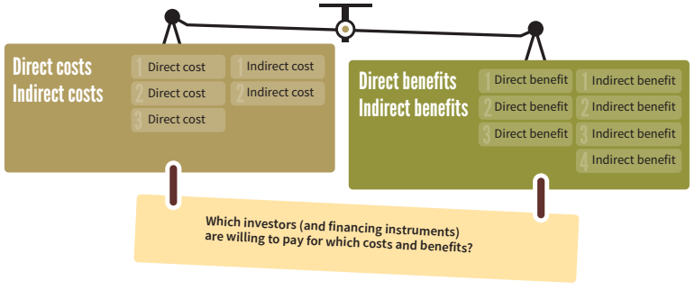
Module 4:
Summary
Source: FAO & UNCCD. 2015.

Slide 72




Module 4:
Credits
Module 4 was developed for ITTO and IUFRO under the GEF-approved project “Fostering Partnerships to Build Coherence and Support for FLR”, which supports the Collaborative Partnership on Forests (CPF) Joint Initiative on FLR.
The following institutions and people collaborated on this module:
Institution: Institute of Green Economy, India
Contributor: Dr. Promode Kant
Layout supporter: Shonart
Suggested citation: ITTO-IUFRO FLR learning modules (2021)

